Slide 1

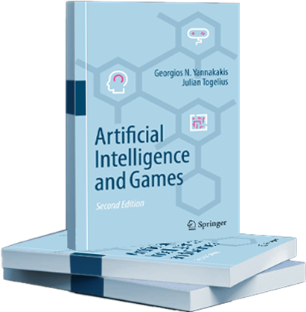
Artificial Intelligence and Games
Introduction
Notes:
These are the slides accompanying the second edition of the Artificial Intelligence and Games textbook through the gameaibook.org website

Slide 2
Why a course on AI in and for Games?
Artificial Intelligence is at the very core of modern game design and development. It plays and tests games, it supports their design, and it analyses the way we play them. AI techniques used for these tasks include expert domain-knowledge systems, search and optimization, and machine learning. This course aims to introduce students to the theory and practice of game artificial intelligence.
Notes:
Some reasons why a course on game AI is time-relevant and important

Slide 3
Learning Objectives
Describe and theorize on the AI algorithms covered in class.
Identify tasks that can be tackled through AI techniques and select the appropriate technique for the problem under investigation.
Compare the performance of different AI techniques and reflect on their suitability for game AI development.
Design and implement efficient and robust game AI algorithms.
Notes:
Some potential learning objectives for a graduate course on game AI

Slide 4

Artificial Intelligence
Notes:
Let us start by discussing AI first…

Slide 5
Artificial Intelligence
Making computers able to do things which currently only humans can do
Notes:
A popular definition of AI

Slide 6
Artificial Intelligence in Games
Making computers able to do things which currently only humans can do in games
Notes:
AI as employed to games

Slide 7

What do Humans Do with Games?
Play them
Study them
Build content for them
  levels, maps, art, characters, missions…
Design and develop them
Do marketing
Make a statement
Make money!
Notes:
Here is a non-inclusive list of things humans can do with games. What if AI could take these roles?

Slide 8
Games for Artificial Intelligence
Notes:
[see Section 1.3 for more details]

Slide 9
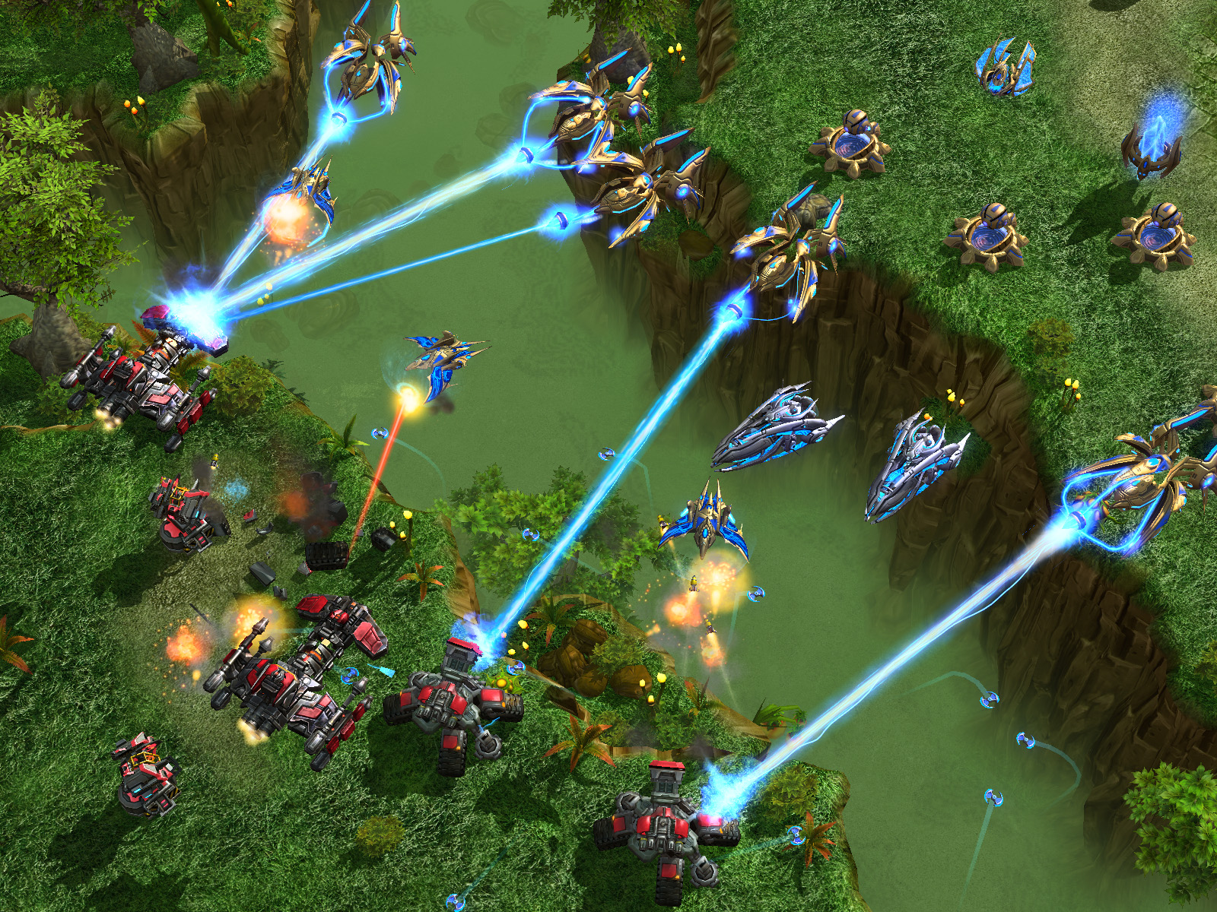

Games are Hard and Interesting Problems!
Notes:
[see Section 1.3.1 for more details]
Just the AI playing most digital games is beyond a NP-hard complexity
Hard evaluation functions (goodness movement, interestingness, engagement)
Large search spaces
Real-time!
Made to challenge human cognitive/social/emotional abilities

Slide 10
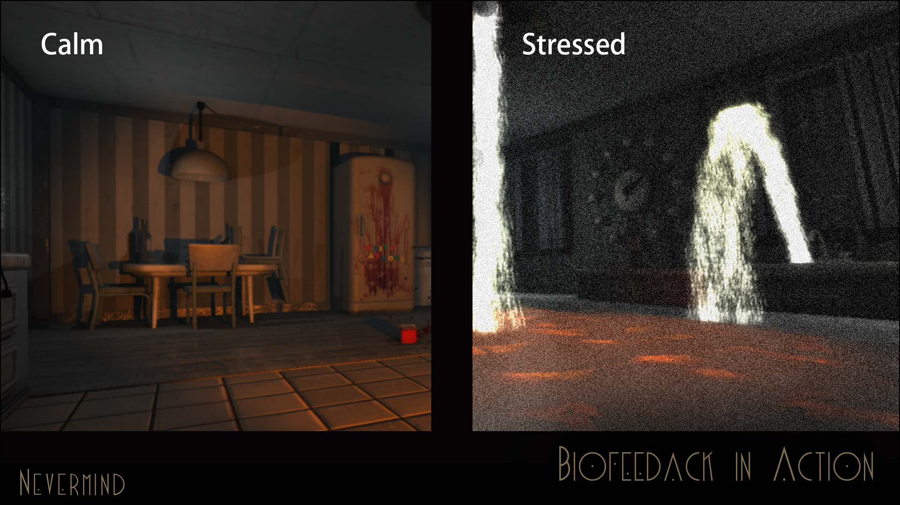

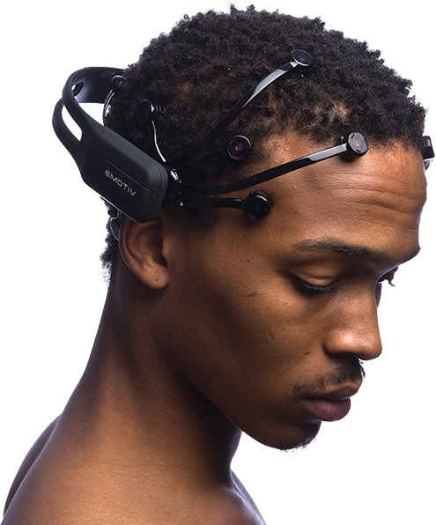
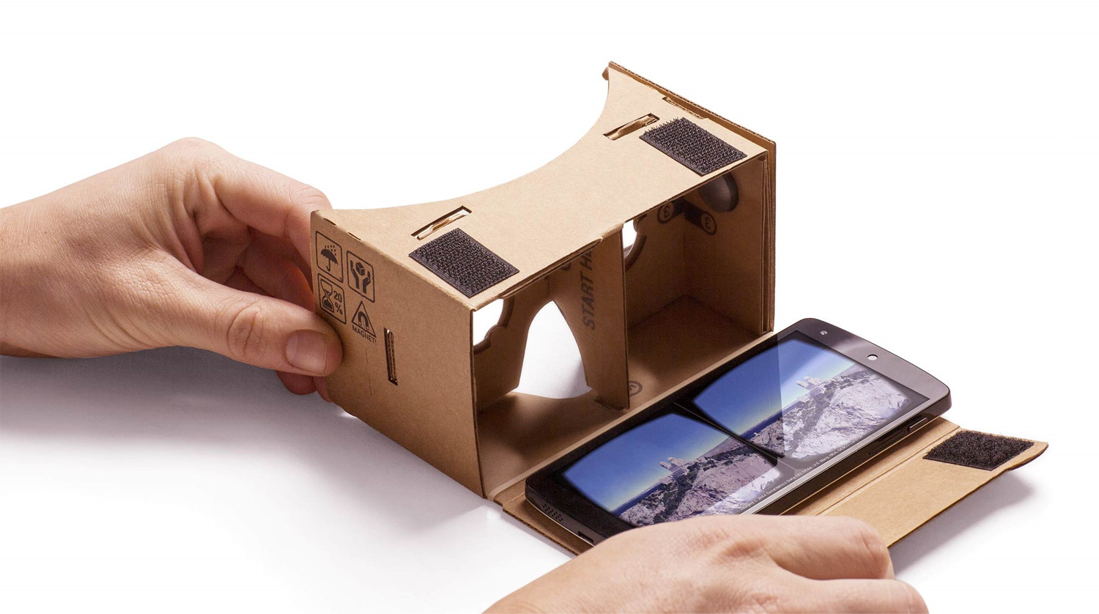
Richest (?) HCI
Notes:
[see Section 1.3.2 for more details]
Games : dynamic media by definition and, arguably, offer one of the richest forms of human-computer interaction (HCI)
The richness of interaction is defined in terms of
the available options a player has at any given moment (i.e. game and action space);
the ways (modalities) a player can interact with the medium - keyboard, mouse and tablet-like haptics, to game controllers, physiology such as heart rate variability, body movement such as body stance and gestures, text, speech [ …]
Games offer one of the best and most meaningful domains for the realization of the affective loop
Image: Nevermind biofeedback game: http://nevermindgame.com/biofeedback/

Slide 11
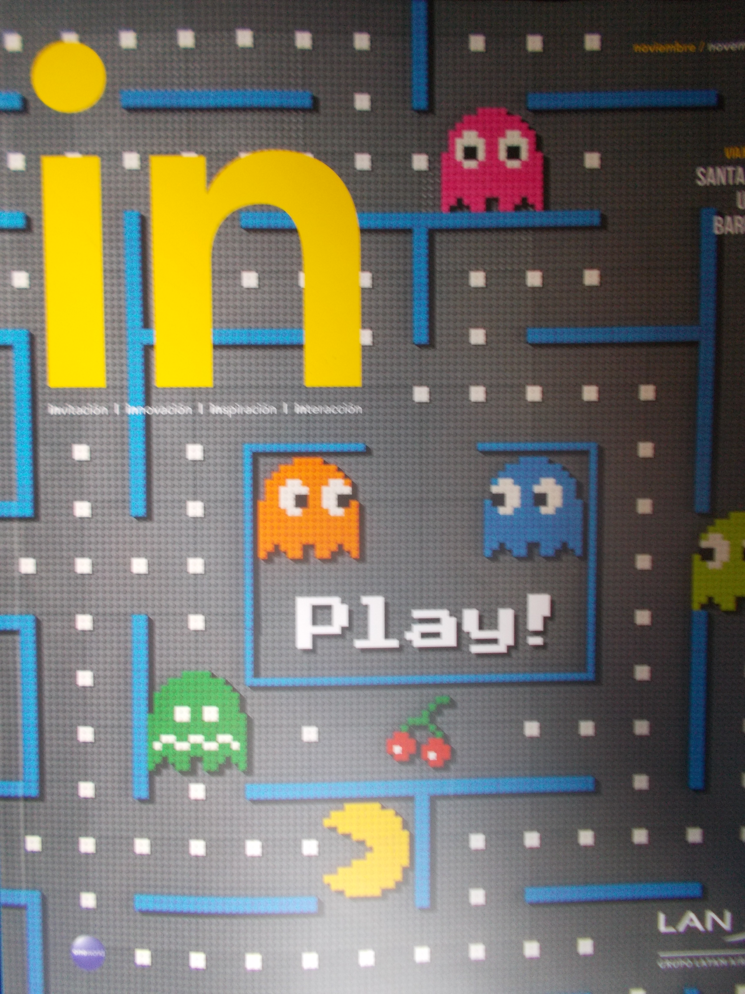
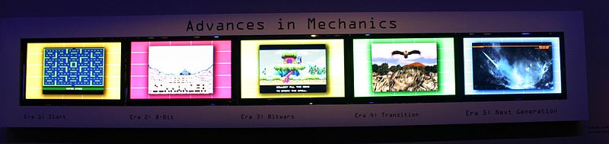


Games are everywhere
More Content More Data
Notes:
[see Section 1.3.3 for more details]
Games are now accessible and fashionable.
Games are “sexy” for the general populace.
Any smartphone these days will have many games installed.
People love discussing their game experiences at the office, at school, at the bar.
They are proud to wear t-shirts displaying their favorite game.
Even museums consider them a valid art form as is the case of the Smithsonian Art Museum which displayed The Art of Video Games in 2012.
Serious Games for Education/Health/Training are getting increasingly important and accessible

Slide 12
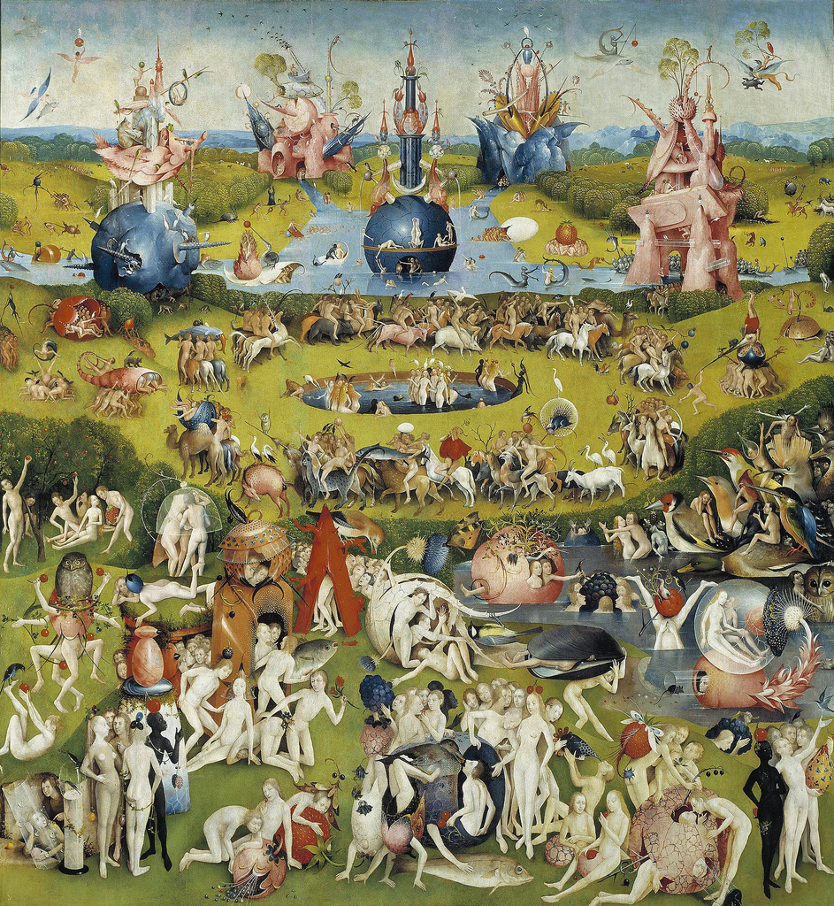
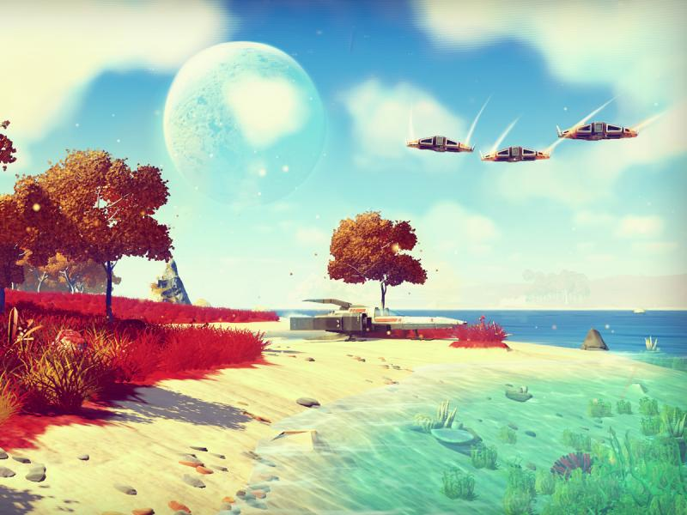
Games are content-intensive
Notes:
[see Section 1.3.3 for more details]
A bit more on content:
Content costs: money and effort !
Open boundaries for creativity as content for each creative domain comes in different representations, under different sets of constraints and often created in massive amounts
Bottom right image: No Man’s sky : over 18 quintillion(1.8×10¹⁹) planets, many with their own set of flora and fauna

Slide 13
Games and AI Areas
Perception
Signal Processing
Machine Learning
Artificial Psychology
Planning and Search
KR and Reasoning
Natural language processing
Navigation
...
Notes:
[see Section 1.3.4 for more details]
Unlike some more narrow benchmarks, games challenge all core areas of AI. This
can be seen by taking a number of broadly accepted areas of AI and discussing the
challenges available for those areas in games.
All areas are advanced via games…

Slide 14

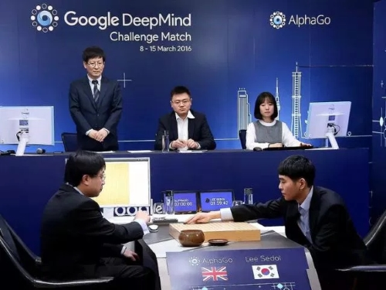

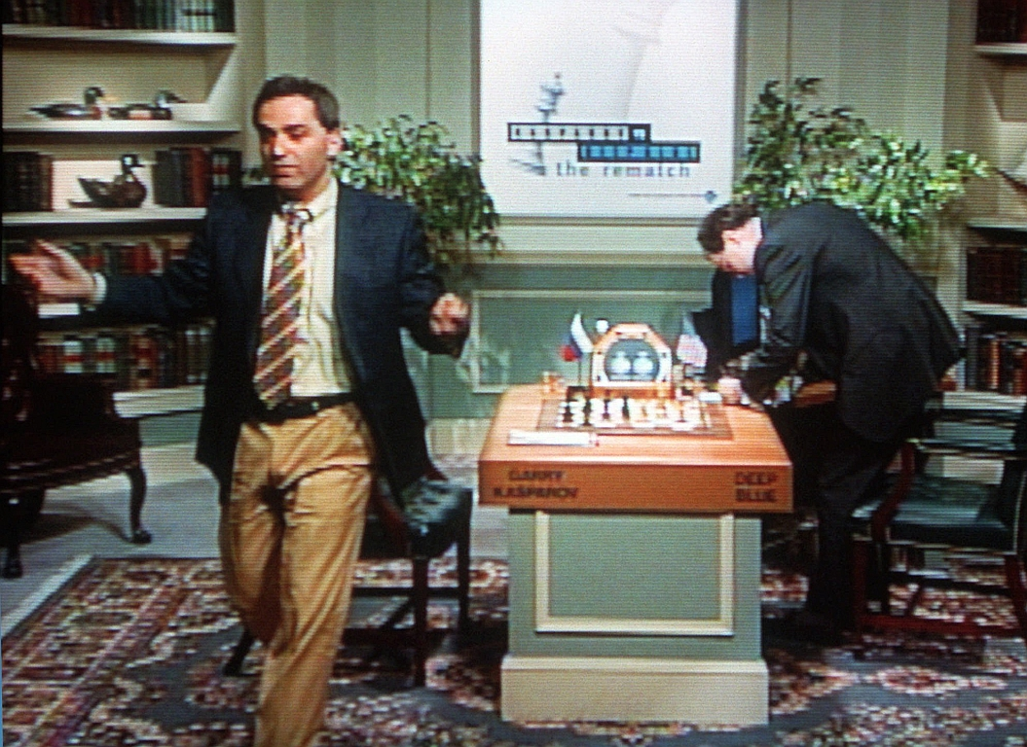
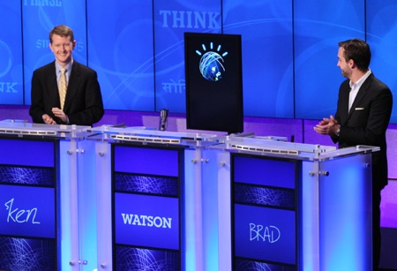
Games realise AI’s long-standing goals
Notes:
[see Section 1.3.5 for more details]
Social and Emotional intelligence [Section 1.3.5.1]
Computational creativity [Section 1.3.5.2]
General intelligence [Section 1.3.5.3]
All AI milestones are based on or derived from games (Deep Blue, Kinect , Jeopardy, Chinook-Checkers, AlphaGo, …)

Slide 15
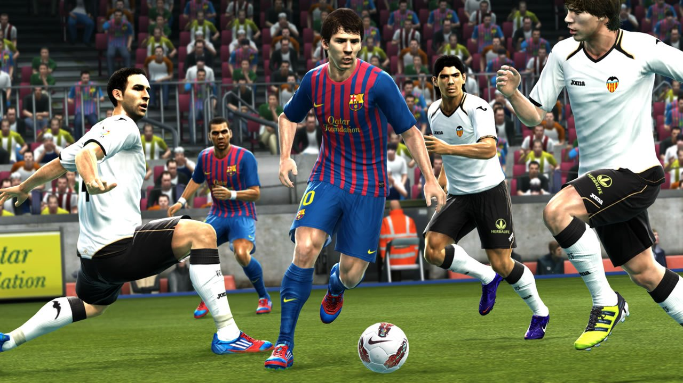
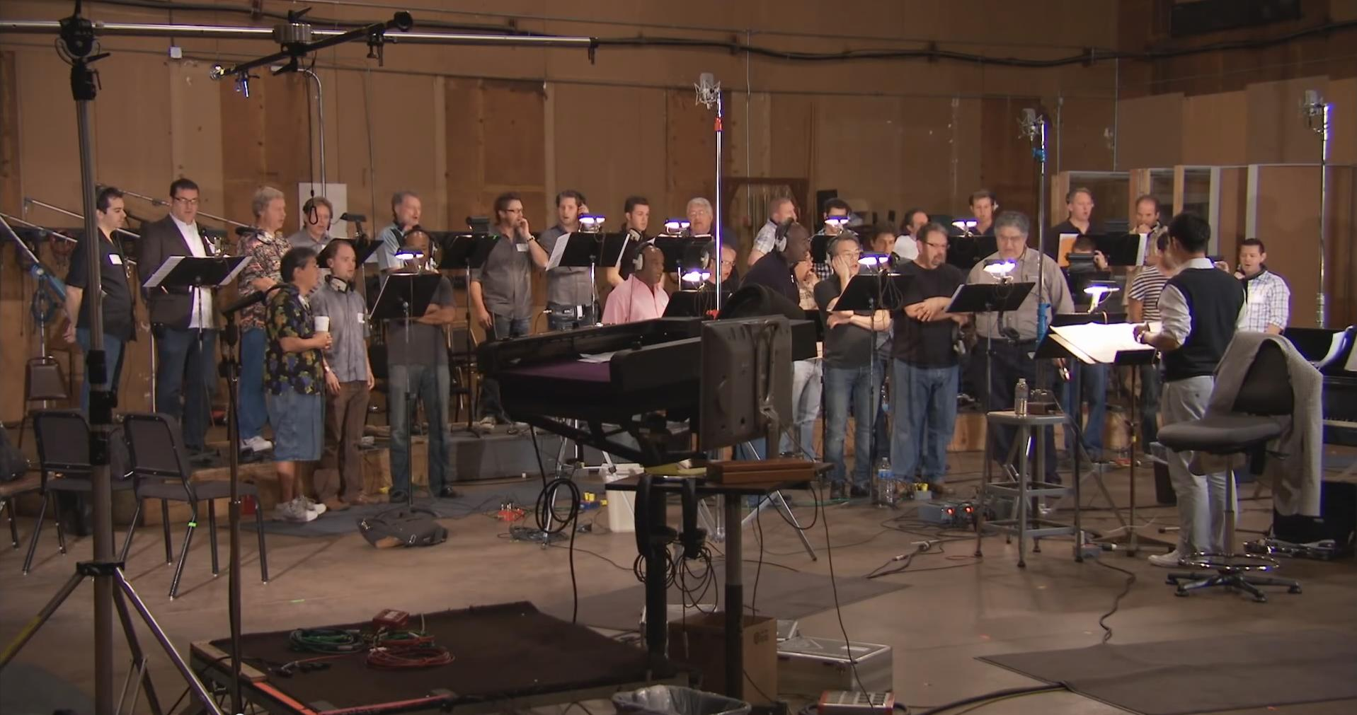
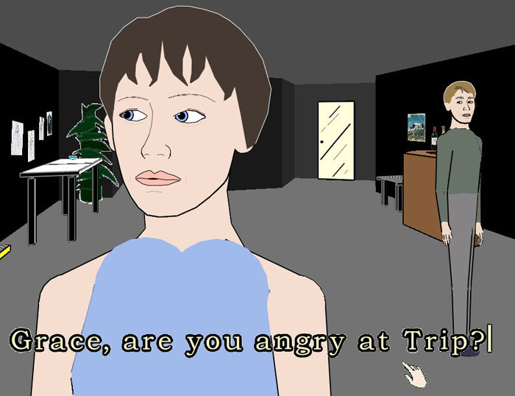
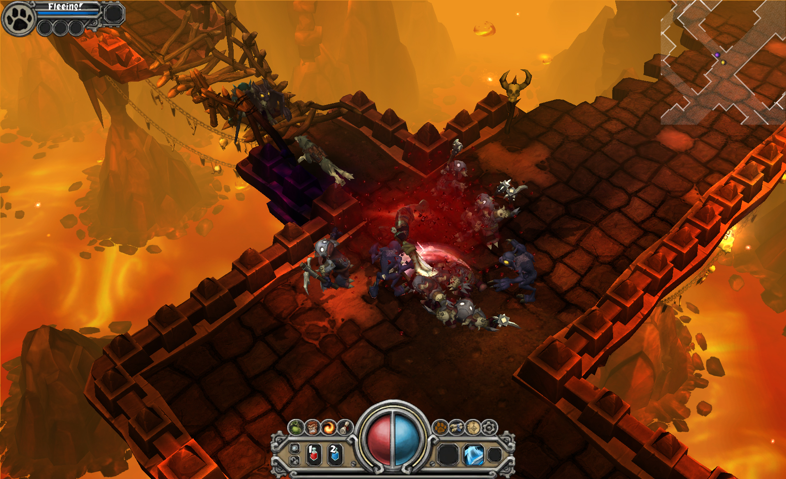
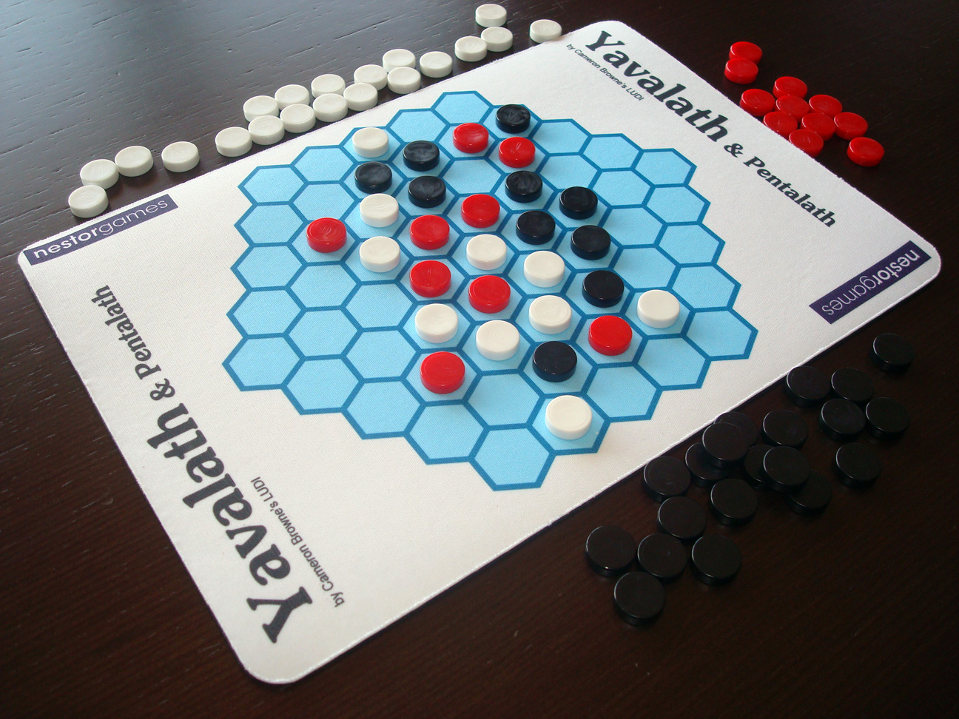
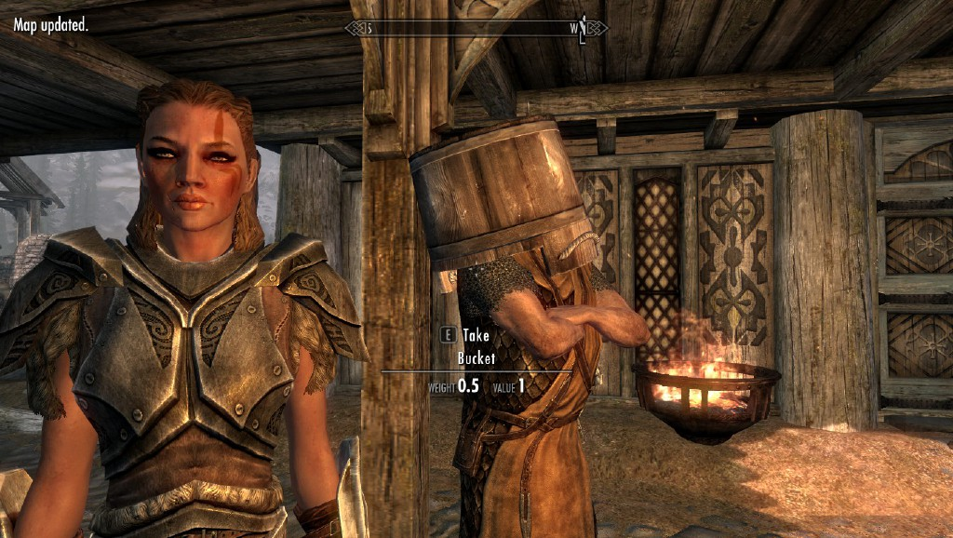
Audio
Multifaceted
Creativity
Visuals
Narrative
Levels
Gameplay
Rules
Liapis, Yannakakis, Togelius: "Computational Game Creativity," in Proceedings of the Fifth International Conference on Computational Creativity, 2014.
Notes:
[see Section 1.3.5.2 for more details]
On computational creativity in games:
Games is the domain where
Art meets science and play …
Problem solving meets creativity
The outcome is experienced (via rich interaction)!
In summary: An AI that can play almost any video game and create a wide variety of video games is, by any reasonable standard, intelligent. That task can be seen as AI complete

Slide 16
Artificial Intelligence for Games
Notes:
[see Section 1.4 for more details]

Slide 17
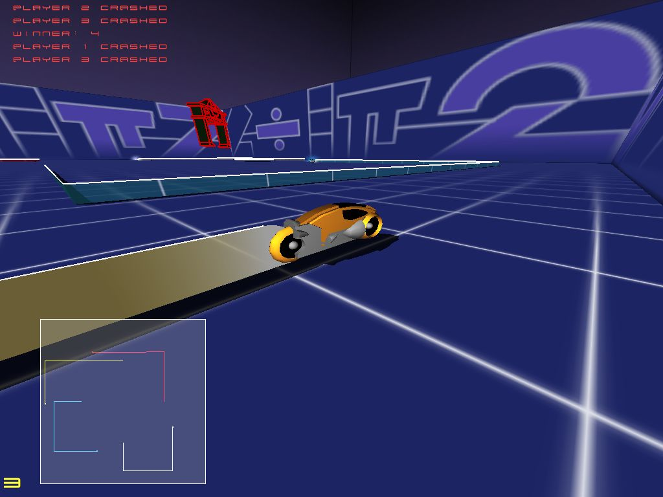
AI Plays and Improves your Game
Notes:
[see Section 1.4.1 for more details]
AI can improve games in several ways:
When the AI adds to the commercial value of the game, it contributes to better game reviews, and it enhances the experience of the player.
An unconventional and effective solution to an NPC task can often be a critical factor that shapes management, marketing and monetization strategies
AI roles and tasks:
AI plays games with two core objectives in mind: play well and/or play believably (or human-like, or interestingly)
AI can control either the player character or the NPC
AI that plays well: empower dynamic difficulty adjustment and automatic game balancing
AI that plays believably or human-like: player experience debugging or demonstration of realistic play

Slide 18
Class Core Aim
Give a comprehensive overview of AI for games and games for AI, as well as hands-on experiences with new technology
Enable new exciting inventions and discoveries
Notes:
A potential core aim for a course on artificial intelligence and games

Slide 19
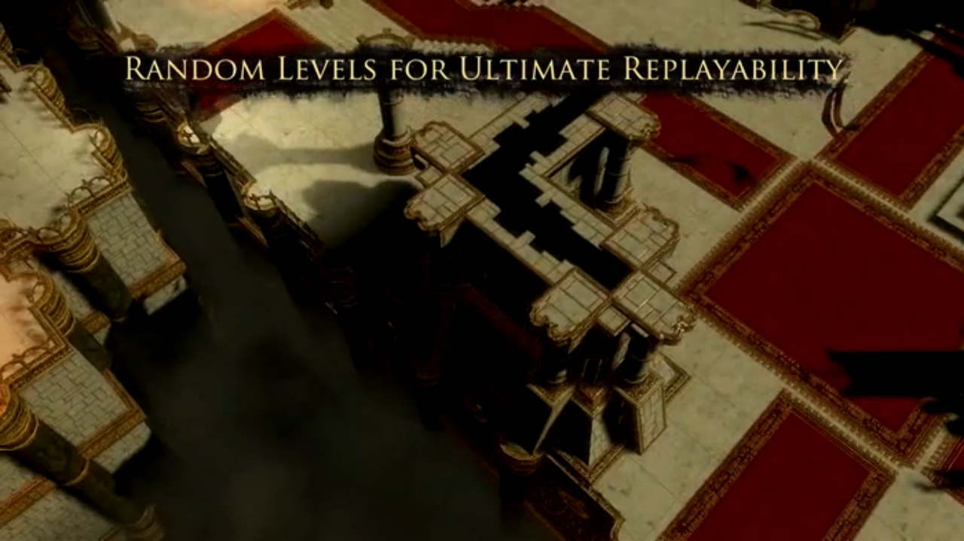
What is Diablo 3: "[previous] games established the series’ hallmarks: randomized levels, the relentless attacks of monsters and events in a perpetually fresh world, [...]"
"Experience Daylight, a procedurally generated psychological thriller for your PC."
More Content, Better Content!
Notes:
[see section 1.4.2 for more details]
Games are unique → they invented procedural content generation (PCG)
PCG is a commercial necessity: highly competitive marketplace (fast development cycles), replayability, retention (online games)…
A constant stream of new content is needed!
The game industry proudly displays its AI.
Some reasons for game designers and developers to be interested in AI, and PCG in particular (see more in Part III):
Memory consumption (as e.g. in Elite)
Content generation might foster or further inspire human creativity
Possible to create truly endless games with ultimate replay value.
Personalized and adaptive play
Generative AI in games (PCG via Machine learning) is concerned currently with the development of methods and tools, such as Large Language Models and Diffusion Models, for the creation of game content

Slide 20

Player Experience – Data Mining
Notes:
[see Section 1.4.3 for more details]
The holy grail of game design—player experience—can be improved and tailored to each player
The use of AI for the understanding of player experience can drive and enhance the design process of games […]
Data derived from games provide a new and complementary way of designing games, of making managerial and marketing decisions about games, of affecting the game production, and of offering a better customer service […].
AI-informed decisions are based on evidence rather than intuition (via game analytics and game data mining) for better design, development and QA procedures.
Game development is boosted and improved (as a whole).
In summary: AI-enabled and data-driven game design can directly contribute to better games.

Slide 21
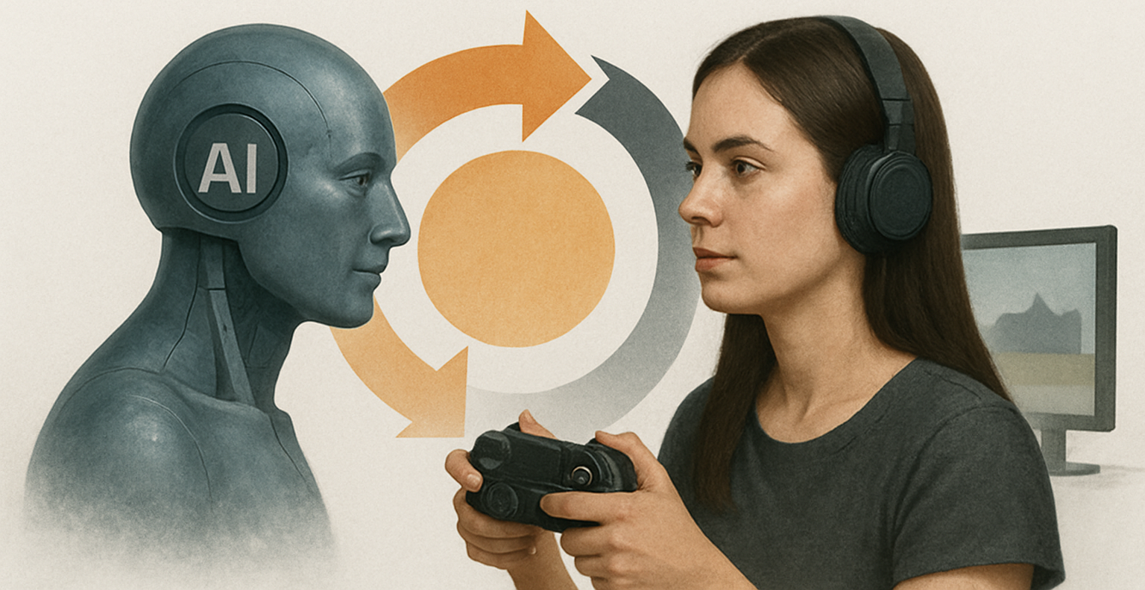
AI and Games: A Co-Revolution
Notes:
[see Section 1.5 for more details] – Image Generated by ChatGPT
AI is a key enabler of the technological advancements we witness nowadays.
Meanwhile games have gradually enabled and popularized highly engaging interactive experiences at a massive scale
The relationship between AI and games is far more impactful than a mere application of a set of methods (AI) in a
domain (games).
Breakthroughs in AI that were made possible via games: tree search, Monte Carlo tree search, deep learning and deep reinforcement learning are just a few examples.
Ways AI has advanced games: play and test games effectively or in a humanlike fashion, generate new content and game worlds, and model player behavior and experiences.
Summary: Games get increasingly more popular but also richer and more complex through generative AI processes; AI advances further and in turn, it will advance the environments it is trained on in a continuous co-(r)evolutionary loop.

Slide 22
AI and Games History – Academia
Notes:
[See section 1.2 for more details]

Slide 23
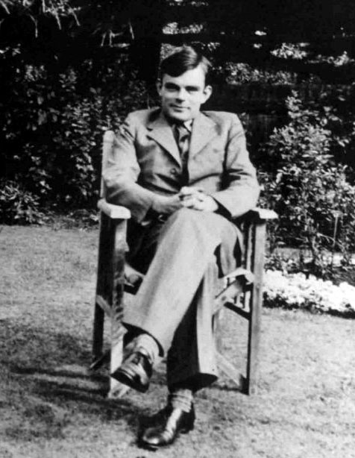
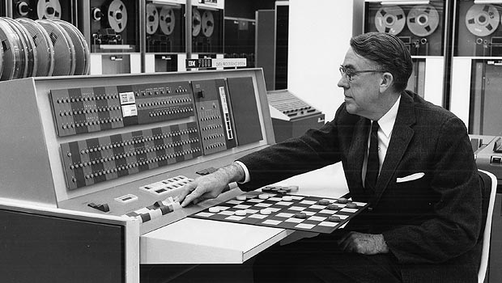
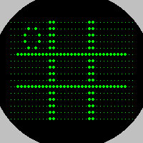

A long-lasting love (1950s)
Notes:
[see Section 1.2 for more details]
1951: Alan Turing, (re)invented the Minimax algorithm and used it to play Chess (TUROCHAMP program – one move chess analyser) [ image: left]
1952: The first software that managed to master a game was programmed by Alexander "Sandy" Douglas on a digital version of the Tic-Tac-Toe game and as part of his doctoral dissertation at Cambridge. [ image: bottom right]
1959: Arthur Samuel was the first to invent the form of machine learning that is now called reinforcement learning using a program that learned to play Checkers [image: top right]

Slide 24
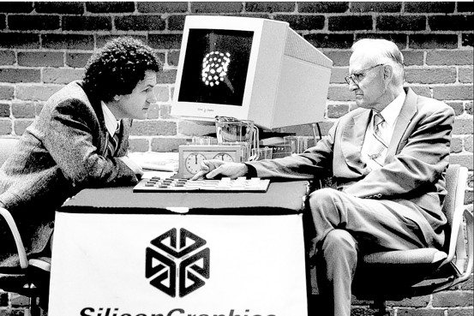
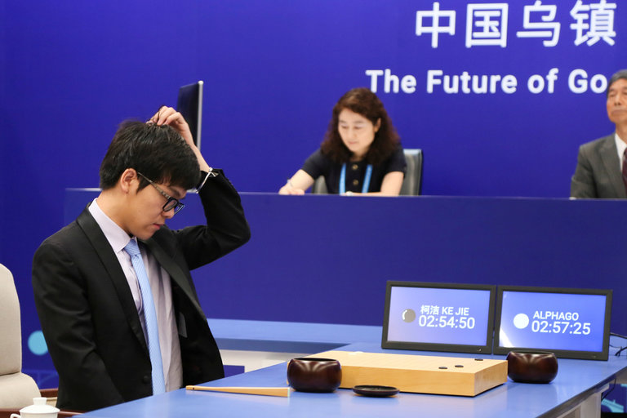

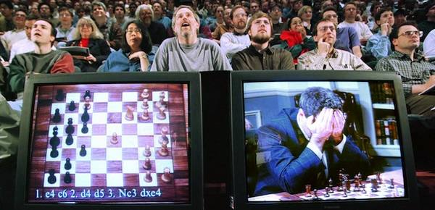
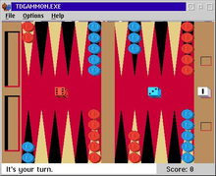
Early Days on the Board (60s-present)
Notes:
[see Section 1.2.1.1. for more details]
1992: TD-Gammon employs an ANN trained via TD learning by playing backgammon against itself a few million times. TDGammon [image: bottom right] managed to play at a level of a top human backgammon player
1994: Over three decades of research on tree search the Chinook Checkers player managed to beat the World Checkers Champion Marion Tinsley - Checkers was eventually solved in 2007 [image: top left]
1997: IBM's Deep Blue (version of Minimax) beats Gary Kasparov. In the 44th move of game 1; Kasparov realises he is losing by a superior Chess player - the move was a result of a bug!) [image: bottom left]
2017: AlphaGo (deep reinforcement learning) won a three-game Go match against the world's number 1 ranking player Ke Jie. Go was the last great classic board game where computers have reached super-human performance. [image: top right]

Slide 25

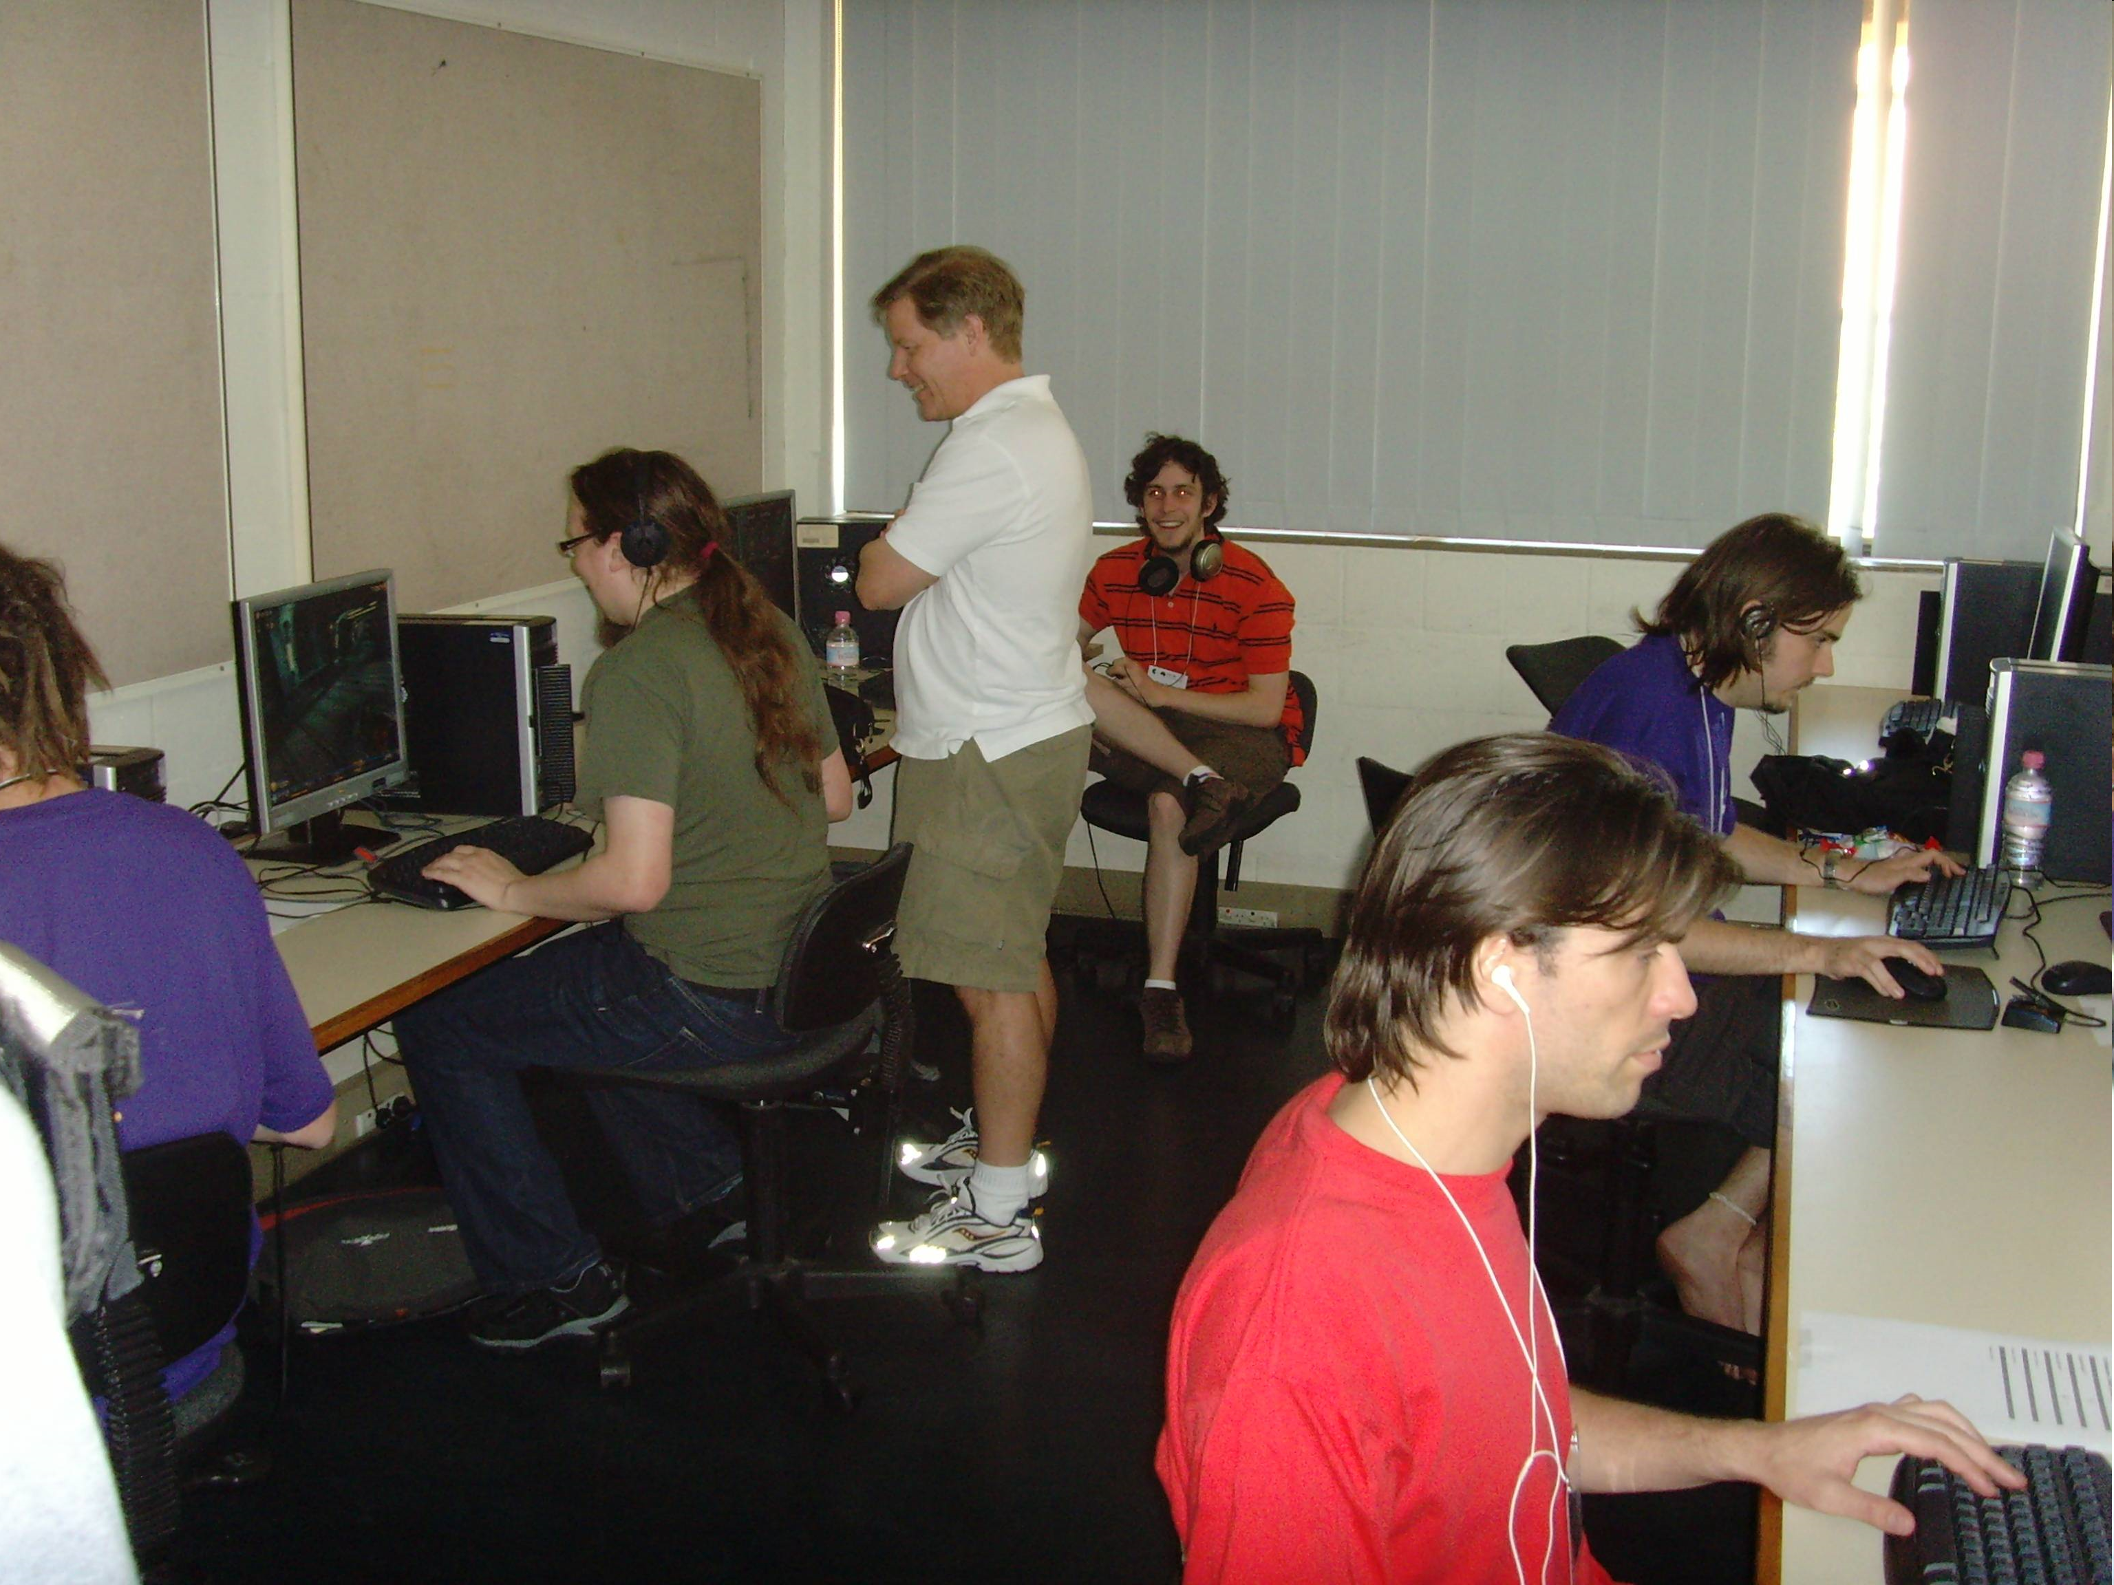

From Board to Video Games
The Game Turing test was passed by two AI-controlled bot entries in Unreal Tournament 2004, in 2012!
Neuroevolution was one of the approaches
Notes:
[see Section 1.2.1.2 for more details]
2K bot prize (Unreal Tournament 2004)
Images: from the IEEE CIG 2008 conference competition [left: players; right: judges]

Slide 26
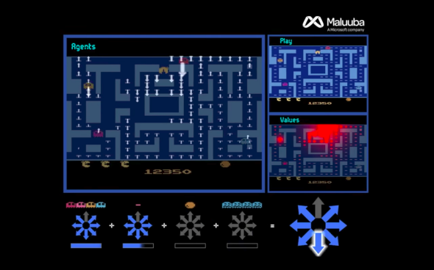


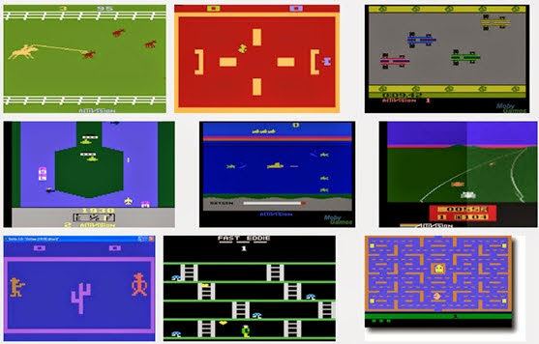

From Board to Video Games
Notes:
[see Section 1.2.1.2 for more details]
Notable milestones (playing games)
2014: Google DeepMind learned to play several games from the classic Atari 2600 video game console on a super-human
skill level just from the raw pixel input
2017: Ms Pac-Man is practically solved by the Microsoft Maluuba team using a hybrid reward architecture for RL
2019: A deep learning-based system from DeepMind, named AlphaStar, managed to defeat top professional players of StarCraft II
2019: Five was the first AI algorithm to beat the world champion team of Dota 2, named OG, in a much publicized event in April 2019.
2022: Sophy AI managed to outperform professional players of Gran Turismo Sport via deep RL [image on the left]
2022: Cicero reached average human-level play in the board game of Diplomacy through
a combination of large language models and strategic reasoning.

Slide 27



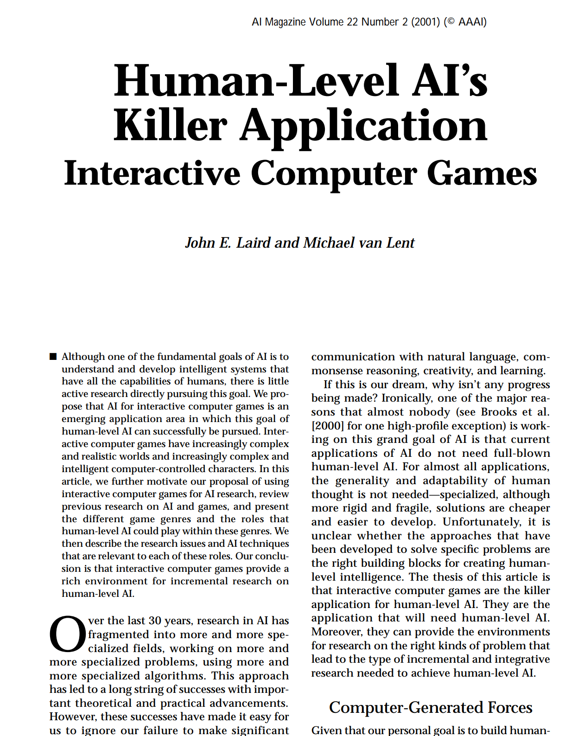

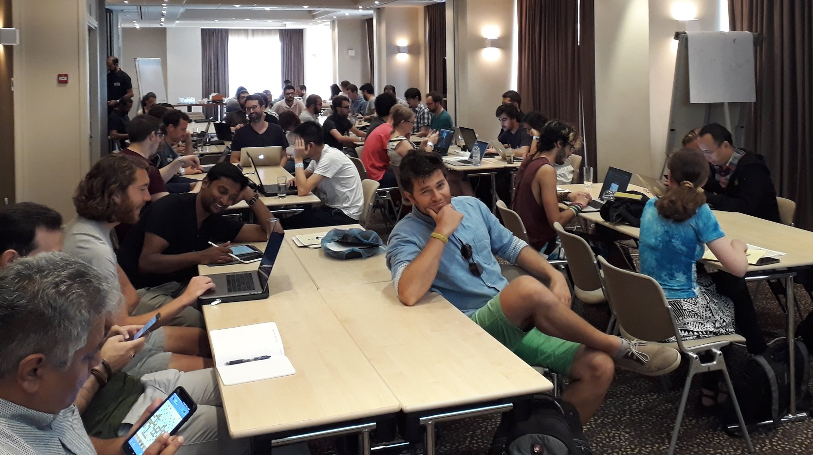


From Board to Video Games
Notes:
1983: The first video game conference occurred at Harvard's Graduate School of Education
2001: “Birth” of game AI. The seminal article by Laird and van Lent, “Human-level AI's killer application: Interactive computer games”
2000-2004: Early days: playing games, agent architectures for non player character (NPC) behaviour - sometimes within interactive drama- and pathfinding
2005: Birth of IEEE CIG and AIIDE conferences
2009: Launch of IEEE Transactions on Computational Intelligence and AI in Games
2018: Launch of IEEE Transactions on Games
2018: The first AI and Games Summer School

Slide 28
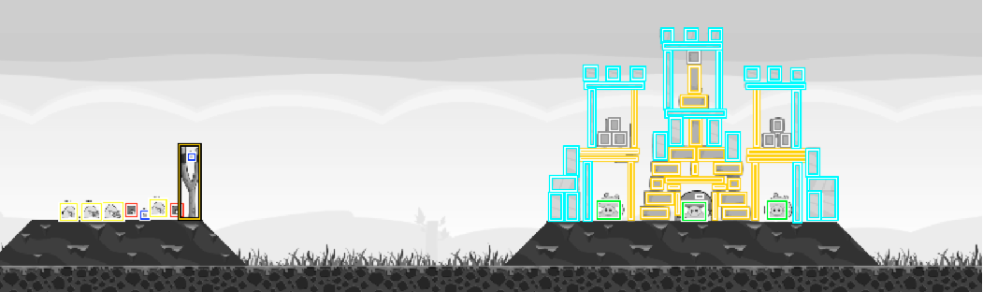
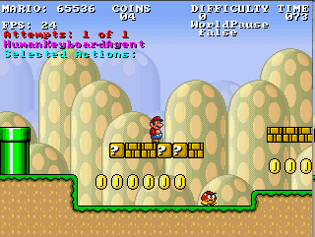
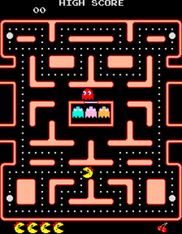
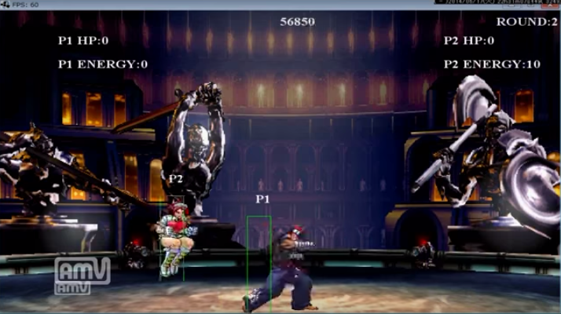
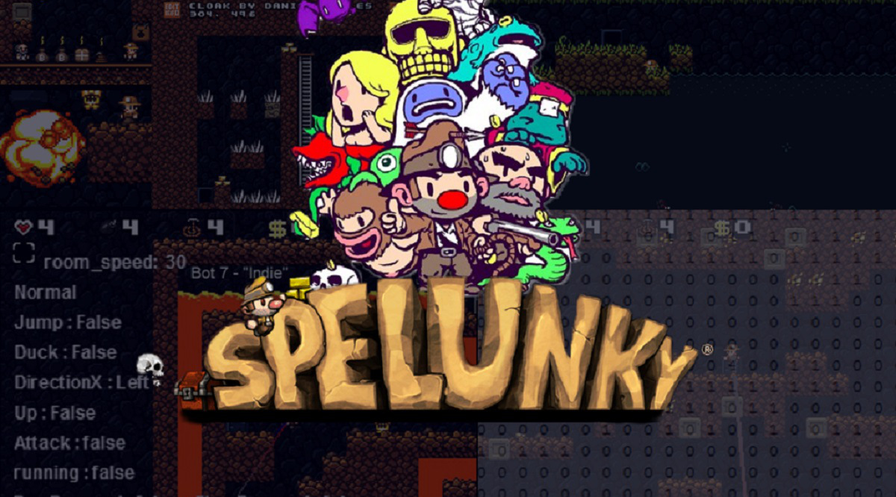
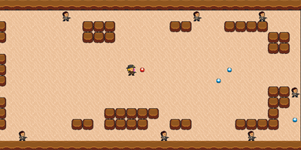
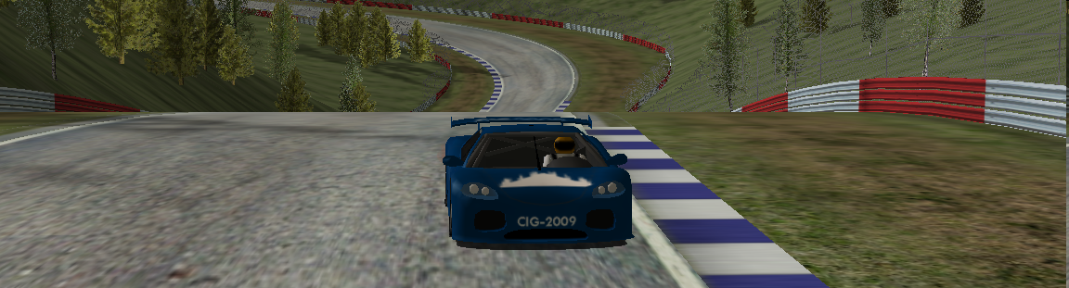
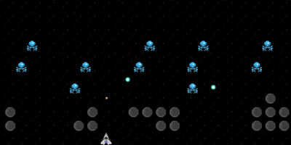
IEEE CIG and AIIDE Competitions
Notes:
A number of successful academic game AI competitions that run (and/or still running) at IEEE CIG and AIIDE conferences

Slide 29
Computer Game AI in Academia: History
Games as AI Arenas
NPC Performance
AI for better games
Player experience / design / authoring
Game AI [2005-….]
Notes:
Brief history of Game AI roles/perspectives
2000-2004: Game AI = Non-Player Character (NPC) AI
2005-2012: A survey on Game AI papers published in IEEE CIG/AIIDE (premier game AI venues) identifies two main research tracks:
Games as AI Arenas - 54% of papers for NPC control/pathfinding/decision making; Focus on NPC performance
AI for better games - 46% of papers for non-traditional uses of AI; Focus on player experience/design/authoring

Slide 30
Computer Game AI
Notes:
Graph: Percentage of papers published in AIIDE and IEEE CIG conference (the two premier conferences in game AI) throughout the years and across the different areas.
The field becomes more diverse as the years go by. A newer study (2012-present) would likely reveal a higher degree of diversity and maturity as a field.

Slide 31
Game AI is Dead!
Ultimate
Experience
Player Experience
NPC Behavior
Effort
Yannakakis, G. N. "Game AI revisited" Proceedings of the 9th conference on Computing Frontiers. ACM, 2012.
Notes:
Graph explaining that while NPC behaviour can help us reach great levels of the ideal player experience there might be better ways (e.g. through procedural content generation, player modelling, interactive storytelling etc.) that could help us achieve better experiences for the player with less cost/effort. These AI roles can be used in conjunction with NPC AI or just on their own.
More details on this view: see reference on the slide.

Slide 32
AI and Games: A bit of history – Industry
Notes:
[see Section 1.2.2 for more details]

Slide 33
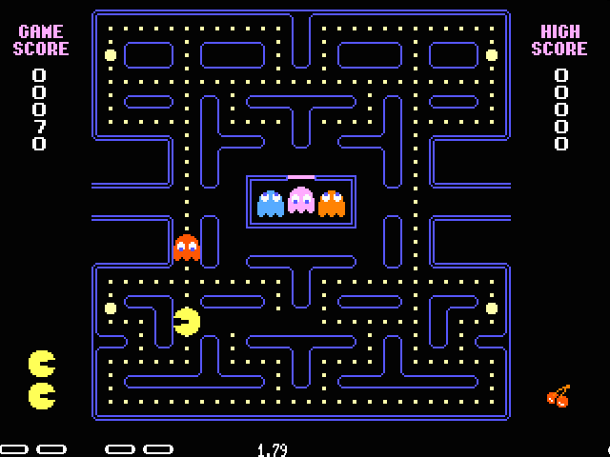
PacMan (Namco, 1980)
Implicit cooperation
Differing Ghost “Personalities”
  Aggressive Blinky
  Cunning Pinky
  Wired Inky
  Scared Clyde
Attack – don’t care waves
No randomness
Notes:
[see Figure 1.1]
The game featured four core AI elements that made it quite challenging despite being almost entirely deterministic. Ghosts would
Follow two different play modes (i.e., attack vs. don’t care),
Each have their own personality and would cooperate in an indirect fashion
Follow a pre-determined spawning strategy
Follow a different speed pattern according to the level played
Ms Pac-Man was recently solved though – almost 1 million points through hierarchical RL

Slide 34
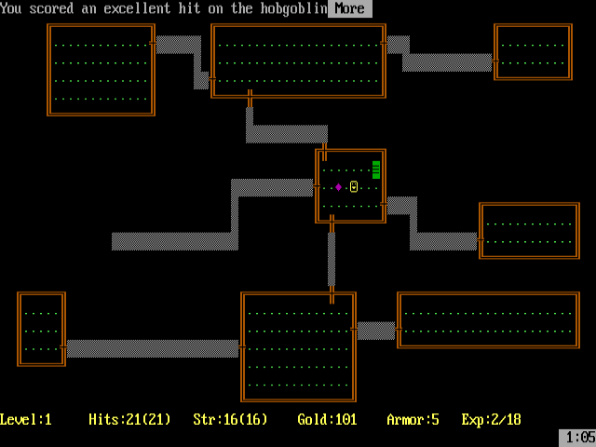
Rogue (AI Design, 1980)
Level generation
Constructive approach
Inspired rogue-like game genre

Slide 35
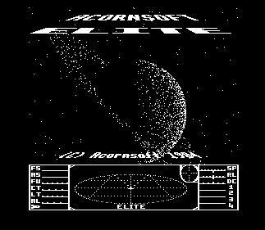
Elite (Acornsoft, 1984)
Galaxy generation
Compression

Slide 36

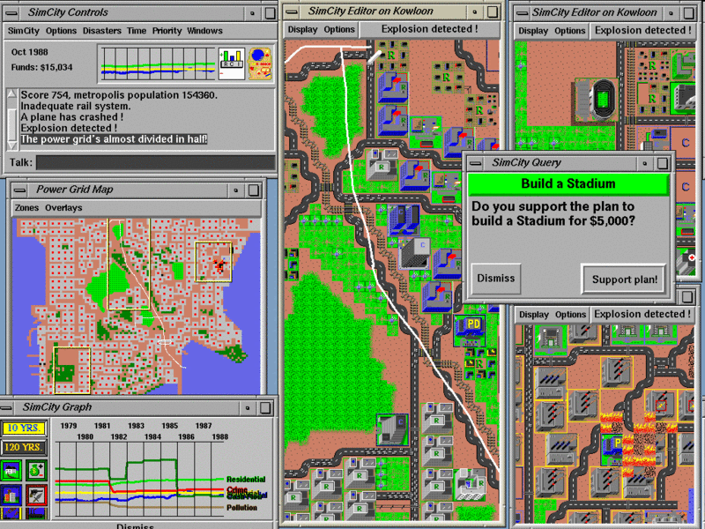
SimCity (Maxis, 1989)
Cellular automata
Influence Maps

Slide 37
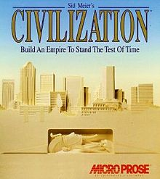
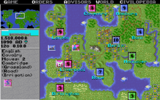
Civilization (MicroProse, 1991)
Map/Level generation

Slide 38
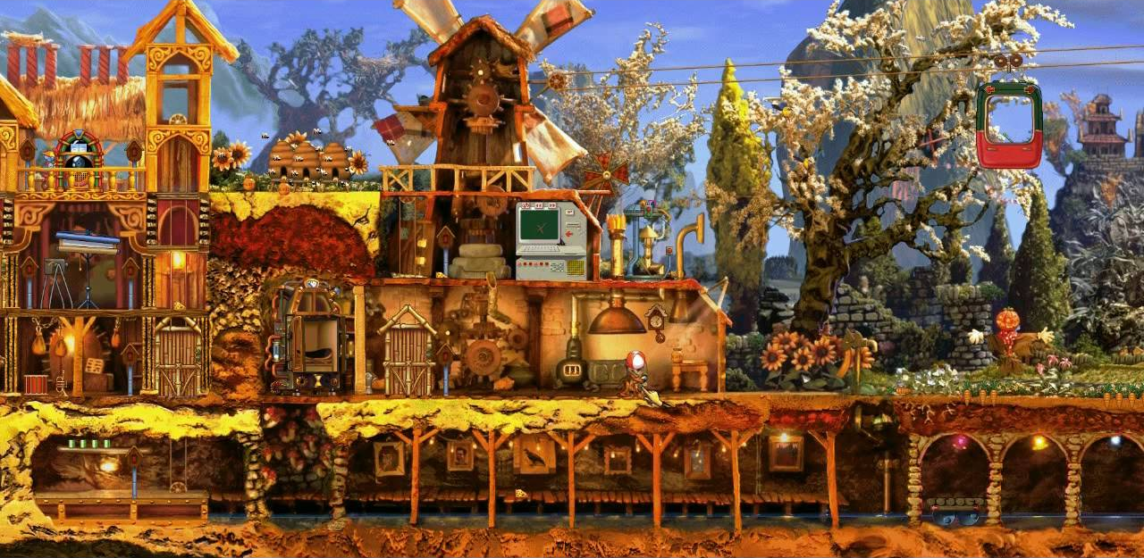
Creatures (Millennium Interactive, 1996)
Notes:
In the 90s we meet the first popular application of neural networks in Creatures
(Millennium Interactive, 1996) with the aim to model the creatures’ behavior.
The first application of a neural network in a commercial game, however,
is the Jellyfish (Frederik Dahl, 1994) backgammon game published two years earlier.

Slide 39
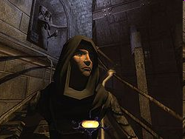
Thief (EIDOS, 1998)
Stealth FPS, FP-Sneaker
Advanced sensory system
Guards perceive and respond to the environment
  Noise, lighting, movement, and shadows.

Slide 40
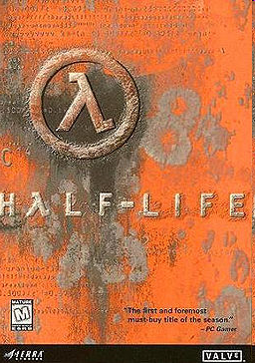
Half-Life (Valve, 1998)
FPS + puzzle solving
Opponent Tactics
  Coverage, dodging, full-level navigation
Integration of AI into the story
Valve hired Quake AI Mod developers for HL 2

Slide 41


Sims (EA, 2000)
Smart (interactive) terrains
Smart (interactive) objects

Slide 42


Black & White (EA, 2000)
Black & White (EA, 2000)
Perceptrons, Decision Trees, Belief-Desire-Intentions model
Imitation Learning
Reinforcement learning: creature slapped or stroked
Gesture recognition
Notes:
A creature that learns through positive rewards and penalties in a reinforcement learning fashion.
The creature employs the belief-desire-intention model for its decision making process during the game.
The desires of the creature about particular goals are modeled via simple perceptrons.
For each desire, the creature selects the belief that it has formed the best opinion about; opinions, in turn, are represented by decision trees.

Slide 43


Halo 2 (MS Game Studios, 2004)
The revolution of Behavior Trees
More human-like bots

Slide 44

F.E.A.R. (Sierra, 2005)
Best AI opponent – bot (at the time)
Bot squads, teammate behaviors
Cover when hit from behind
Intelligent tactics
Move through walls and under objects
Planning system based on STRIPS
“Environments to showcase the AI”

Slide 45

Forza Motorsport (MS game studios, 2005)
Drivatar system
Imitation Learning
MS Research – Cambridge

Slide 46

Façade (Mateas & Stern, 2005)
Interactive Storytelling
Natural Language Processing
AI faults: absorbed by game (character) design

Slide 47


Left 4 Dead (Valve, 2008)
AI director
  Intelligent enemy placement
  Intelligent item placement
  Player emotional cues (visual effects, dynamic music)

Slide 48

Spelunky (Mossmouth, 2008)
Level generation
Ultimate re-playability
Guarantees playability

Slide 49


Silent Hill (Konami, 2010)
Survival horror
Personality-based adaptation

Slide 50


Heavy Rain (Quantic Dream, 2010)
Notes:
Affect-based cinematographic representation of multiple cameras

Slide 51



Various Kinect Games (2010 – …)
E.g. Kate & Milo (demo), Kinectimals, etc..
Affective AI
Posture (fully body) Recognition
Speech recognition

Slide 52


Bioshock Infinite (2k Games, 2013)
Notes:
The companion character, Elizabeth, in BioShock Infinite (2k Games, 2013);
Elizabeth, a crucial element of the game, was designed as a character which could not only be a useful AI companion to the player but a real partner with a significant emotional bond as well

Slide 53

Nevermind (Flying Mollusk, 2016)
Notes:
Survival horror - affect-based game adaptation via a multitude of physiological sensors.

Slide 54

No Man’s Sky (Hello Games, 2016)

Slide 55




20s
Notes:
At the time of writing the second edition of this book, the early (20s), we experience
an ongoing effort and significant investment for the adoption of state of the art generative AI methods—such as LLMs—and variants of deep (reinforcement) learning in commercial-standard games. E.g. the first integration of a large language model into a game: the LLM-powered text adventure game AI Dungeon (Latitude, 2019).
Other noteworthy recent examples of successful AI adoption include the use of the
wave function collapse generative algorithm for enhancing a player’s city building
experience in Townscaper (Oskar Stalberg, 2021) and the integration of the deep
RL controlled racer Sophy AI in Gran Turismo 7 (Sony Interactive Entertainment, 2022).
We also witness an increasing number of AI companies that build specialised AI tools for game development (e.g., modl.ai) or traditional video game companies hosting AI research
departments (e.g., EA SEED)

Slide 56
The “Gap” Between Academia and Industry
Game AI
Academia
Methods
Game AI
Industry
Domain
Notes:
[See Section 1.2.3 for more details]
Some traditional “complaints” – myths to a large degree
Academia: Industry does not use our tools
Industry: Academics lack domain knowledge and ignore our problems
Game AI researchers do not collaborate with industry
Not much of a gap after all
The gap is there in problems that academics do not wish to solve and industry does not care about. But that is a healthy one – more progress needs to be made

Slide 57



Some Facts about the “Gap”
Notes:
Industry: NPC AI is more or less “solved”(e.g. look at Left 4 Dead, F.E.A.R. and Skyrim; Satisfying NPC behaviors)
AI tracks in Game Developers Conference do not necessarily focus on NPC AI
Academic Panels/Special Sessions/Tutorials (FDG, CIG, AIIDE), Special Issues (IEEE TCIAIG/ToG) focus on non-traditional uses of AI
More effective and active industry/academia communication/collaboration over the years
Academic support on multidisciplinary nature of game AI
Pragmatic and holistic view of game AI

Slide 58
Games helps us design better AI…
…and AI can help us make better games ...
…but not necessarily through game agents!
How then?
G. N. Yannakakis, “Game AI Revisited,” in Proceedings of the 9th ACM Computing Frontiers Conference, pp. 285-292, 2012. (invited paper)
Notes:
Overall summary: Game AI is not all about NPC AI

Slide 59
Game AI
Play Games
Generate Content
Model Players
G. N. Yannakakis and J. Togelius, “Artificial Intelligence and Games,” Springer Nature, 2025
Notes:
The tree main roles that AI takes in and for Games
Play games [Part II]
Generate Content [Part III]
Model Players [Part IV]

Slide 60
Game AI
Play Games
Generate Content
Model Players
G. N. Yannakakis and J. Togelius, “Artificial Intelligence and Games,” Springer Nature, 2025
Notes:
A brief introduction to the “Generate content” role

Slide 61

Procedural Content Generation
Notes:
What is PCG? "The creation / production of new game content (semi) automatically via algorithmic means "
Why is PCG important?
Lowers development costs
Enables adaptability
Increases replayability
Design beyond human creativity (?)

Slide 62
Game AI
Play Games
Generate Content
Model Players
G. N. Yannakakis and J. Togelius, “Artificial Intelligence and Games,” Springer Nature, 2025

Slide 63
Game AI
Play Games
Generate Content
Model Players
G. N. Yannakakis and J. Togelius, “Artificial Intelligence and Games,” Springer Nature, 2018
Notes:
Now onto a brief introduction to the “model players” role

Slide 64
“Games cannot be dissociated from emotion and learning…”
G. N. Yannakakis and A. Paiva “Emotion in Games,” in Oxford Handbook of Affective Computing, 2014
Notes:
Why is there an association between games, emotion and learning?
We play games throughout our lives – we learn
We experience positive negative (and even) emotions voluntarily! Impressive!
We can control our experiences via adaptation (not like tv, filmes etc..)

Slide 65
Player Modeling
Notes:
Why Player Modeling is Important?
There is no game without a player…
The perfect suit is tailored to you! How about the perfect game?
We (players) are very different
We (players) are many more than before
Holy grail of game development

Slide 66
“Games: the final frontier for AI?”
“AI: the next step for Games!”
Notes:
Summary of the Introduction

Slide 67

Readings: Chapter 1
gameaibook.org

