Slide 1

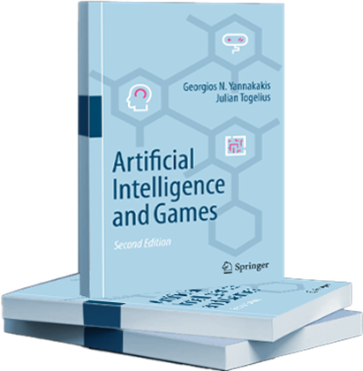
Artificial Intelligence and Games Play
Notes:
These are the slides accompanying the book Artificial Intelligence and Games through the gameaibook.org website

Slide 2
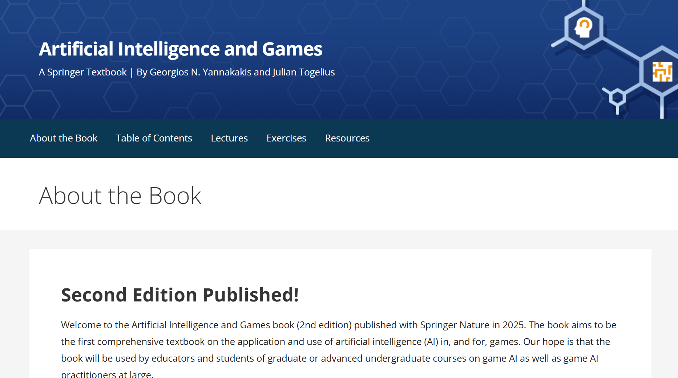
Readings: Part II
gameaibook.org

Slide 3
Reminder: Artificial Intelligence and Games
Making computers able to do things which currently only humans can do in games
Notes:
AI as employed to games – A reminder from the intro lecture

Slide 4

What do humans do with games?
Play them
Study them
Build content for them
levels, maps, art, characters, missions…
Design and develop them
Do marketing
Make a statement
Make money!
Notes:
Here is a non-inclusive list of things humans can do with games. What if AI could take these roles?
In this lecture we will focus on play!

Slide 5
Game AI
Play Games
Generate Content
Model Players
G. N. Yannakakis and J. Togelius, “Artificial Intelligence and Games,” Springer Nature, 2025.
Notes:
As a reminder: “Play” is identified as one of the three major roles of AI in games in this book
When we think of AI in games we think of an AI playing the game, or controlling an NPC . Maybe due to the associations between AI and autonomy, or between game characters and robots.
Playing games is a very important role for AI and the role with the longest history.
Many methods for content generation (Part III) and player modeling (Part IV) are dependent on methods for playing games,
Therefore it makes sense to cover play before content generation and player modeling.

Slide 6
Game AI
Play Games
Generate Content
Model Players
G. N. Yannakakis and J. Togelius, “Artificial Intelligence and Games,” Springer Nature, 2025.
Notes:
So, let us focus on “play” and start by asking the question “why would one use AI to play games?”

Slide 7
Chapter 4: Playing Games

Slide 8
Why use AI to Play Games?
Playing to win vs playing for experience
For experience: human-like, “fun”, believable, predictable...?
Playing in the player role vs. playing in a non-player role
Notes:
[see Section 4.1 for more details]
The question can be reduced to two more specific questions:
- “Is the AI playing to win?”
- “Is the AI taking the role of a human player?”

Slide 9
Player
Non-Player
Player | Non-Player
Use Cases Games as AI Testbeds AI that Challenges Players RL Benchmarking General Game Playing Examples TD-Gammon, Chinook, Deep Blue, Watson, AlphaGo, AlphaStar | Use Cases Game Balancing Playing Roles that Humans Would not (Want to) Play Examples Rubber Banding in Racing Games
Use Cases Content Evaluation, Multiplayer Team Bots, Ghosts and Personas, Game Testing, Demo Mode Examples Game Turing Tests (2kBot Prize) Drivatar in Forza Series | Use Cases Believable & Human-like Agents, Adversarial NPCs, Cooperative NPCs Examples Ellie in The Last of Us, Alyx in Half Life 2, Elites in Halo Series
Win
Experience
Notes:
AI could be playing a game to win or for the experience of play either by taking the role of the player or the role of a non-player character. This yields four core uses of AI for playing games as illustrated in the Figure. The figure illustrates the two possible goals (win, experience) AI can aim for and the two roles (player, non-player) AI can take in a gameplaying setting.
With these distinctions in mind, we will now look at each of the four key uses in more detail.

Slide 10
Player
Non-Player
Player | Non-Player
Use Cases Games as AI Testbeds AI that Challenges Players RL Benchmarking General Game Playing Examples TD-Gammon, Chinook, Deep Blue, Watson, AlphaGo, AlphaStar | Use Cases Game Balancing Playing Roles that Humans Would not (Want to) Play Examples Rubber Banding in Racing Games
Use Cases Content Evaluation, Multiplayer Team Bots, Ghosts and Personas, Game Testing, Demo Mode Examples Game Turing Tests (2kBot Prize) Drivatar in Forza Series | Use Cases Believable & Human-like Agents, Adversarial NPCs, Cooperative NPCs Examples Ellie in The Last of Us, Alyx in Half Life 2, Elites in Halo Series
Win
Experience
Notes:
[see Section 4.2.1.1 for more details]

Slide 11
Player
Non-Player
Player | Non-Player
Use Cases Games as AI Testbeds AI that Challenges Players RL Benchmarking General Game Playing Examples TD-Gammon, Chinook, Deep Blue, Watson, AlphaGo, AlphaStar | Use Cases Game Balancing Playing Roles that Humans Would not (Want to) Play Examples Rubber Banding in Racing Games
Use Cases Content Evaluation, Multiplayer Team Bots, Ghosts and Personas, Game Testing, Demo Mode Examples Game Turing Tests (2kBot Prize) Drivatar in Forza Series | Use Cases Believable & Human-like Agents, Adversarial NPCs, Cooperative NPCs Examples Ellie in The Last of Us, Alyx in Half Life 2, Elites in Halo Series
Win
Experience
Notes:
[see Section 4.2.1.2 for more details]

Slide 12
Player
Non-Player
Player | Non-Player
Use Cases Games as AI Testbeds AI that Challenges Players RL Benchmarking General Game Playing Examples TD-Gammon, Chinook, Deep Blue, Watson, AlphaGo, AlphaStar | Use Cases Game Balancing Playing Roles that Humans Would not (Want to) Play Examples Rubber Banding in Racing Games
Use Cases Content Evaluation, Multiplayer Team Bots, Ghosts and Personas, Game Testing, Demo Mode Examples Game Turing Tests (2kBot Prize) Drivatar in Forza Series | Use Cases Believable & Human-like Agents, Adversarial NPCs, Cooperative NPCs Examples Ellie in The Last of Us, Alyx in Half Life 2, Elites in Halo Series
Win
Experience
Notes:
[see Section 4.2.1.3 for more details]

Slide 13
Player
Non-Player
Player | Non-Player
Use Cases Games as AI Testbeds AI that Challenges Players RL Benchmarking General Game Playing Examples TD-Gammon, Chinook, Deep Blue, Watson, AlphaGo, AlphaStar | Use Cases Game Balancing Playing Roles that Humans Would not (Want to) Play Examples Rubber Banding in Racing Games
Use Cases Content Evaluation, Multiplayer Team Bots, Ghosts and Personas, Game Testing, Demo Mode Examples Game Turing Tests (2kBot Prize) Drivatar in Forza Series | Use Cases Believable & Human-like Agents, Adversarial NPCs, Cooperative NPCs Examples Ellie in The Last of Us, Alyx in Half Life 2, Elites in Halo Series
Win
Experience
Notes:
[see Section 4.2.1.4 for more details]

Slide 14
A Taxonomy of Play
Notes:
[see Section 3.2 for more details]

Slide 15
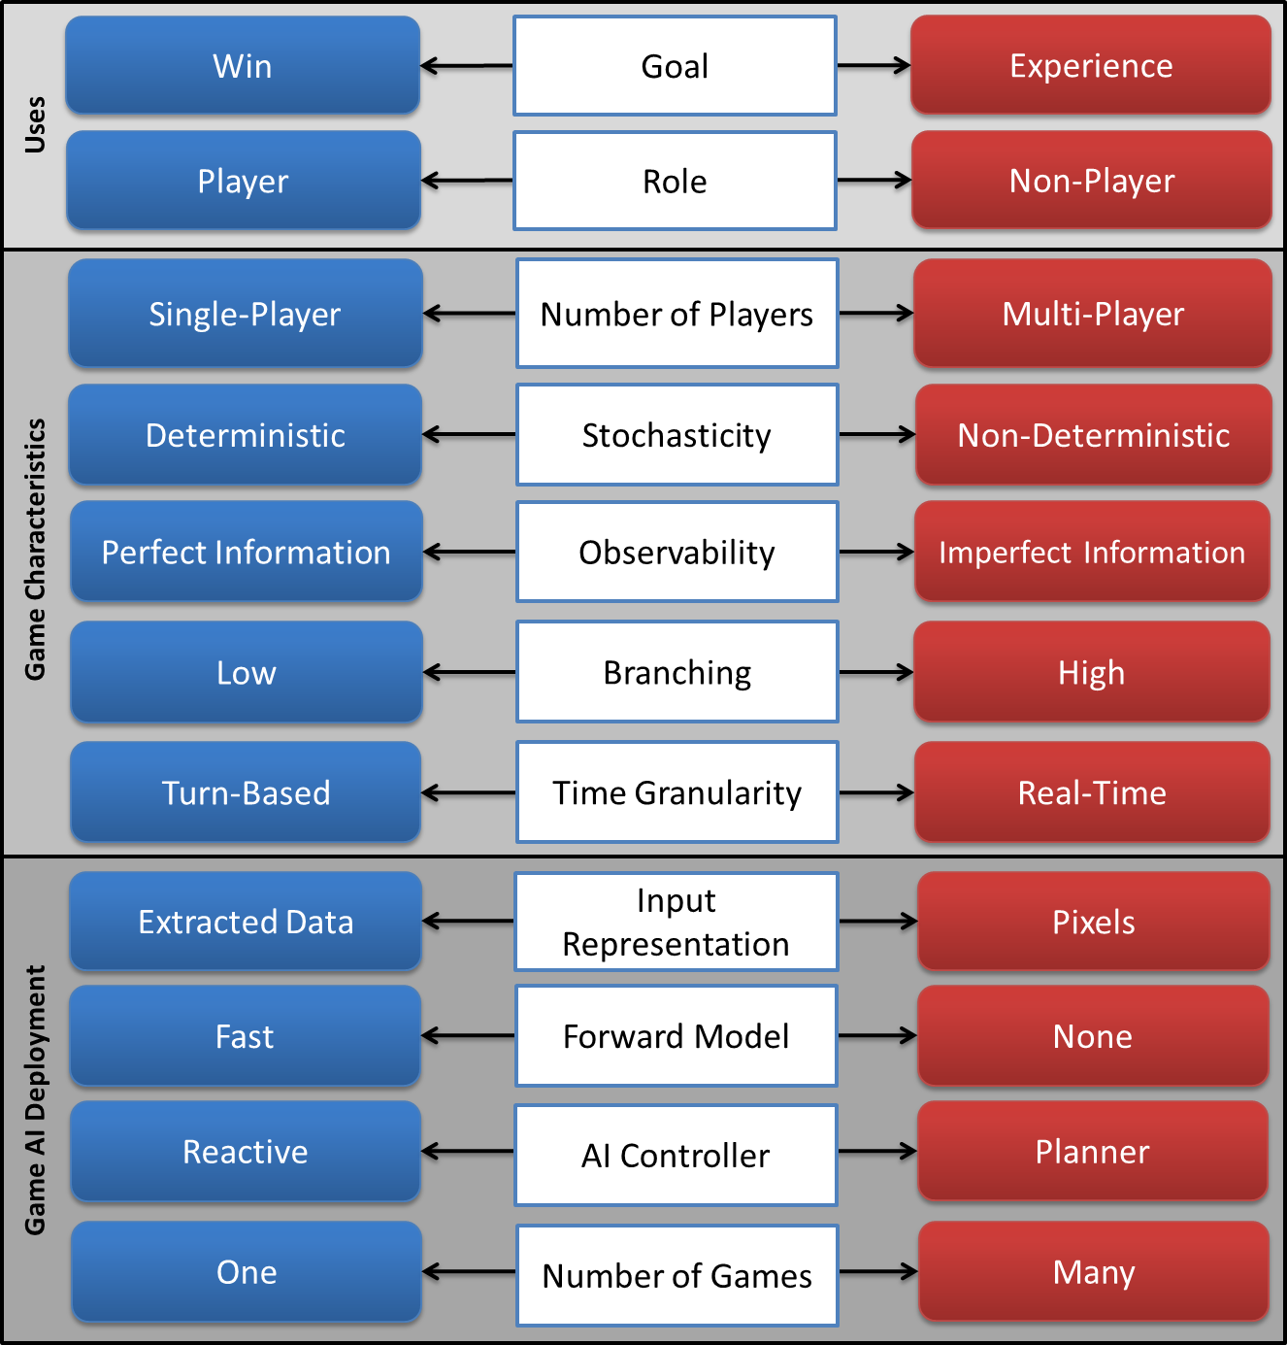
Notes:
Beyond the taxonomy for the four possible uses we introduced earlier the taxonomy
includes important game characteristics (see Section 4.2.2) and deployment
aspects that affect AI gameplaying (see Section 4.2.3). Figure 4.2 depicts an illustration of the taxonomy.
Next, we move on and discuss the 5 taxonomy dimensions related to game characteristics

Slide 16
Game Characteristics
Notes:
[see Section 4.2.2 for more details]

Slide 17
Game (and AI) Design Considerations
When designing AI
It is crucial to know the characteristics of the game you are playing and
the characteristics of the algorithms you are about to design
These collectively determine what type of algorithms can be effective
Notes:
When choosing an AI method for playing a particular game it is crucial to know the characteristics of the game you are playing and the characteristics of the algorithms you are about to design. These collectively determine what type of algorithms can be effective.

Slide 18
Characteristics of Games
Number of Players
Type: Adversarial? Cooperative? Both?
Stochasticity
Observability
Branching
Time Granularity
Notes:
[see Section 4.2.2 for more details]
We list a number of characteristics of games and we discuss the impact they have on the potential use of AI methods. All are tied to the design of the game but a few (e.g., input representation and forward model) are also dependent on the technical implementation of the game and possibly amenable to change. Much of our discussion is inspired by the book Characteristics of Games by Elias et al. which discusses many of these factors from a game design perspective.

Slide 19
Number of Players
Single-player – e.g. puzzles and time-trial racing
One-and-a-half-player – e.g. campaign mode of an FPS with nontrivial NPCs
Two-player – e.g. Chess, Checkers and Spacewar!
Multi-player – e.g. League of Legends (Riot Games, 2009), the Mario Kart (Nintendo, 1992–2014) series and the online modes of most FPS games.
Notes:
[see Section 4.2.2 for more details]

Slide 20

Stochasticity
The degree of randomness in the game
Does the game violate the Markov property?
Deterministic (e.g. Pac-Man, Go, Atari 2600 games)
Non-deterministic (e.g. Ms Pac-Man, StarCraft, …)
Notes:
[see Section 4.2.2 for more details]

Slide 21
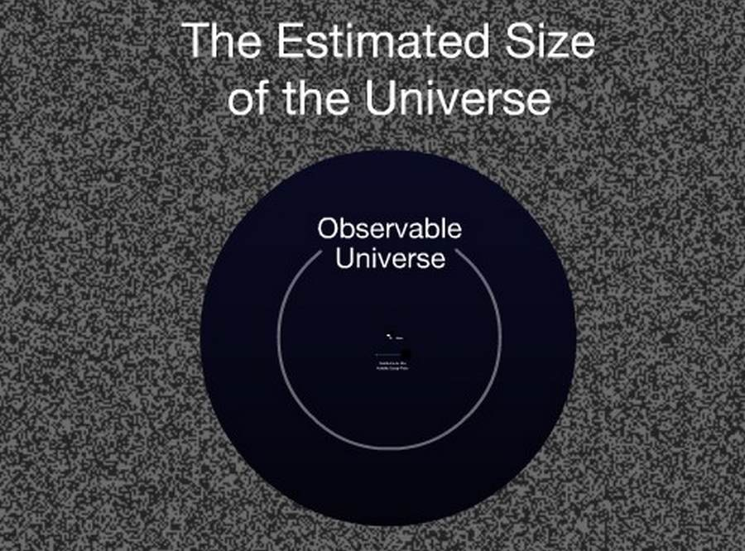
Observability
How much does our agent know about the game?
Perfect Information (e.g. Zork, Colossal Cave Adventurer)
Imperfect (hidden) Information (e.g. Halo, Super Mario Bros)
Notes:
[see Section 4.2.2 for more details]

Slide 22
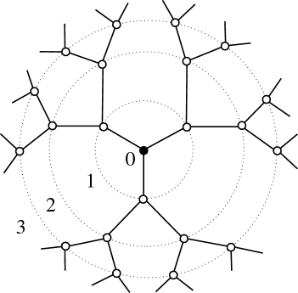
Action Space and Branching Factor
How many actions are there available for the player?
From two (e.g. Flappy Bird) to many (e.g. StarCraft)….
Notes:
[see Section 4.2.2 for more details]

Slide 23

Time Granularity
How many turns (or ticks) until the end (of a session)?
Turn-based (e.g. Chess)
Real-time (e.g. StarCraft)
Notes:
[see Section 4.2.2 for more details]

Slide 24
Observability
Pac-Man
Atari 2600
Ms Pac-Man
Checkers
Chess
Go
Ludo
Monopoly
Backgammon
Perfect
Information
Super Mario Bros
Halo
StarCraft
Time
Granularity
Battleship
Scrabble
Poker
Imperfect
Information
Real-Time
Turn-Based
Deterministic
Non-deterministic
Stochasticity
Notes:
For illustrative purposes, this Figure places a number of core game examples onto the three-dimensional space of observability, stochasticity and time granularity. Note that the game examples presented are sorted by complexity (action space and branching factor) within each cube. Minimax can theoretically solve merely any deterministic, turn-based game of perfect information (red cube in the figure)—in practice, it is still impossible to solve games with substantially large branching factors and action spaces such as Go via Minimax. Any AI method that eventually approximates the Minimax tree (e.g., MCTS) can be used to tackle imperfect information, non-determinism and real-time decision making (see blue cubes in figure).

Slide 25
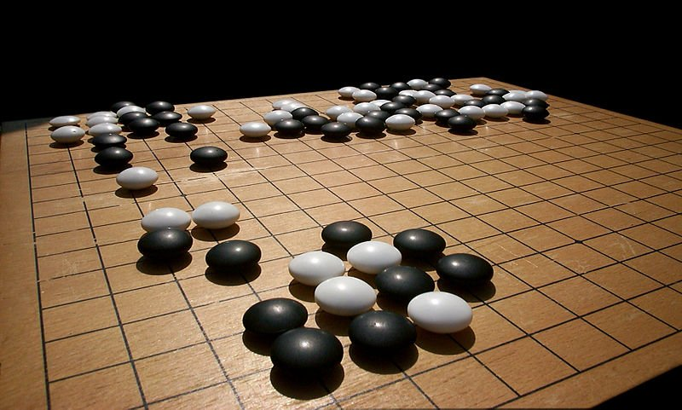
Characteristics of Games: Some Examples
Chess
Two-player adversarial, deterministic, fully observable, bf ~35, ~70 turns
Go
Two-player adversarial, deterministic, fully observable, bf ~350, ~150 turns
Backgammon
Two-player adversarial, stochastic, fully observable, bf ~250, ~55 turns
Notes:
Some board game examples

Slide 26
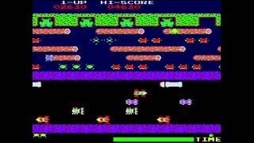
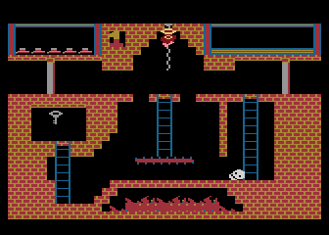
Characteristics of Games: Some Examples
Frogger (Atari 2600)
1 player, deterministic, fully observable, bf 6, hundreds of ticks
Montezuma's revenge (Atari 2600)
1 player, deterministic, partially observable, bf 6, tens of thousands of ticks
Notes:
Arcade game examples

Slide 27
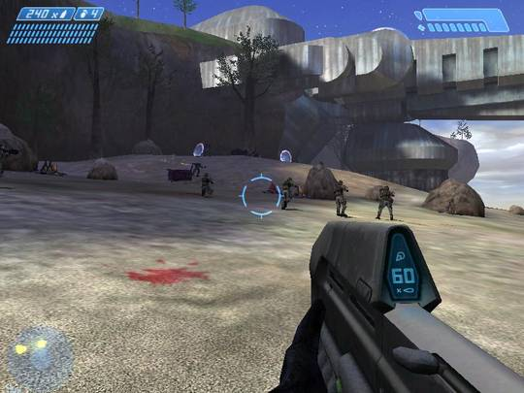
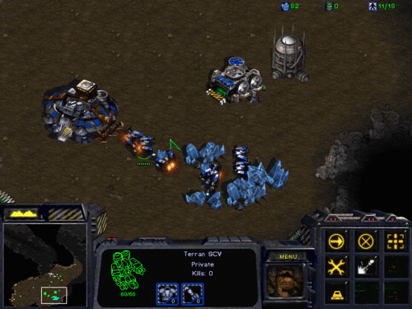
Characteristics of Games: Some Examples
Halo series
1.5 player, deterministic, partially observable, bf ??, tens of thousands of ticks
StarCraft
2-4 players, stochastic, partially observable, bf > a million, tens of thousands of ticks
Notes:
AAA digital game examples
Imagine having 6 different units that can each take 10 different actions at a given time—a rather conservative estimate compared to typical games of, say, StarCraft (Blizzard Entertainment, 1998) or Civilization (MicroProse, 1991)—then your branching factor is a million!

Slide 28
Game AI Deployment
Notes:
[see Section 4.2.3 for more details]

Slide 29
Characteristics of AI Algorithm Design
Key questions
How is the game state represented?
Is there a forward model available?
Do you have time to train?
How many games are you playing?
Notes:
[see Section 4.2.3 for more details]
Answers to these four questions lead to core algorithmic decisions. We will look at each one of them in detail

Slide 30
Input Representation
Games differ wither regards to their output
Text adventures → Text
Board games → Positions of board pieces
Graphical video games → Moving graphics and/or sound
The same game can be represented in different ways!
The representation matters greatly to an algorithm playing the game
Example: Representing a racing game
First-person view out of the windscreen of the car rendered in 3D
Overhead view of the track rendering the track and various cars in 2D.
List of positions and velocities of all cars (along with a model of the track)
Set of angles and distances to other cars (and track edges)
Notes:
[see Section 4.2.3 for more details]
The same game can be represented in different ways, and which way it is represented matters greatly to an algorithm playing the game. We view the input representation dimension as a continuum of many possibilities between extracted
data and pixels (see racing game example).

Slide 31
Forward Model
A forward model is a simulator of the game
Given s and α → s’
Is the model fast? Is it accurate?
Tree search is applicable only when a forward model is available!
Notes:
[see Section 4.2.3 for more details]
A very important factor when selecting an AI algorithm to play a game is whether there is a simulator of the game, a so-called forward model, available.
For many games, however, it is impossible or at least very hard to obtain a fast forward model.

Slide 32
What if…
We don’t have a model (or a bad or slow model), but we have training time, what do we do?
Train function approximators to select actions or evaluate states
For example, deep neural networks
…using gradient descent…
…or evolution
Notes:
In some cases the computational complexity of the core game loop might still be so high that any forward models built on the
core game code would be too slow to be usable.
In some of such cases, it might be practical to build and/or learn a simplified or approximate forward model, where the state resulting from a series of actions taken in the forward model is not guaranteed to be identical to the state resulting from the same series of actions in the actual game.

Slide 33
Life without a forward model…
Sad…!
We could learn a direct mapping from state to action
Or some kind of forward model
Even a simple forward model could be useful for shallow searches, if combined with a state value function

Slide 34

AI Controller
AI distinction with regards to time:
AI that decides what to do by examining possible actions and future states—e.g. tree search (reactive)
AI that learns a model (such as a policy) over time—i.e., machine learning (planner)
Notes:
[see Section 4.2.3 for more details]
What type of algorithm you will want to use depends largely on your motivation for using AI to play games. If you are using the game as a testbed for your AI algorithm, your choice will be dictated by the type of algorithm you are testing. If you are using the AI to enable player experience in a game that you develop then you will probably not want the AI to perform any learning while the game is being played, as this risks interfering with the gameplay as designed by the designer. In other cases you are looking for an algorithm that can play some range of games well, and do not have time to retrain the agent for each game.

Slide 35
Number of Games
Will AI play one game?
Specific game playing
Will AI play more than one games?
General game-playing
Notes:
[see Section 4.2.3 for more details]
General game playing is typically motivated by a desire to use games to progress towards artificial general intelligence, i.e., developing AI that is not only good at one thing but at many different things
Frameworks for general game playing:
General Game Playing Competition
General Video Game AI Competition
Arcade Learning Environment
XLand framework

Slide 36
Problem: Overfitting!

Slide 37
Solution: General Game-playing
Can we construct AI that can play many games?

Slide 38
Chapter 5: Methods for Playing Games

Slide 39
How Can AI Play Games?
Different methods are suitable, depending on:
The characteristics of the game
How you apply AI to the game
Why you want to make a game-playing
There is no single best method (duh!)
Often, hybrid (chimeric) architectures do best

Slide 40

“Surely, deep RL is the best algorithm for playing games…”
Notes:
Given the success of deep reinforcement learning in Atari games and Go (predominately by Deepmind) one might conclude that it is the best algorithms available out there

Slide 41
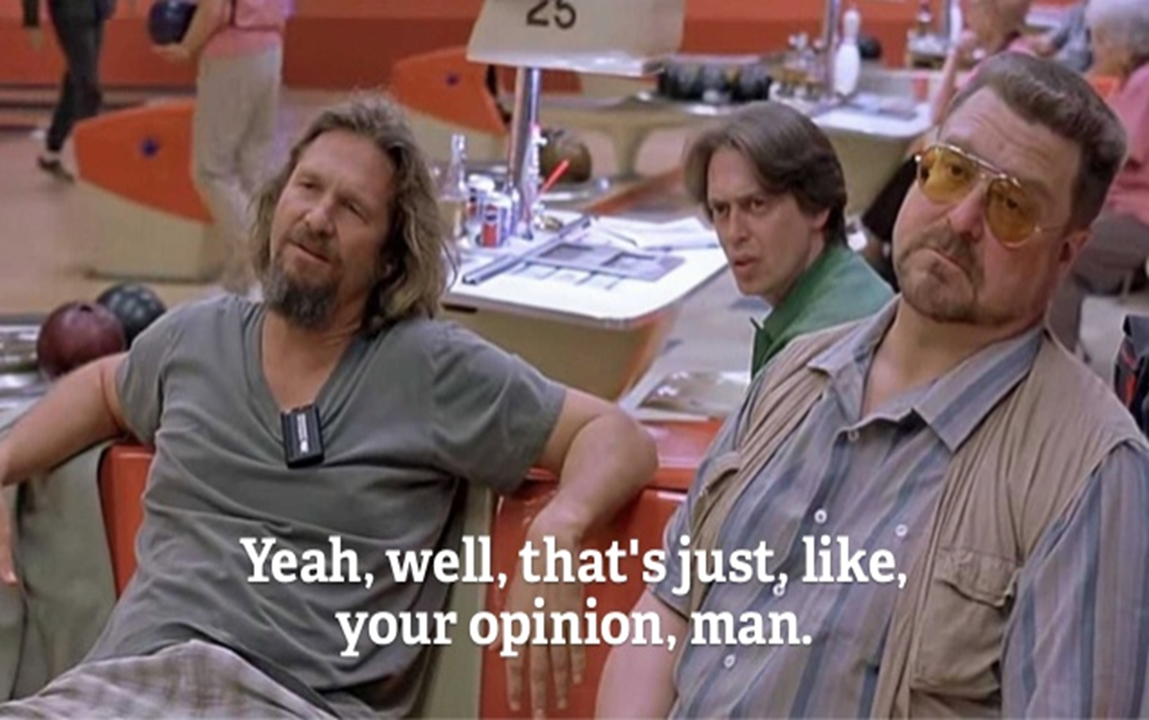
Notes:
It is however just an opinion – let’s see why

Slide 42
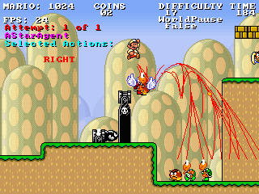
How Would you Play Super Mario Bros?
https://www.youtube.com/watch?v=DlkMs4ZHHr8
Notes:
Here is an example of a AI playing Super Mario Bros. This is the winner entry of Robin Baumgarten (Imperial College at the time) that won the 2012 Mario AI competition. Surprisingly enough this is merely an A*-controlled agent which at any point simply tries to get to the right edge of the screen.

Slide 43
How Can AI Play Games: An Overview
Behaviour authoring – requires human ingenuity and time
Planning-Based – requires forward model
Uninformed search (e.g. best-first, breadth-first)
Informed search (e.g. A*)
Evolutionary algorithms
Reinforcement Learning – requires training time
TD-learning / approximate dynamic programming
Evolutionary algorithms
Supervised Learning – requires play traces
Neural nets, k-NN, SVMs, Decision Trees, etc.
Random – requires nothing
Notes:
Here is an overview of methods that can be used to play games (and their corresponding requirements).
Some algorithms do not need to learn anything about the game, but do need a forward model (tree search)
Some algorithms do not need a forward model, but instead learn a policy as a mapping from state(s) to action (model-free reinforcement learning)
And some algorithms require both a forward model and training time (model-based reinforcement learning and tree search with adaptive hyperparameters).
Let us start with the assumption that a forward model is available and cover the planning based methods first

Slide 44
Life with a model…

Slide 45
How Can AI Play Games
Planning-Based – requires forward model
Uninformed search (e.g. best-first, breadth-first)
Informed search (e.g. A*)
Adversarial search (e.g. Minimax, MCTS)
Evolutionary algorithms
But path-planning does not require a forward model
Search in physical space
Notes:
Algorithms that select actions through planning a set of future actions in a state space are generally applicable to games, and do not in general require any training time. They do require a fast forward model if searching in the game’s state space, but not if simply using them for searching in the physical space (path-planning).
Tree search algorithms are widely used to play games, either on their own or in supporting roles in game-playing agent architectures.

Slide 46
A Different Viewpoint
Planning-Based
Classic Tree Search (e.g. best-first, breadth-first, A*, Minimax)
Stochastic Tree Search (e.g. MCTS)
Evolutionary Planning (e.g. rolling horizon)
Planning with Symbolic Representations (e.g. STRIPS)
Notes:
A different taxonomy of the same algorithms
Algorithms that require a forward model appear in green
Algorithms that do not require a forward model appear in red

Slide 47
Classic Tree Search
Notes:
[see Section 5.2.1 for more details]
Classic tree search methods, which feature little or no randomness, (Minimax and α-β pruning) have been used in game-playing roles since the very beginning of research on AI and games.
In general, classic tree search methods can be applied in games that feature
full observability
low branching factor
fast forward model
Theoretically they can solve any deterministic game that features full observability for the player; in practice, they still fail in games containing large state spaces.

Slide 48
Informed Search (A*)
Notes:
[see section 5.2.1 for more details]
In the following slides we will focus on a popular algorithm of informed search (and classic tree search) in games: A*
Path-planning and A*: Best-first search, in particular a myriad variations of the A* algorithm, is very commonly used for path-planning in modern video games. When an NPC decides how to get from point A to point B, this is typically done using some version of A*. In such case no forward model is required.
NPC control: best-first algorithms such as A* can be used for controlling all aspects of NPC behaviour. To take an example, the winner of the 2009 Mario AI Competition was entirely based on A* search in state space [see Figure]

Slide 49


A* in Mario: Current Position
Goal: right border
of screen
current node
Notes:
Let us now see how A* worked in Super Mario Bros in more detail. Further details can be found in section 3.3.1.1 and in the following paper:
Julian Togelius, Sergey Karakovskiy, and Robin Baumgarten. The 2009 Mario AI competition. In Evolutionary Computation (CEC), 2010 IEEE Congress on. IEEE, 2010
The figures in the following slides illustrate the key steps of A* search for playing the game. Super Mario’s goal (heuristic to be maximised) is to reach the right boarder of the screen

Slide 50









A* in Mario: Child Nodes
jump
right, jump
left, jump, speed
current node
right, speed
Notes:
The agent considers a maximum of nine possible actions at each frame of the game, as a
result of combining the jump and speed buttons with moving right or left.

Slide 51





A* in Mario: Best First
current node
right, speed
Notes:
Then the agent picks the action with the highest heuristic value.

Slide 52

A* in Mario: Evaluate Node
current node
right, speed
Notes:
But this action gets a high negative reward as an enemy is threatening Mario

Slide 53

A* in Mario: Backtrack
right, jump, speed
current node
right, speed
Notes:
Hence, Mario takes the action second highest heuristic value (i.e., right, jump, speed in this example),

Slide 54

A* in Mario: Next State
current node
Notes:
Then Mario takes the next move to a new state

Slide 55










S
current node
A* in Mario: Create Child Nodes
Notes:
From this new state Mario considers all new possible action states

Slide 56
A* in Mario: Best first
current node
Notes:
And finally Mario evaluates the new action space by considering “unexplored” states in the stack

Slide 57
So why was A* successful?
Notes:
Potential question for the class
Potential answers:
Super Mario Bros is deterministic
The game has locally perfect information (at any instant the information in the current screen is completely known)
A good forward model is available: if the A* would not have used a complete model of the game including the movement of enemies, it would have been impossible to plan paths around these enemies.
Levels are fairly linear; in a later edition of the competition, levels with dead ends which required back-tracking were introduced, which defeated the pure A* agent (see next slide).

Slide 58
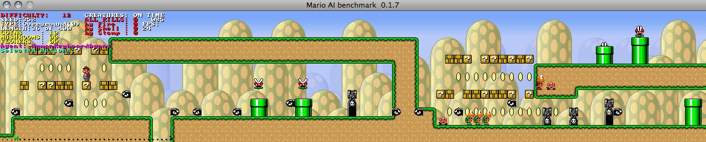
Limitations of A*
Notes:
An example level generated for the 2010 Mario AI Competition (a year after Robin’s agent won).
Note the overhanging structure in the middle, creating a dead end for Mario; if he chooses to go beneath the overhanging platform, he will need to backtrack to the start of the platform and take the upper route instead after discovering the wall at the end of the structure. Agents based on simple A* search are unable to do this.

Slide 59
Stochastic Tree Search
Notes:
[see Section 5.2.2 for more details]
Stochastic tree search refers primarily to Monte Carlo Tree search and its myriad variants

Slide 60
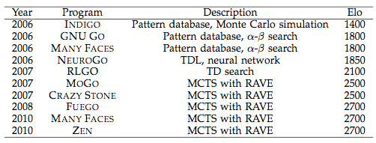
Monte Carlo Tree Search
The best new tree search algorithm you hopefully already know about
When invented, revolutionized computer Go

Slide 61
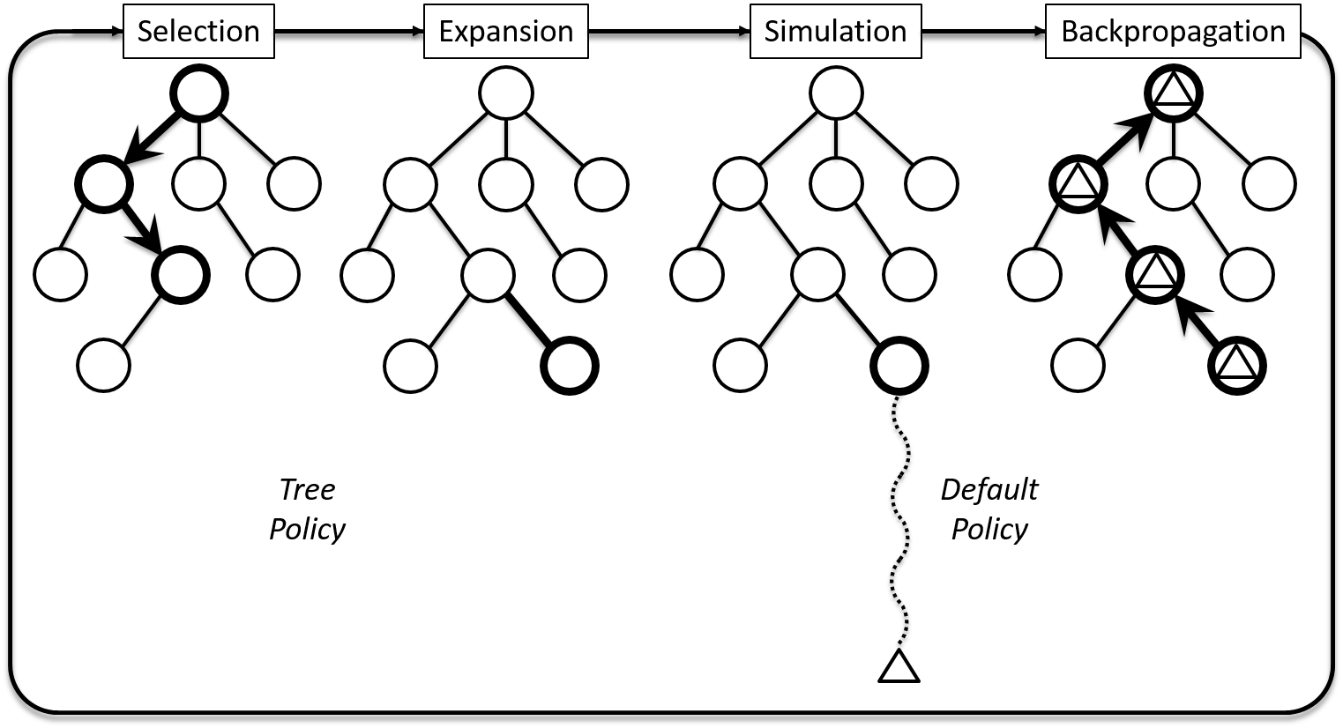
Monte Carlo Tree Search
Tree policy: choose which node to expand (not necessarily leaf of tree)
Default (simulation) policy: random playout until end of game
Notes:
[see Section 3.2.4 for more details on the MCTS algorithm]
The basic steps of MCTS are given here as a reminder.
We recommend an extensive lecture on MCTS

Slide 62
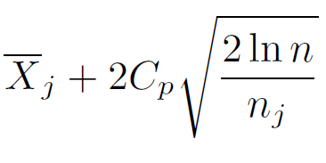

UCB1 Criterion
MCTS as a multi-armed bandit problem
Every time a node (action) is to be selected within the existing tree, the choice may be modelled as an independent multi-armed bandit problem. A child node j is selected to maximise:
Constant positive (exploration) parameter
Times child j has been visited
Times parent node has been visited
Notes:
Child nodes are chosen based on the upper confidence bound (UCB) criterion
In brief
With UCB we choose which node to explore based so as to balance exploration and exploitation
UCB only calculates average reward for all children of a node, and number of visits

Slide 63
MCTS Goes Real-Time
Limited roll-out budget
Heuristic knowledge becomes important
Action space is fine-grained
Take macro-actions otherwise planning will be very short-term
Maybe no terminal node in sight
Use a heuristic
Tune simulation depth
Next state function may be expensive
Consider making a simpler abstraction
Notes:
There are certain challenges MCTS faces when it is applied for real-time control of fast-paced games (e.g. Ms Pac-Man or Super Mario Bros)

Slide 64
MCTS for Mario
https://www.youtube.com/watch?v=01j7pbFTMXQ
Jacobsen, Greve, Togelius: Monte Mario: Platforming with MCTS. GECCO 2014.
Notes:
An Example: Jabosen et al. (2014) applied a number of MCTS variants for controlling Mario (video: best result obtained)

Slide 65
MCTS Modifications
Modification | Mean Score | Avg. T Left
Vanilla MCTS (Avg.) | 3918 | 131
Vanilla MCTS (Max) | 2098*** | 153
Mixmax (0.125) | 4093 | 147
Macro Actions | 3869 | 142
Partial Expansion | 3928 | 134
Roulette Wheel Selection | 4032 | 139
Hole Detection | 4196** | 134
Limited Actions | 4141* | 137
(Robin Baumgarten’s A*) | 4289*** | 169
Notes:
The various modifications on the paper by Jacobsen et al. (2014) that led to dissimilar results

Slide 66
A* Still Rules
Several MCTS conﬁgurations get the same score as A*
It seems that A* is playing essentially optimally
But what if we modify the problem?

Slide 67
Making a Mess of Mario
Introduce action noise:
20% of actions are replaced with a random action
Destroys A*
MCTS handles this much better
AI | Mean Score
MCTS (X-PRHL) | 1770
A* agent | 1342**
Notes:
See “Jacobsen, Greve, Togelius: Monte Mario: Platforming with MCTS. GECCO 2014.” for more details

Slide 68
MCTS in Commercial Games

Slide 69
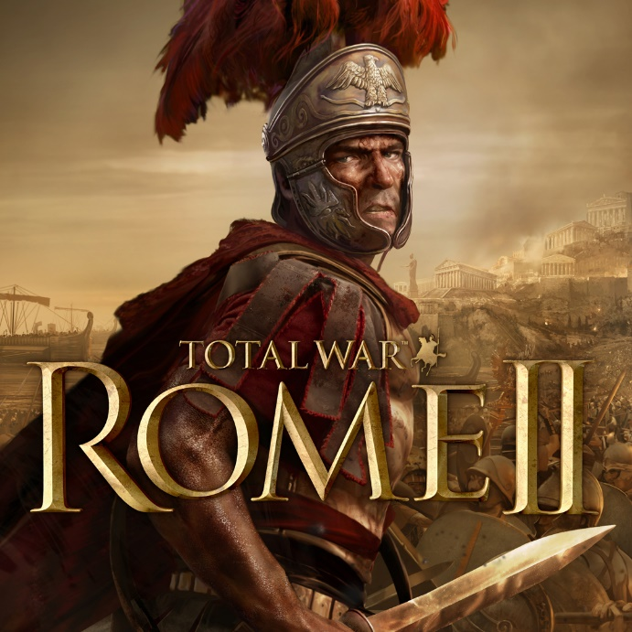
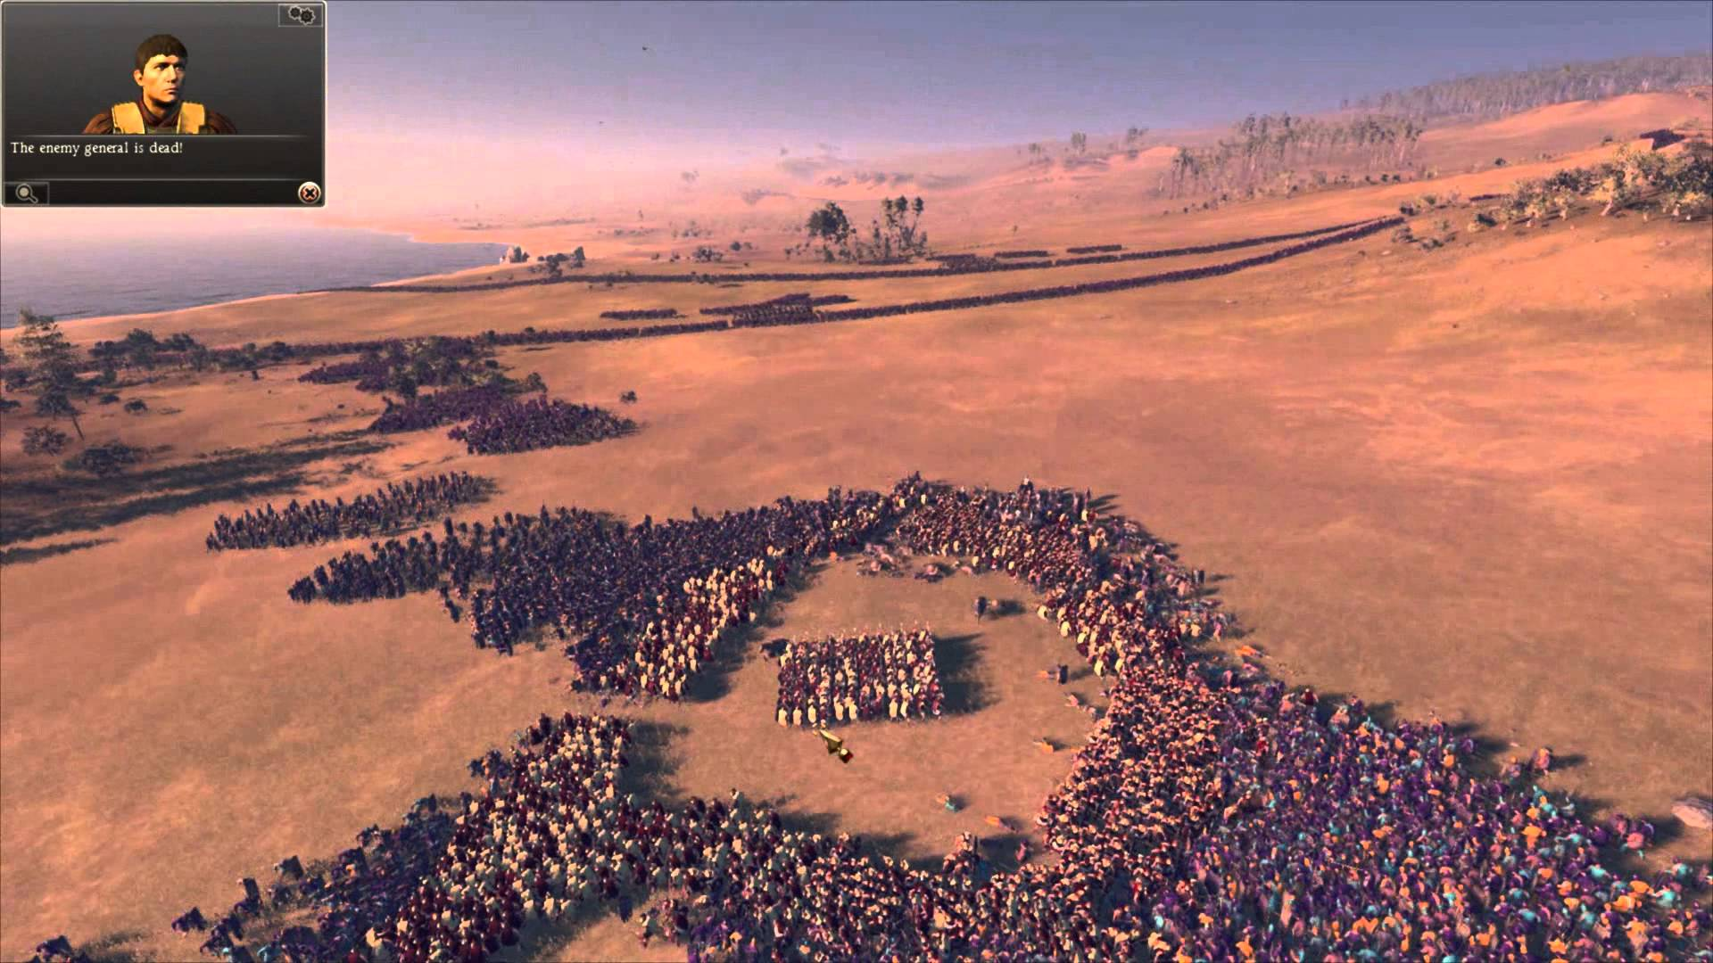
Example: MCTS @ Total War Rome II
Task Management System
Resource Allocation (match resources to tasks)
Typically many tasks.. but few resources
Large search space, little time
Resource Coordination (determine the best set of actions given resources & their targets)
Large search space
Grows exponentially with number of resources
Expensive pathfinding queries
MCTS-based planner to achieve constant worst-case performance

Slide 70
Evolutionary Planning
Notes:
[see Section 5.2.3 for more details]
Decision making through planning does not need to be built on tree search. Alternatively, one can use optimization algorithms for planning.

Slide 71
Evolutionary Planning
Basic idea:
Don’t search for a sequence of actions starting from an initial point
Optimize the whole action sequence instead!
Search the space of complete action sequences for those that have maximum utility.
Evaluate the utility of a given action sequence by taking all the actions in the sequence in simulation, and observing the value of the state reached after taking all those actions.
Notes:
[see Section 5.2.3 for more details]

Slide 72
Evolutionary Planning
Any optimization algorithm is applicable
Evolutionary algorithms are popular so far; e.g.
Rolling horizon evolution in TSP
Competitive agents in General Video Game AI Competition
“Online evolution” outperforms MCTS in Hero Academy
Evolutionary planning performs better than varieties of tree search in simple StarCraft scenarios
Performs well in cooperative board games such as Pandemic
A method at birth – still a lot to come!
Notes:
[see Section 5.2.3 for more details and references to papers]

Slide 73
Planning with Symbolic Representations
Notes:
[see Section 5.2.4 for more details]
The last category of planning-based methods in games include classical planning with symbolic representations.

Slide 74
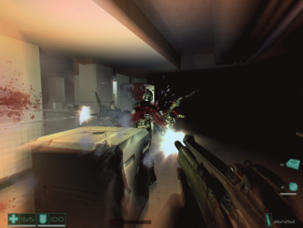
Planning with Symbolic Representations
Planning on the level of in-game actions requires a fast forward model
However, one can plan in an abstract representation of the game’s state space.
Typically, a language based on first-order logic represents events, states and actions, and tree search is applied to find paths from current state to end state.
Example: STRIPS-based representation used in Shakey, the world’s first digital mobile robot
Game example: F.E.A.R. (Sierra Entertainment, 2005) agent planners by Jeff Orkin
Notes:
[see Section 5.2.4 for more details]

Slide 75
Life without a model…
Notes:
[see Section 3.2.2.2 for more details]
A very important factor when selecting an AI algorithm to play a game is whether there is a simulator of the game, a so-called forward model, available.
For many games, however, it is impossible or at least very hard to obtain a fast forward model.

Slide 76
How Can AI Play Games?
Reinforcement learning (requires training time)
TD-learning/approximate dynamic programming
Deep RL/Deep Q-N, …
Evolutionary algorithms
Notes:
When a forward model cannot be produced, tree search algorithms cannot be applied. It is still possible to manually construct agents, and also to learn agents through supervised learning or some form of reinforcement learning
Note: the planning-based methods (described earlier) for playing games cannot be directly compared with the reinforcement learning methods described here. They solve different problems: planning requires a forward model and significant time at each time step; reinforcement learning instead needs learning time and may or may not need a forward model.

Slide 77
Classic and Deep RL
Notes:
[see Section 5.3.1 for more details]

Slide 78
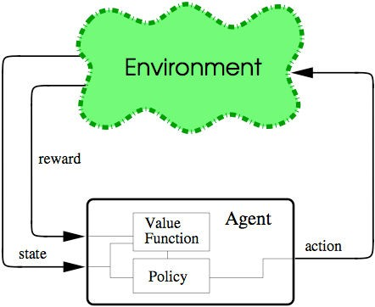
RL Problem
Notes:
[see Section 3.7 for more details on RL methods]

Slide 79
Q-learning
Off-policy reinforcement learning method in the temporal difference family
Learn a mapping from (state, action) to value
Every time you get a reward (e.g. win, lose, score), propagate this back through all states
Use the max value from each state
Notes:
[see Section 3.7.1 for more details on Q-learning as a method]

Slide 80

Agent consists of two components:
Value-function (Q-function)
Policy

Slide 81
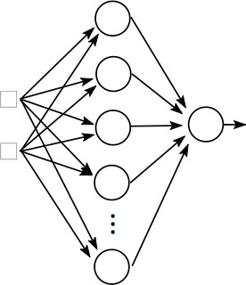
Representing Q(s,α) with ANNs
s_{t}
Q(s_{t} ,a_{t} )
a
t
Notes:
[see Section 3.7.2 for more details on TD Learning with Artificial Neural Networks methods]

Slide 82
Training the ANN Q-function
Training is performed on-line using the Q-values from the agent’s state transitions
For Q-learning:
input: s_{t} , a_{t}
target: r_{t}
+ γ maxQ(s_{t+1} ,a)
a

Slide 83
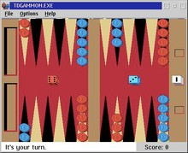
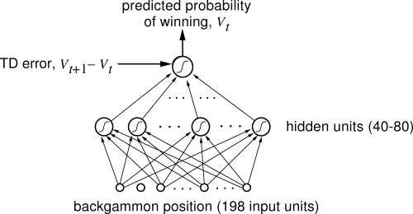
TD-Gammon (Teusaro, 1992)

Slide 84
Deep Q-learning
Use Q-learning with deep neural nets
In practice, several additions useful/necessary
Experience replay: chop up the training data so as to remove correlations between successive states
Niels Justesen, Philip Bontrager, Sebastian Risi, Julian Togelius: Deep Learning for Video Game Playing. ArXiv.

Slide 85
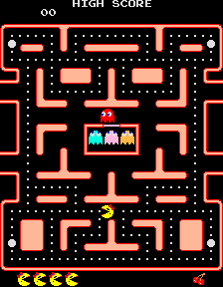
Deep Q Network (DQN)
Ms Pac-Man Example
Reward
Convolution
Rectifier
Rectifier
Action

Slide 86
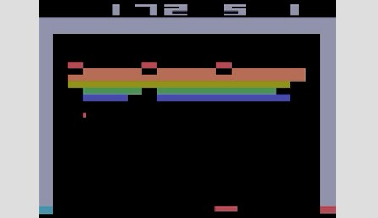

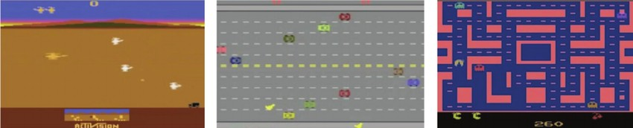
Arcade Learning Environment
Notes:
[see 3.4.3.3 for more details]

Slide 87
Arcade Learning Environment
Based on an Atari 2600 emulator
Atari: very successful but very simple
128 byte memory, no random number generator
A couple of dozen games available (hundreds made for the Atari)
Agents are fed the raw screen data (pixels)
Most successful agents based on deep learning

Slide 88
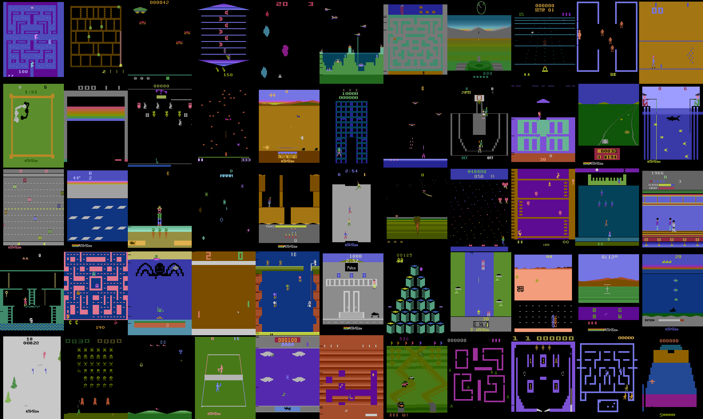

Slide 89


Slide 90


















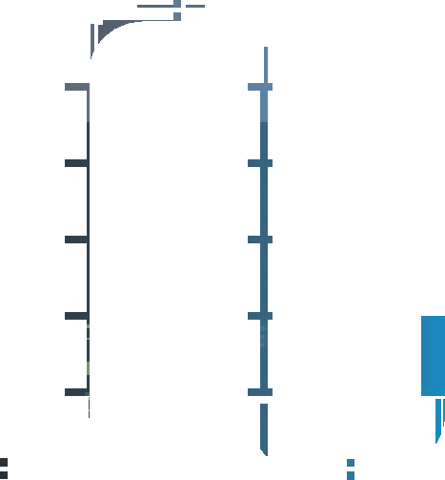


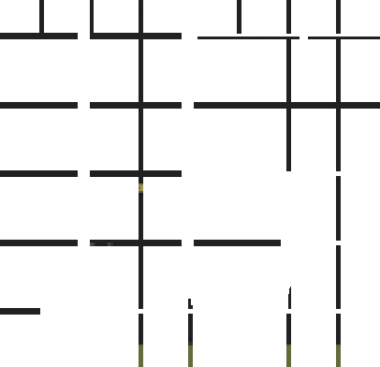












































Convolution
Convolution
Fully connected
Fully connected
No input

Slide 91

Video Pinball
Boxing Breakout Star Gunner Robotank Atlantis
Crazy Climber
Gopher Demon Attack Name This Game
Krull Assault Road Runner Kangaroo
James Bond
Tennis Pong
Space Invaders Beam Rider Tutankham Kung-Fu Master
Freeway Time Pilot Enduro Fishing Derby Up and Down Ice Hockey
Q*bert H.E.R.O.
Asterix Battle Zone Wizard of Wor
Chopper Command
Centipede Bank Heist River Raid Zaxxon Amidar
Alien Venture Seaquest Double Dunk
Bowling Ms. Pac-Man Asteroids Frostbite Gravitar Private Eye
Montezuma's Revenge
Results: not bad!
…but not general
At human-level or above
Below human-level
DQN
Best linear learner
0
100
200
300
400
500
600 1,000
4,500%

Slide 92
Justesen et al. (2017). Deep learning for video game playing. arXiv preprint arXiv:1708.07902.

Slide 93
Proximal Policy Optimization
Major step forward for RL in games
Policy gradient method; limits the changes to the policy yielding a more stable RL method (i.e., less catastrophic forgetting)
Atari: great performance!
Dota 2: beating the world champion!
Because of its simplicity, stability, and versatility, PPO is often used as a default RL algorithm in gameplaying
Notes:
[see more details about the PPO algorithm in Section 3.7.3]

Slide 94
Evolutionary RL
Notes:
[see Section 5.3.2 for more details]

Slide 95
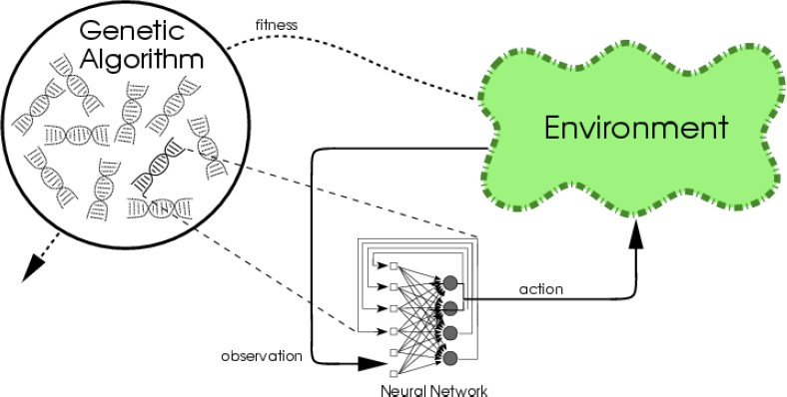
(Neuro)Evolution as a RL Problem
Notes:
[see Section 3.7.4 for more details on neuro-evolution methods]

Slide 96
Evolutionary Algorithms
Stochastic global optimization algorithms
Inspired by Darwinian natural evolution
Extremely domain-general, widely used in practice

Slide 97
Simple μ+λ Evolutionary Strategy
Create a population of μ+λ individuals
At each generation
Evaluate all individuals in the population
Sort by ﬁtness
Remove the worst λ individuals
Replace with mutated copies of the μ best individuals

Slide 98



















Evolving ANNs
Ms Pac-Man Example
1
0
0
1
1
1
0
$$w_{1}$$
$$w_{2}$$
$$w_{3}$$
$$w_{4}$$
$$w_{5}$$
$$w_{n}$$
2
0
0
1
1
1
0
$$w_{1}$$
$$w_{2}$$
$$w_{3}$$
$$w_{4}$$
$$w_{5}$$
$$w_{n}$$
P
0
0
1
1
1
0
$$w_{1}$$
$$w_{2}$$
$$w_{3}$$
$$w_{4}$$
$$w_{5}$$
$$w_{n}$$
Fitness value $f_{2}$

Slide 99
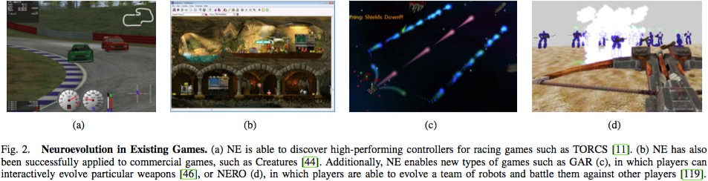
Neuroevolution has been used broadly…
Sebastian Risi and Julian Togelius (2016): Neuroevolution in games. TCIAIG.

Slide 100
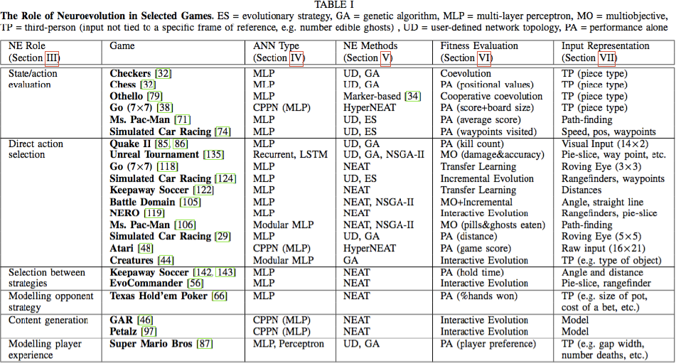
Notes:
The various role neuroevolution has played across dissimilar games genres

Slide 101
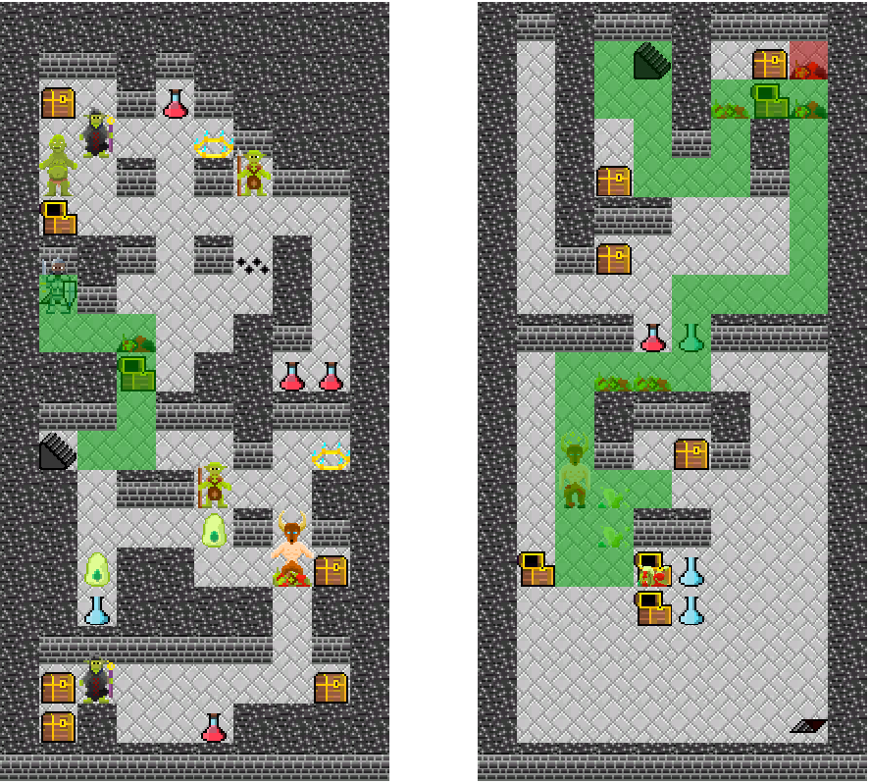
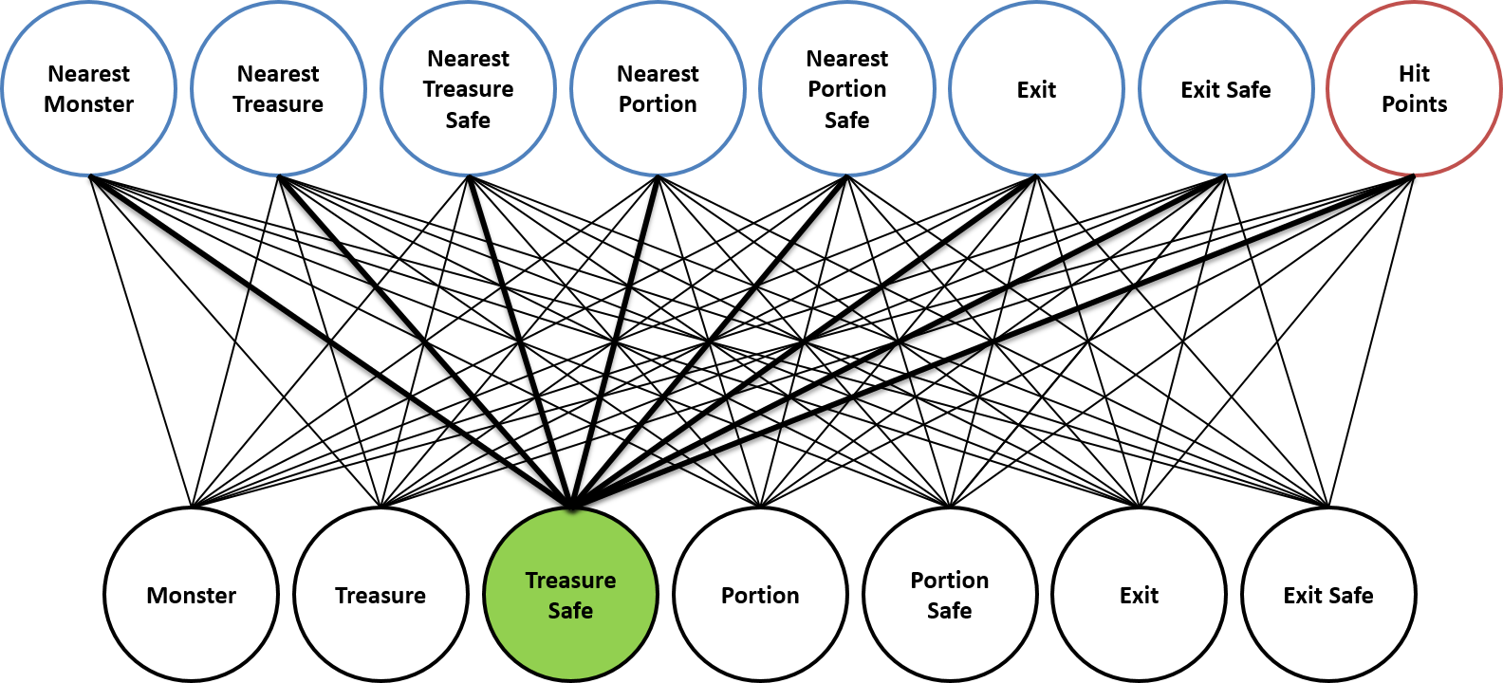
Procedural Personas
Given utilities (rewards) show me believable gameplay
Useful for human-standard game testing
RL
MCTS
Neuroevolution
…
Inverse RL
Liapis, Antonios, Christoffer Holmgård, Georgios N. Yannakakis, and Julian Togelius. "Procedural personas as critics for dungeon generation." In European Conference on the Applications of Evolutionary Computation, pp. 331-343. Springer, Cham, 2015.

Slide 102
Supervised Learning
Notes:
[see Section 5.4 for more details]

Slide 103
Supervised Learning
Supervised learning requires play traces to learn from
Aka behaviour cloning
Basic idea: record traces of human players and train some function approximator to behave like the human player.
Methods
Neural networks, k-nearest neighbours, SVMs etc.
Generative Adversarial Imitation Learning (GAIL), Diffusion models in CS:GO, Dagger algorithm
Notes:
[see Section 5.4 for more details]

Slide 104
Chimeric Game Players
Notes:
[see Section 5.5 for more details]

Slide 105
Chimeric Methods
While planning, RL and SL are fundamentally different approaches to playing games, it does not mean that they cannot be combined.
Many examples of successful hybrid approaches (chimeras) such as dynamic scripting – a form of a learning classifier system
Other examples
AlphaGo, AlphaZero and MuZero
Notes:
[see Section 5.5 for more details]

Slide 106
Learning Beyond Policies
Notes:
[see Section 5.6 for more details]
Various ML methods are not directly learning policies, but learning models that are useful for creating and learning policies. Such models can be used for other downstream tasks beyond gameplaying such as content
generation and player modeling.
In the following slides we look at learning representations of the state space, and learning forward models or world models.

Slide 107
Learning Representations
Challenges of Pixel-Based Inputs
Native but high-dimensional: Pixel inputs are the natural representation for most games, but require large neural networks, making them computationally expensive.
Real-time constraints: At 60 FPS on CPU (GPU busy with rendering), AI has only a few milliseconds for inference → network size often limited to a few million parameters.
Training difficulties: Evolutionary and stochastic search methods perform poorly in large parameter spaces.
Notes:
[see Section 5.6.1 for more details]

Slide 108
Learning Representations
Dimensionality reduction
Autoencoders can compress visuals into latent vectors for smaller policy networks.
Must train on diverse game scenes to avoid poor performance on out-of-distribution levels.
Example: Alvernaz & Togelius (2017) evolved small networks for Doom by periodically retraining autoencoders.
Alternative methods
Dictionary vector quantizers store novel game states and use discrete encodings → enables networks with only a few thousand parameters to play Atari games effectively.
Samuel Alvernaz and Julian Togelius. Autoencoder-augmented neuroevolution for visual
doom playing. In IEEE Conference on Computational Intelligence and Games. IEEE, 2017.

Slide 109
Learning Representations
Improving Generalizability
Many parameters go to visual processing; policies may be simpler than expected.
Challenges: Learning good representations often requires internal game state, which isn’t always accessible.
Solutions:
Reverse engineering: Capture rendering data (GTA V), or approximate internal states (CS:GO).
I/O-based capture: BehAVE collects high-level player actions (e.g., “move forward,” “aim gun”) from raw inputs; uses pretrained text encoders (e.g., GPT) to align behaviors across games; demonstrates strong zero-shot gameplay transfer—even between very different games like Minecraft and FPS titles.
Future: BehAVE may excel further with more computational resources!
Rasajski, Trivedi, Makantasis, Liapis, Yannakakis (2024). BehAVE: Behaviour Alignment of Video Game Encodings. In Proc of ECCV.

Slide 110
Learning Forward Models
Why? Enables planning/training without a real game engine.
Issue: Most engines aren’t forward model–friendly.
Key example: Ha & Schmidhuber (2018)
VAE compresses pixels, LSTM predicts next encoded state.
Works for Doom & 2D racing.
Challenge: Prediction errors pile up → unrealistic states.
Ha and Schmidhuber. World models. arXiv preprint, arXiv:1803.10122, 2018.
Notes:
[see Section 5.6.2 for more details]

Slide 111
Learning Forward Models
Recent advances and future directions
DreamerV3: Discrete encoding + built-in actor-critic RL → fast, strong results.
Neural Game Engines: Learn dynamics from pixels + actions (diffusion models); Still struggle with hidden states.
Genie: Learns from videos only → short interactive 'games’. Hints at prompt-based game creation.
Bruce et al., Genie: Generative interactive environments. arXiv preprint, arXiv:2402.15391, 2024.

Slide 112
Chapter 6: Gameplaying AI by Game Genre
Notes:
[see Chapter 6. for more details]
The last chapter of the gameplaying part divides up the space of
games by game genre, and discusses how AI methods can be applied in various types
of games.
The chapter contains examples from the literature, from published games and extended examples
from academic research, giving some detail about particular implementations.
NB. The list is not inclusive of all possible game genres AI can play as a player or non-player
character; the selection is made on the basis of popularity of game genres and the
available published work on AI for playing games in each genre.

Slide 113
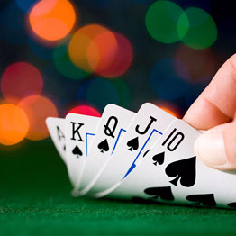
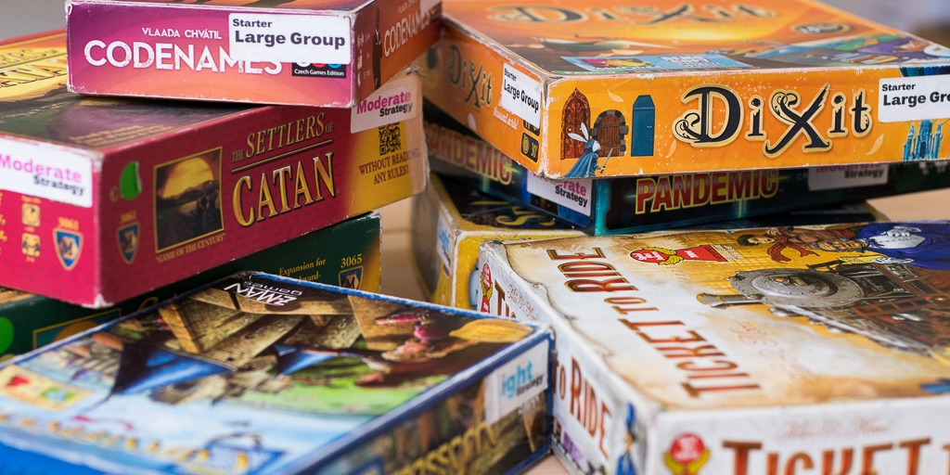
Board and Card Games
Board games (Classic and Modern)
Adversarial planning, tree search
Card games (Classic and Collectible)
Reinforcement learning, tree search
Notes:
[see Section 6.1 and 6.2 for more details]

Slide 114
Real Time 2D Video Games
Classic arcade games
Pac-Man and the like: Tree search, RL
Super Mario Bros: Planning, RL, Supervised learning
Arcade learning environment: RL
General Video Game AI: Tree search, RL
Fighting games: Tree search, RL, LLMs
Notes:
[see Section 6.3 for more details]
Classic arcade games [see Section 6.3.1]
Pac-Man / Ms Pac-Man [see Section 6.3.2]
Super Mario Bros [see Section 6.3.3]
Arcade learning environment [see Section 6.3.4]
General Video Game AI: [see Section 6.3.5]
Fighting games [see Section 6.3.6]

Slide 115
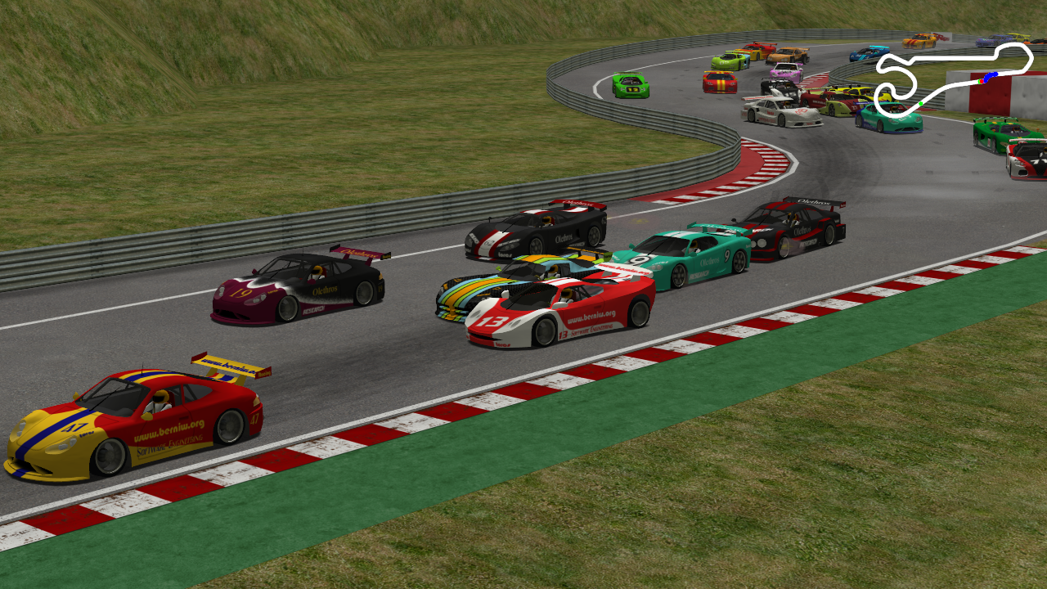
Real-Time 3D Games
Racing games
Supervised learning, RL, adversarial planning
Drivatar: from lazy learning (2005) all the way to deep nets (present)
GT Sophy: RL
Notes:
[see Section 6.4.1 for more details]

Slide 116
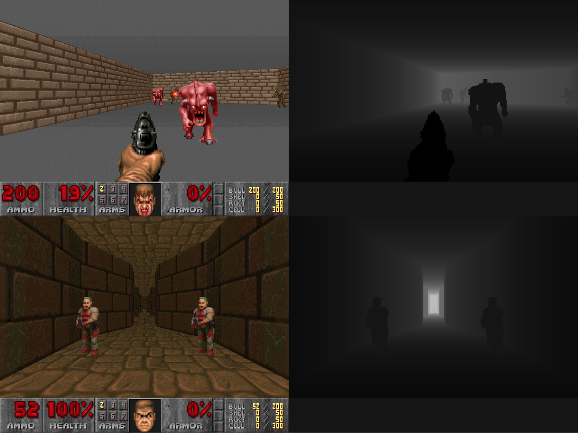
Real-Time 3D Games
First Person Shooters
UT2004: Neuroevolution, imitation learning
Doom: (Deep) RL in VizDoom
Valorant variant: Imitation learning
CS:GO: Diffusion models
Notes:
[see Section 6.4.2 for more details]

Slide 117
Real-Time 3D Games
Minecraft
Sandbox game played in a 3D procedurally generated world
Project Malmo: deep nets
Voyager: LLM-powered “lifelong learning” agent
Video-Pre Training (VPT):
First train an inverse dynamics model (IDM) on a small labelled dataset
The IDM labels a huge number (70k hours) of YouTube videos with actions
Such videos are then used to train a much larger model to play Minecraft
Notes:
[see Section 6.4.3 for more details]

Slide 118
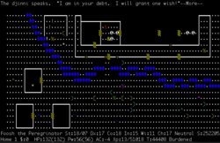
Dungeon Crawlers
Fantasy role-playing worlds in which a player navigates through some sort of labyrinth (dungeon); e.g. Hades (2020)
Nethack Challenge:
Game remains unsolved; standard Deep RL agents are far from solving it
Motif: aims to solve the problem of sparse and potentially misleading rewards in by constructing intrinsic rewards. These rewards are generated via LLMs for preference elicitation.
MiniDungeons
Introduction of procedural personas: Q-learning, neuroevolution
Notes:
[see Section 6.5 for more details]

Slide 119
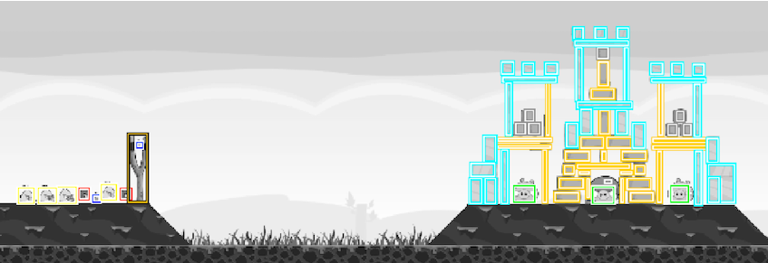
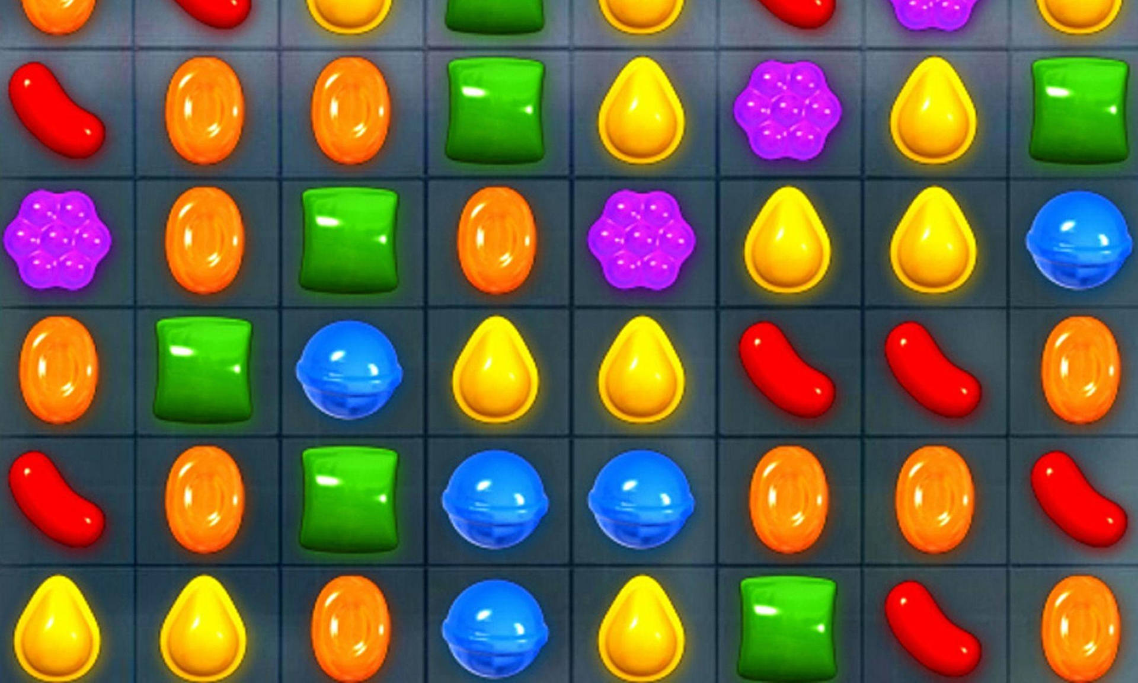
Puzzle Games
Typically, puzzle games feature complete or near-complete observability
Angry Birds AI Competition: runs since 2012, mainly in conjunction with IJCAI. Early approaches: planning and reasoning. More recent work: deep RL, and deceptive level design.
Match 3-games (e.g., Candy Crush): imitation learning, RL
Notes:
[see Section 6.6 for more details]

Slide 120
Strategy Games
Strategy games: control multiple units, often in military-themed conquest/conflict.
Types: Turn-based (Civilization, XCOM) vs. Real-time (StarCraft, Age of Empires).
Challenges: Hidden info, long planning horizons, predicting multi-unit adversaries. Massive branching factors → millions of possible actions per turn.
Solutions:
- Decomposition: control units separately (tractable but uncoordinated).
- Sampling: Naive Sampling MCTS, non-linear Monte Carlo.
- Evolutionary planning: outperforms MCTS in high-branching games.
- NEAT & deep learning for macro-management, playtesting, balancing.
Notes:
[see Section 6.7 for more details]

Slide 121
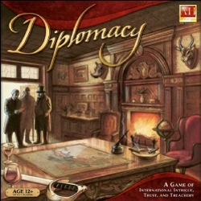
Strategy Games
Diplomacy
Strategic board game (1959) with secret dealmaking as key mechanic
Challenges: modeling belief spaces & unbounded player communication.
Early AI agents: moderate performance due to negotiation complexity.
Breakthrough (2022): Meta's Cicero – hybrid model-based RL + language model.
RL outputs intents → dialogue model generates natural English.
Dialogue model infers others’ intents → feeds back to RL.
Emergent behavior: occasional deception, ungrounded conversational statements.
Notes:
[see Section 6.7.1 for more details]

Slide 122
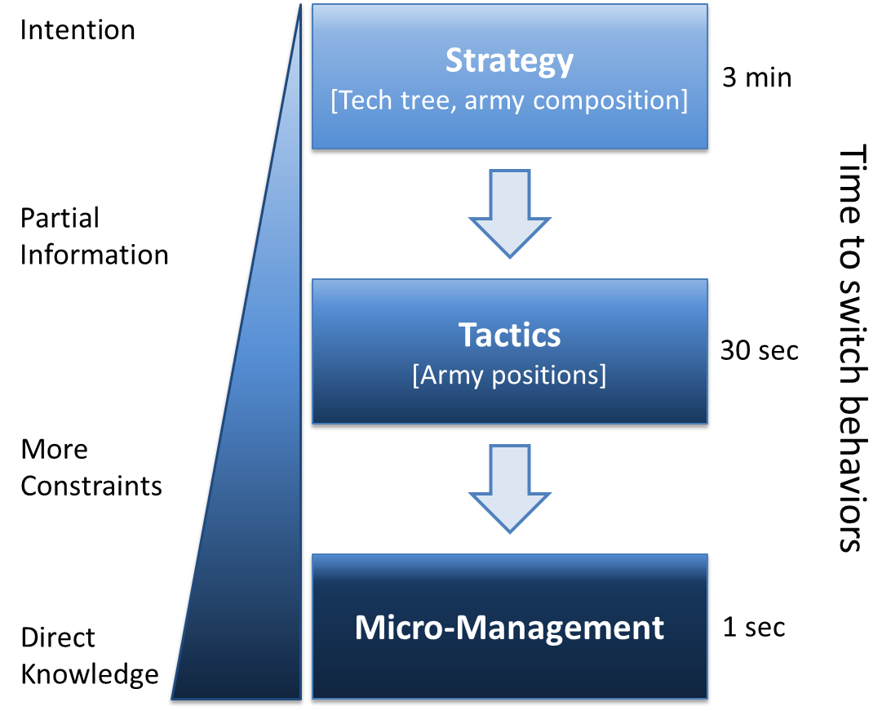
Strategy Games
StarCraft
Strategic real-time strategy game of high complexity
Challenges: real-time, high branching factor, hidden info
Early AI agents: moderate performance; work focused on only part of the problem, commonly playing it at some level of abstraction; e.g. divide the different levels of decision-making (Strategy, Tactics and Micro-Management)
Recent AI: AlphaStar and variants reaching grandmaster level
Notes:
[see Section 6.7.2 for more details]

Slide 123
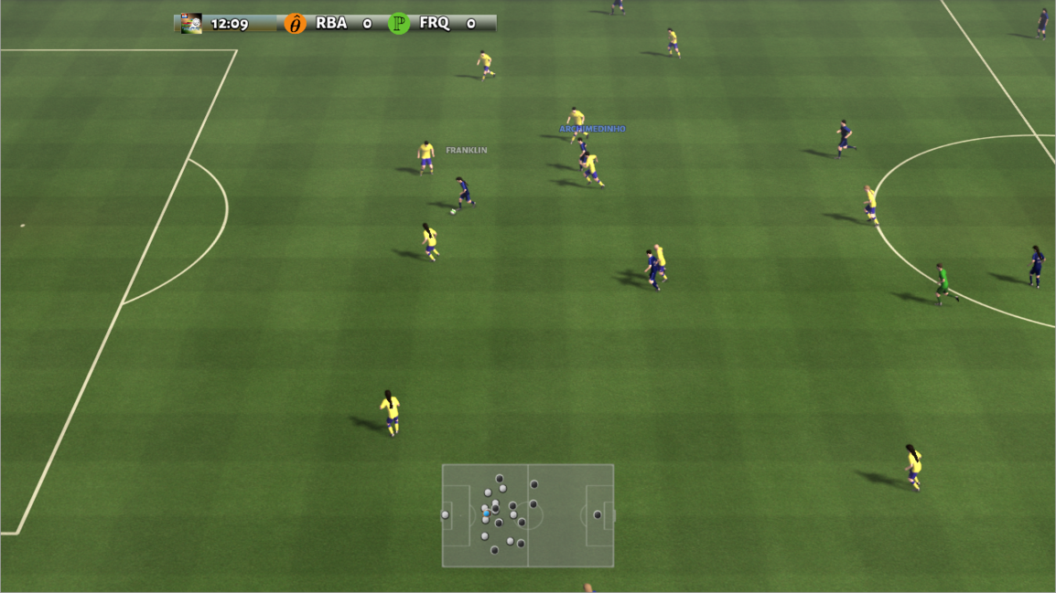
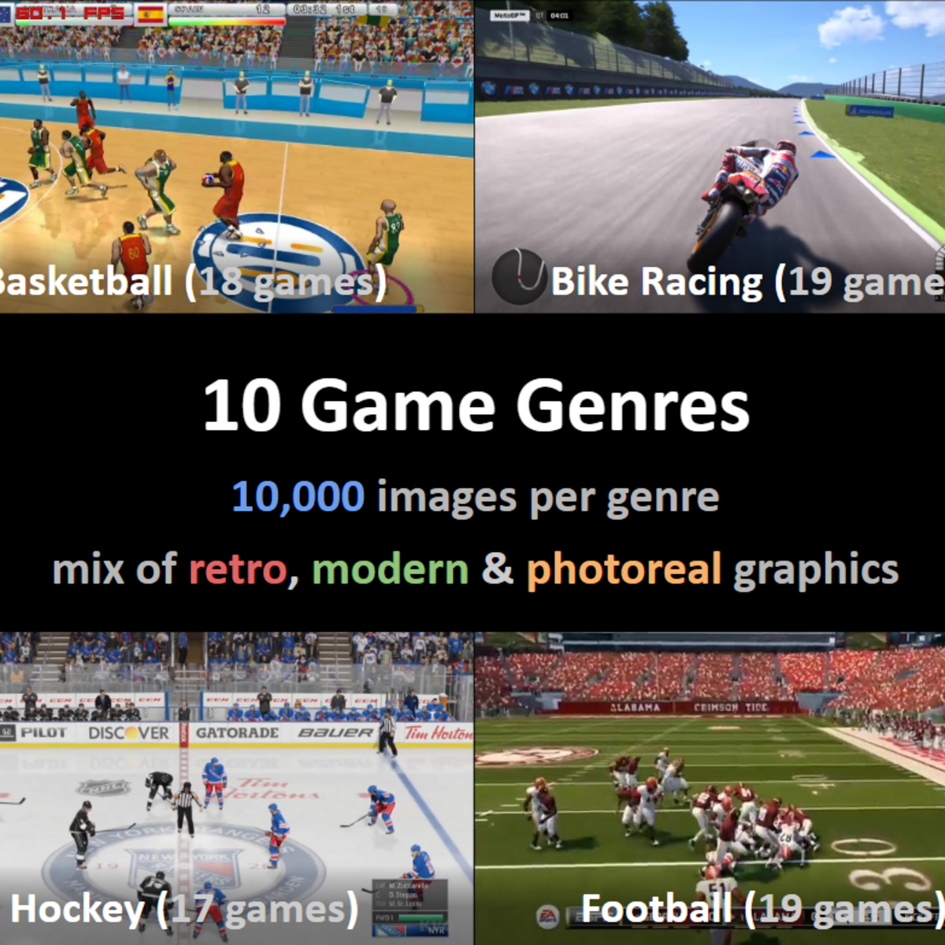
Strategy Games
Team Sports Games
Coordination of multiple units that work together towards the goal of beating the other team.
RoboCup (since 1996): several simulation leagues in 2D / 3D. Hard to disentangle gameplaying from problems derived from robotics.
Google Research Football Environment:: a recent yet increasingly popular framework for studying RL.
Sports10 dataset was created to enable studies on style-invariant representation learning for gameplaying. Contains 100k gameplay images of 175 different sport games across 10 genres.
Notes:
[see Section 6.7.3 for more details]

Slide 124

Text-Based Games
Games in which players must use natural language commands to play, by interacting with objects and characters and solving puzzles. Fantasy is a popular genre for text-based games (aka interactive fiction), e.g., Zork and like Façade
Interactive fiction
AI as NLP, Deep learning (LSTM, Deep Q networks) for text processing and generation
Recent years: Text-based interaction dominated by LLMs; both playing such games and providing NPC interaction. e.g. AI People
Notes:
[see Section 6.8 for more details]

Slide 125
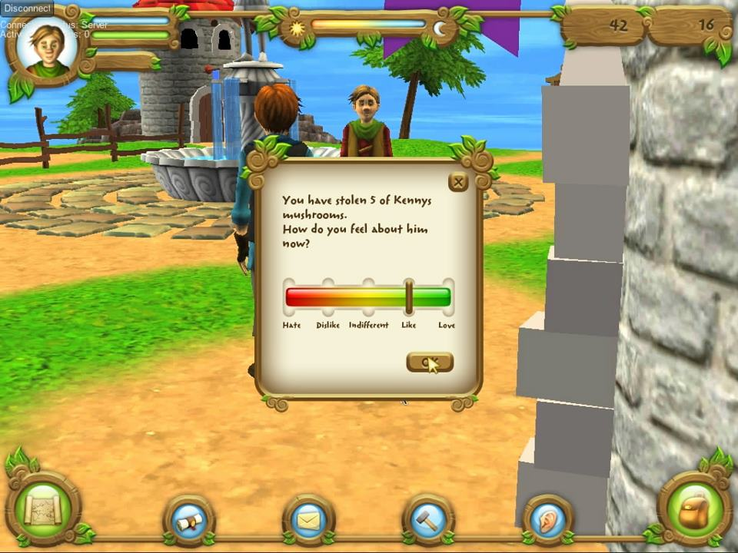
Social Simulation Games
Games in which players explore social interactions with multiple other game characters predominantly controlled by AI; e.g., The Sims series and Animal Crossing.
Popular AI Methods: Ad-hoc designed believable agent architectures, expressive agents, conversational agents and utility-based AI
Recent methods are LLM-dominated; e.g. Smallville by Park et al. (2023)
Park et al.,. Generative agents: Interactive simulacra of human behavior. In Proceedings of the 36th Annual ACM Symposium on User Interface Software and Technology, pages 1–22, 2023.
Notes:
[see Section 6.9 for more details]

Slide 126
Game AI
Play Games
Generate Content
Model Players
G. N. Yannakakis and J. Togelius, “Artificial Intelligence and Games,” Springer, 2025.

Slide 127
Readings: Part II
gameaibook.org
Notes:
See Section 6.10 for further reading and Section 6.11 for exercises related to Play.

