Slide 1

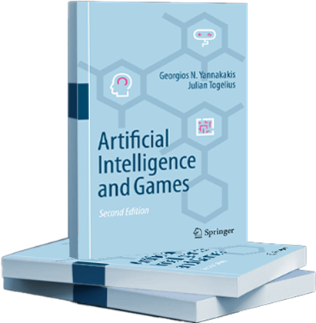
Artificial Intelligence and Games Generate
Notes:
These are the slides accompanying the book Artificial Intelligence and Games through the gameaibook.org website

Slide 2

Readings: Part III
gameaibook.org

Slide 3
Game AI
Play Games
Generate Content
Model Players
G. N. Yannakakis and J. Togelius, “Artificial Intelligence and Games,” Springer Nature, 2025.
Notes:
As a reminder: “Generate Content” is identified as one of the three major roles of AI in games in this book.

Slide 4
Game AI
Play Games
Generate Content
Model Players
G. N. Yannakakis and J. Togelius, “Artificial Intelligence and Games,” Springer Nature, 2025.
Notes:
The focus of this slide deck is on the role of AI for generating content

Slide 5
Overview
Procedural Content Generation (PCG)
What is it?
Why we need it?
Constructive Approaches
Search-Based PCG
Machine Learning PCG
PCG though QD
PCG via RL
PCG via LLM
Mixed-Initiative PCG
Experience-Driven PCG
Experience-Driven PCG via RL
Notes:
The overview of the slide-deck

Slide 6
Chapter 7: Procedural Content Generation
Notes:
[see Chapter 8 for more details]

Slide 7
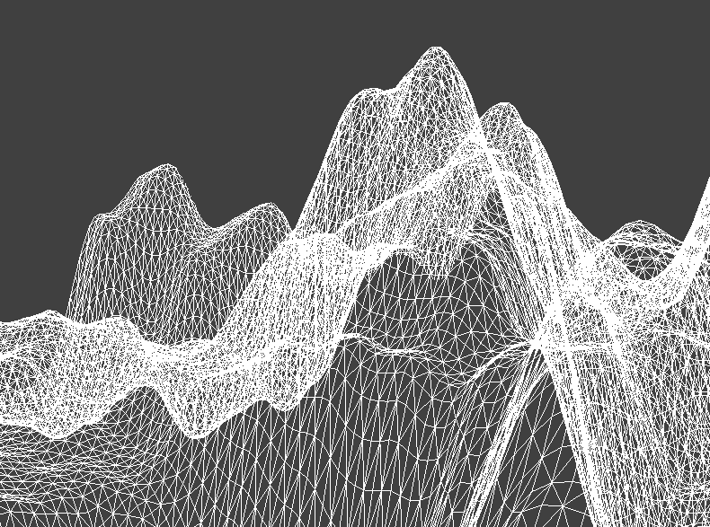
What is Procedural Content Generation?
“The creation of new game content automatically, through algorithmic means”
Notes:
Simply put, PCG refers to methods for generating game content either autonomously or with only limited human input.

Slide 8
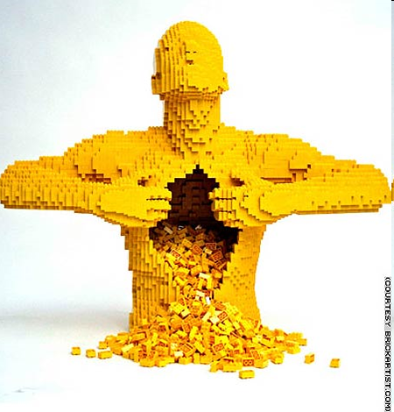
What is Game Content?
Content can be:
NPC behavior (aspects)
Quest/story/narrative
Camera profiles
Audiovisual settings
Levels/maps/tracks
Items
Game mechanics
Reward schedules
…
Everything together?
Content is the game context
Content has differing quality (ability to player experience elicitation)
Notes:
Game content is that which is contained in a game: levels, maps, game rules, textures, stories, items, quests, music, weapons, vehicles, characters, etc.

Slide 9
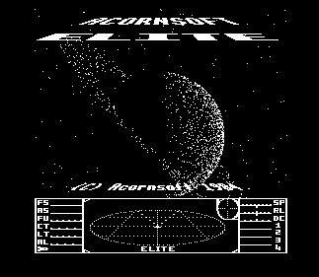
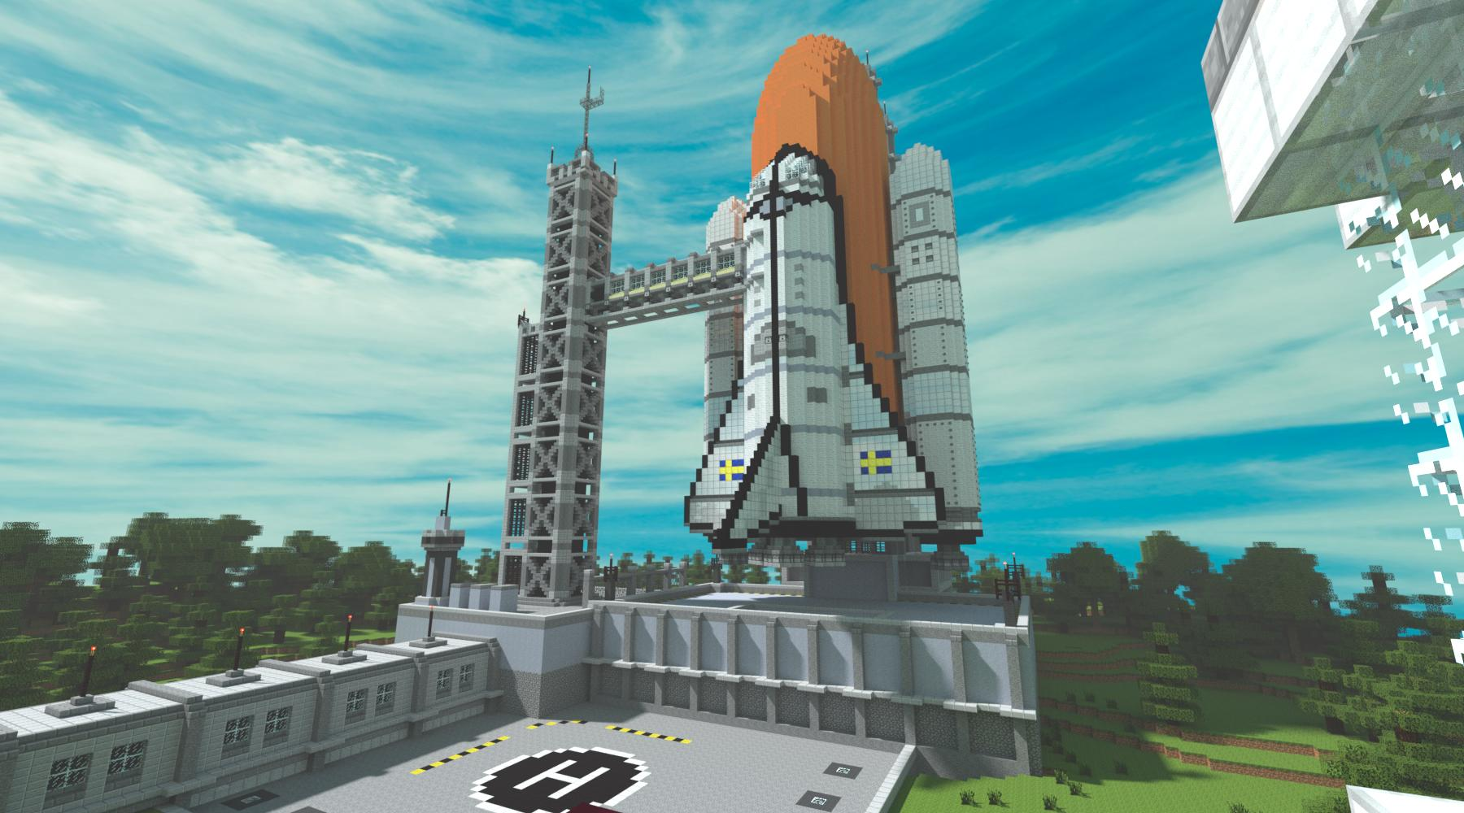
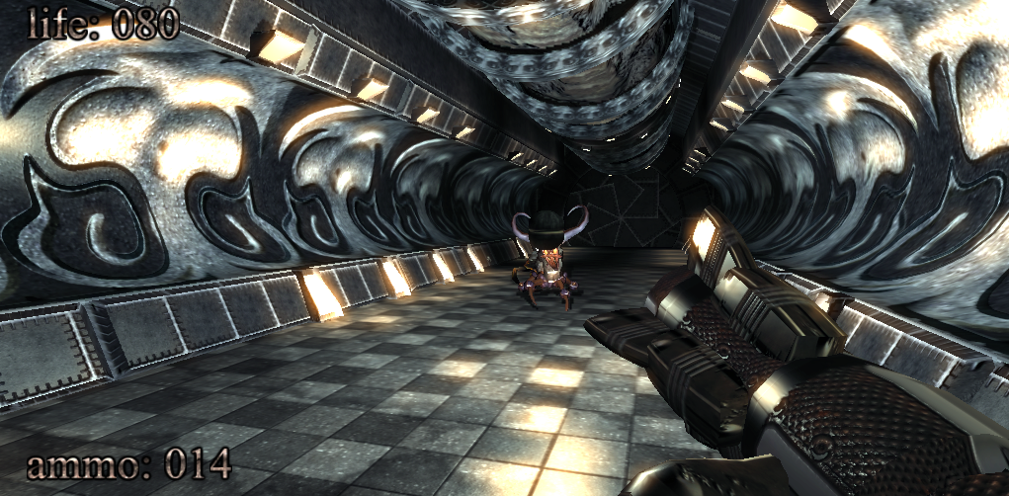
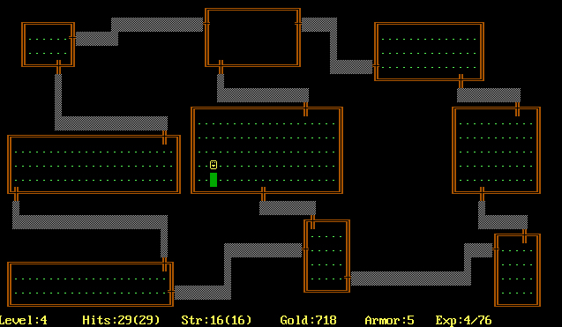

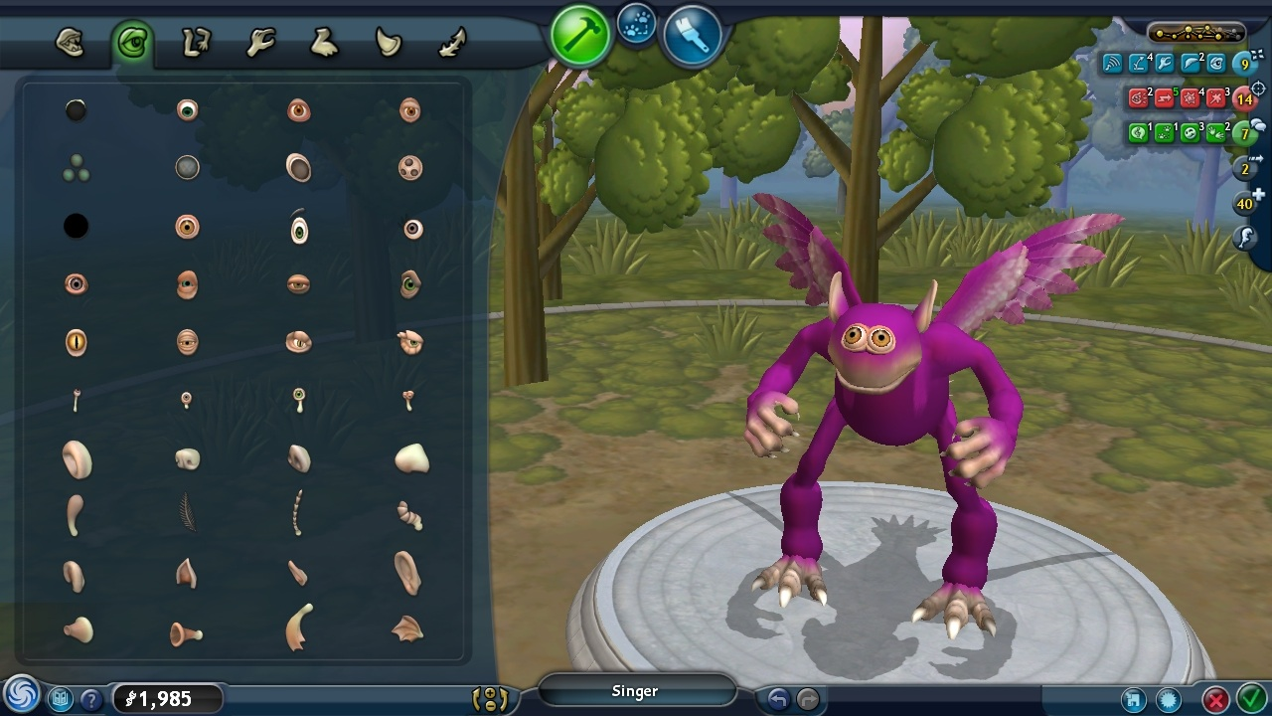
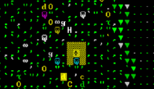
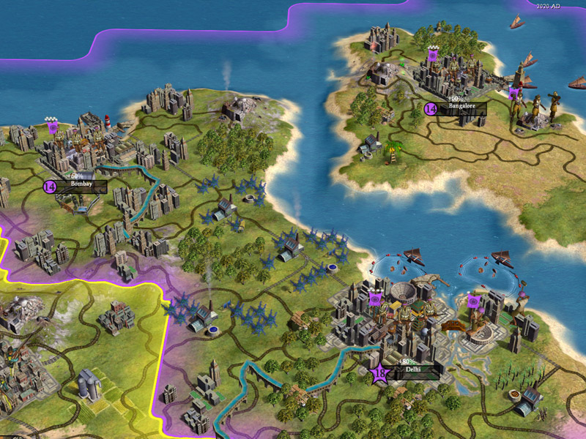
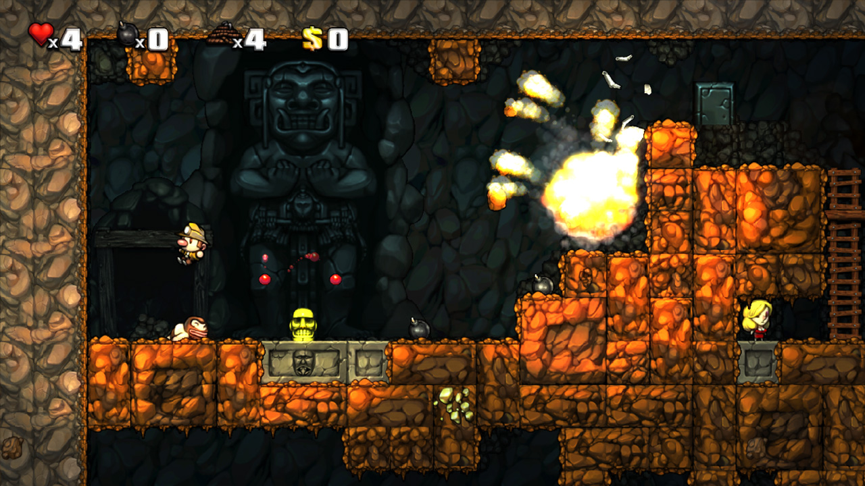
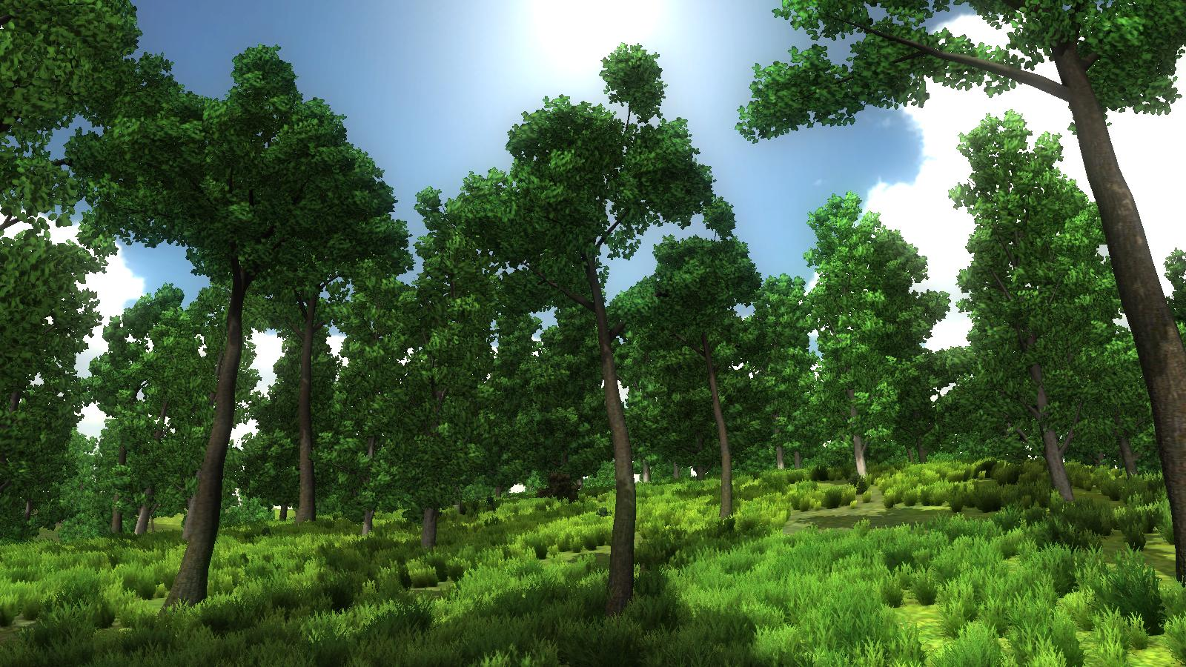
PCG in Industry
Notes:
[see introduction of Chapter 7 for more details]
Procedural content generation (PCG) is an area of game AI that has seen an explosive growth of interest.
Games that incorporate some procedurally generated content have existed since the early 1980s. Some Examples:
Dungeon crawler Rogue (1980) – level generation [top right]
Space trading simulator Elite (1984) [top left image]
.kkrieger is a FPS made entirely with 96 kb of memory [top right image]
SpeeTree (bottom right): vegetation and tree generation software/dev tool
Minecraft – pseudo-random level generation [top middle]
Spelunky - level generation [bottom middle]
Civilization – level generation [bottom left]
Borderlands – weapon generation [middle left]
Hundreds of commercial games feature PCG by now… e.g. according to pcg.wikidot

Slide 10
PCG in Academia
Prior to 2005 or so: (crickets)
After 2005, a steadily growing number of papers
An IEEE Task Force
Key venues: IEEE CoG, FDG, AIIDE, IEEE ToG, PCG Workshop
A book: pcgbook.com
Most papers are about level or map generation
Also papers about generation of texture, music, rules, quests, items, weapons, bosses…
Somewhat constrained by a lack of good testbed games
A paradigm shift over the years: ML-based PCG (generative AI in games), Mixed-Initiative PCG, Experience-driven PCG, PCGRL, PCGQD,…
Notes:
[see introduction of Chapter 7 for more details]
Research interest in academia has really picked up within the second half of the 00s

Slide 11

Why Generate Content?
Achieve a specific aesthetic
AI-assistive tools
Replayability through variation
Making infinite or player-adaptive games
Surpassing human creativity
Saving cost on content production
Co-creativity
Saving storage space
Notes:
[see Section 7.1 for more details]

Slide 12
Pie Chart of Questionable Origin and Veracity
Notes:
The Figure illustrates a cost breakdown of an average AAA game and showcases the dominance of artwork and marketing in that process. Art, programming, and debugging constitute around 50% of the cost of an AAA game. Essentially, PCG can assist in the processes of art and content production, thus directly contributing to the reduction of around 40% of a game’s cost.

Slide 13
What Can PCG Do?
Can we drastically cut game development costs by creating content automatically from designers’ intentions?
Can we create games that adapt their game worlds to the preferences of the player?
Can we create endless games?
Can the computer circumvent or augment limited human creativity and create new types of games?
Can we understand game design through formalizing the design process?
Notes:
[see Section 7.1 for more details]

Slide 14

What Are the Trade-offs?
Speed Real-time? Or design-time?
Reliability Catastrophic failures break gameplay
Controllability Allow specification of constraints and goals
Diversity Content looks like variations on a theme
Creativity Content looks “computer-generated”
Notes:
[see Section 7.1 for more details]
The challenges and key questions of PCG. Some questions have been addressed to a good degree by now; some questions generate more questions than answers

Slide 15
A PCG Taxonomy
Notes:
[see Section 4.2 for more details]
With the variety of content generation problems, methods and approaches that are available, it helps to have a structure that can highlight the differences and similarities between them.

Slide 16
Notes:
[see Section 7.2 for more details]
The taxonomy consists of a number of dimensions, where an individual method or solution should usually be thought of as lying somewhere on a continuum between the ends of that dimension. Beyond the taxonomy for the content types and the PCG methods we provide an outline of the roles a PCG algorithm can take

Slide 17
Notes:
[see Section 7.2.1 for more details]
PCG can be used to generate necessary game content that is required for the completion of a level, or it can be used to generate optional content that can be discarded or exchanged for other content. The main distinguishing feature between necessary and optional content is that necessary content should always be correct while this condition does not hold for optional content.
The second axis of our taxonomy distinguishes between functional content, which has functional roles, and decorative content. Decorative content simply means that it does not need to fulfil a function where it enables certain interactions. One way of thinking about it is that if you played a game blind, with no visual or aural input, only functional content would matter. Another way of thinking about it is that decorative content can often be produced without knowing the details of the mechanics of the game.
The spatiality dimension ranges from spatial (levels, maps, 3D and 2D objects) to non-spatial (stories, music). There are types of content that have less than full spatiality as well; for example, quests are often represented as graphs that fit within a spatial representation of a level.

Slide 18
Notes:
[see Section 7.2.2 for more details]
PCG algorithms can be classified according to a number of properties such as their level of determinism, controllability, testing, learning and iterativity.
Determinism: amount of randomness in content generation. Stochasticity allows an algorithm to offer great variation, necessary for many PCG tasks, at the cost of controllability. While content diversity and expressivity are desired properties of generators, the effect of randomness on the final outcomes can only be observed and controlled after the fact. Completely deterministic PCG algorithms, on the other hand, can be seen as a form of data compression (e.g. .kkrieger)
Controllability: The generation of content can be controlled in different ways. The use of a random seed is one way to gain control over the generation space; another way is to use a set of parameters that control the content generation along a number of dimensions.
Testing: Another distinction may be made between algorithms that can be called constructive and those that can be described as generate-and-test. A constructive algorithm
generates the content once, and is done with it; however, it needs to make sure that the content is correct or at least “good enough” as it is being constructed.
Learning: it considers the existence or lack of an underlying learning process for content generation. On one end of the spectrum we meet methods that are entirely authored and do not involve any machine learning tasks. On the other end of the spectrum, we meet methods that generate content via machine learning techniques (trained)
Iterativity: PCG methods can be classified as single pass when they generate content once and they don’t iterate over their generated outcome (e.g., pre-trained neural networks or GANs). Alternatively, methods can be classified as iterative when they are required to iterate over their generated content (e.g., cellular automata, diffusion models, RL, and LLMs that are prompted several times)

Slide 19
Notes:
[see Section 7.2.3 for more details]
Temporality: PCG systems that consider designers while they generate content or they operate interdependently of designers; the same applies for players. Ultimately any of those PCG systems can run in design (offline) or play time (runtime).
Autonomy: PCG can act either autonomously or as a collaborator in a mixed-initiative fashion.
Adaptivity: PCG algorithms may consider the player experience in whatever they try to generate (experience-driven) or instead, ignore the player (experience-agnostic).

Slide 20
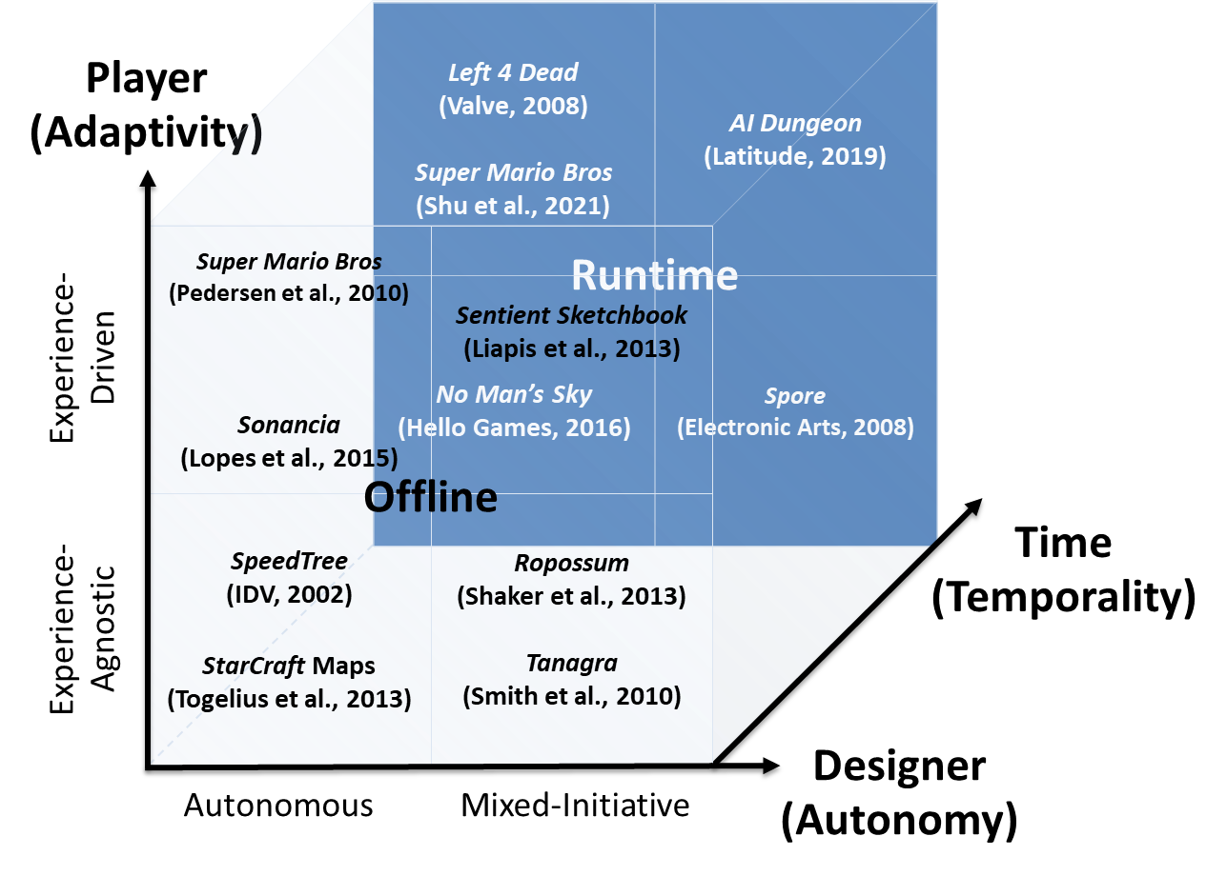
Notes:
[see Section 7.2.3 for more details]
The figure visualizes the key roles of PCG in games across the dimensions of designer, player, and time, corresponding, respectively, to the dimensions of autonomy, adaptivity and temporality of the PCG taxonomy (earlier slide)

Slide 21
Content
Optional
Type
Necessary
Decorative
Functionality
Functional
Non-Spatial
Spatiality
Spatial
Method
Stochastic
Determinism
Deterministic
Non-Controllable
Controllability
Controllable
Constructive
Testing
Generate-and-test
Authored
Learning
Trained
Single Pass
Iterativity
Iterative
Role
Offline
Temporality
Runtime
Autonomous
Autonomy
Mixed-Initiative
Computational Game Creativity
Experience-Agnostic
Experience-Driven
Experience-Driven PCG
Adaptivity
Notes:
By viewing the dimensions (roles) of “autonomy” and “adaptivity” from a different perspective we can, respectively, refer to computational game creativity and experience-driven PCG
In the following part we focus on the notion of computational game creativity: from mixed-initiative generation all the way to completely autonomous generation.

Slide 22
Computational Creativity in and for Games!
Liapis, Yannakakis, Togelius: "Computational Game Creativity," in Proceedings of the Fifth International Conference on Computational Creativity, 2014.
Notes:
Refer to the cited paper for more details

Slide 23

Computational Creativity
“Computational Creativity is a recent area of creativity research that brings together academics and practitioners from diverse disciplines, genres and modalities, to explore the potential of computers to be autonomously creative or to collaborate as co-creators with humans.”
-- PROSECCO Network of Excellence
Notes:
“Computational Creativity” as defined by the PROSECCO network of excellence

Slide 24
Computational Game Creativity
“The study of Computational Creativity within and for digital games”
Within: Games as an ideal canvas for studying CC
For: Games benefit as products from artifacts of CC
Liapis, Yannakakis, Togelius: "Computational Game Creativity," in Proceedings of the Fifth International Conference on Computational Creativity, 2014.
Notes:
“Computational Game Creativity” as defined by Liapis et al. (2014)
Games challenge and advance computational creativity (and AI at large)

Slide 25
Player (Experience)
Super Mario Bros (Pedersen et al., 2010)
Sonancia
(Lopes et al., 2015)
Sentient Sketchbook (Liapis et al., 2013)
Experience Driven
SpeedTree (IDV, 2002)
StarCraft Maps (Togelius et al., 2013)
Garden of Eden Creation Kit (Bethesda, 2009)
Ropossum
(Shaker et al., 2013)
Tanagra
(Smith et al., 2010)
Experience Agnostic
Designer (Initiative)
Autonomous
Mixed-Initiative
Notes:
[see Section 7.2.3 for more details]
We identify two axes across which PCG roles can be placed: players and designers
We envision PCG systems that consider designers while they generate content or they operate interdependently of designers; the same applies for players. The figure visualizes the key roles of PCG in games across the dimensions of designer initiative and player experience.
PCG can act either autonomously or as a collaborator in the design process. We refer to the former role as autonomous generation and the latter role as mixed-initiative generation. Further, we cover the experience-driven PCG role by which PCG algorithms consider the player experience in whatever they try to generate. Finally, if PCG does not consider the player as part of the generation process it becomes experience-agnostic.
We will first focus on autonomous, experience-agnostic generation and look at some indicative examples in the area
The role of autonomous generation is arguably the most dominant PCG role in
games.
Note the fuzzy borderline between mixed-initiative and autonomous PCG systems. It might be helpful, for instance, to consider autonomous PCG as the process by which the role of the designer starts and ends with an offline setup of the algorithm.

Slide 26
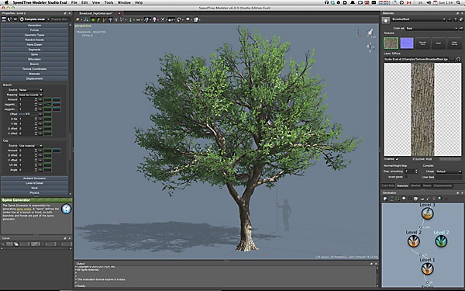
Notes:
For instance, the designer is only involved in the parameterization of the algorithm as in the case of SpeedTree (IDV, 2002).

Slide 27
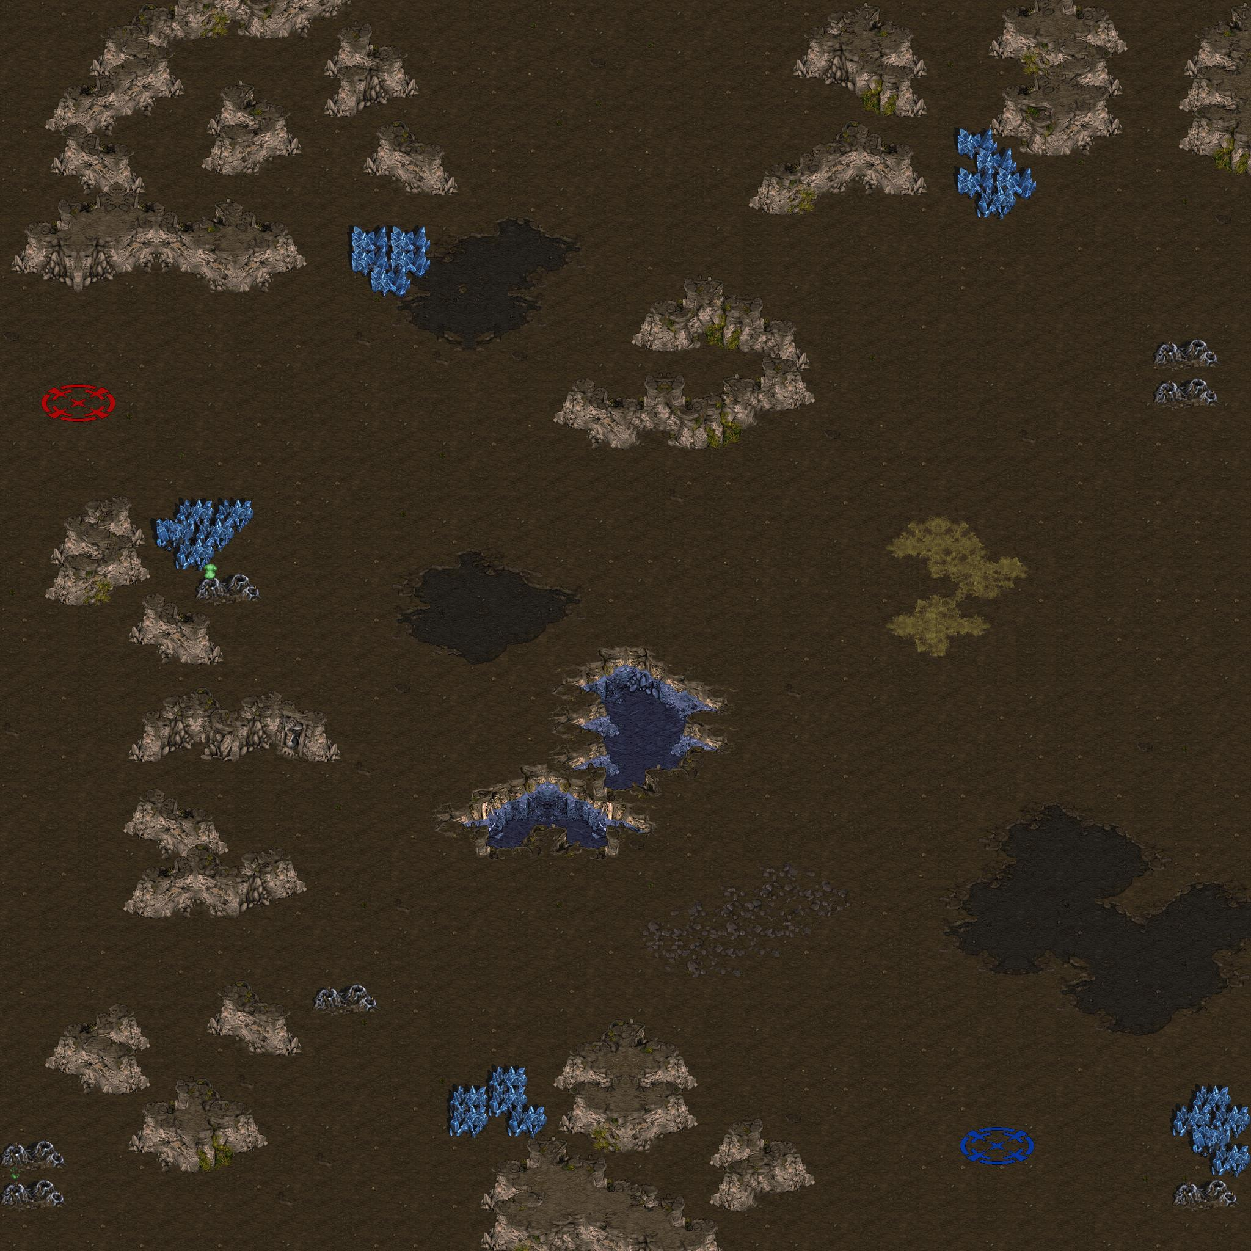
Togelius, Julian, Mike Preuss, Nicola Beume, Simon Wessing, J. Hagelback, and Georgios N. Yannakakis. "Multiobjective exploration of the Starcraft map space." In Computational Intelligence and Games (CIG), IEEE Conference on, pp. 265-272, 2010.
Notes:
This is a Starcraft map generated autonomously via multiobjective evolution. Objectives included balance and symmetry. Further details can be found in the referenced paper

Slide 28
Deep Learning Meets Novelty Search
Liapis, Martínez, Togelius, and Yannakakis: "Transforming Exploratory Creativity with DeLeNoX," in Proceedings of the Fourth International Conference on Computational Creativity, 2013.
Content Generation (Training Data)
Exploration
Novelty Search
(NEAT)
Transformation
Deep Learning
(Stacked Autoencoders)
Search function
Notes:
In this work Deep Learning (stacked autoencoders) are used in combination with novelty search (via NEAT) to drive the generation of increasingly complex and novel content (spaceships in this example) in an iterative fashion. The DeLeNoX system realises a process named “transformational exploration”.
The basic steps of DeLeNoX are as follows: 1) Content is generated in massive amounts to provide training data; 2) In the transformation phase, content is deep learned (unsupervised learning) resulting in compact representations of the generated content; 3) Such representations are used as inputs to the final layers of a neural network; 4) During the exploration phase, novelty search shapes Neuroevolution of Augmenting Topologies (NEAT) networks which provide content that is increasingly novel and complex as the network’s architecture grows.

Slide 29
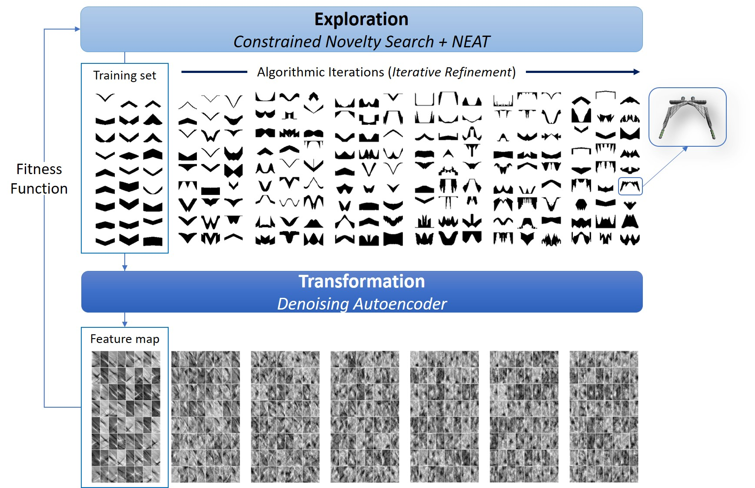
Deep Learning Meets Novelty Search
Liapis, Martínez, Togelius, and Yannakakis: "Transforming Exploratory Creativity with DeLeNoX," in Proceedings of the Fourth International Conference on Computational Creativity, 2013.
Notes:
The top images display the evolution of spaceships (from left to right) whereas to bottom images illustrate the autoencoder feature maps constructed at each generation (from left to right). DeLeNoX renders its graphical output in 3D (spaceships on the left)

Slide 30
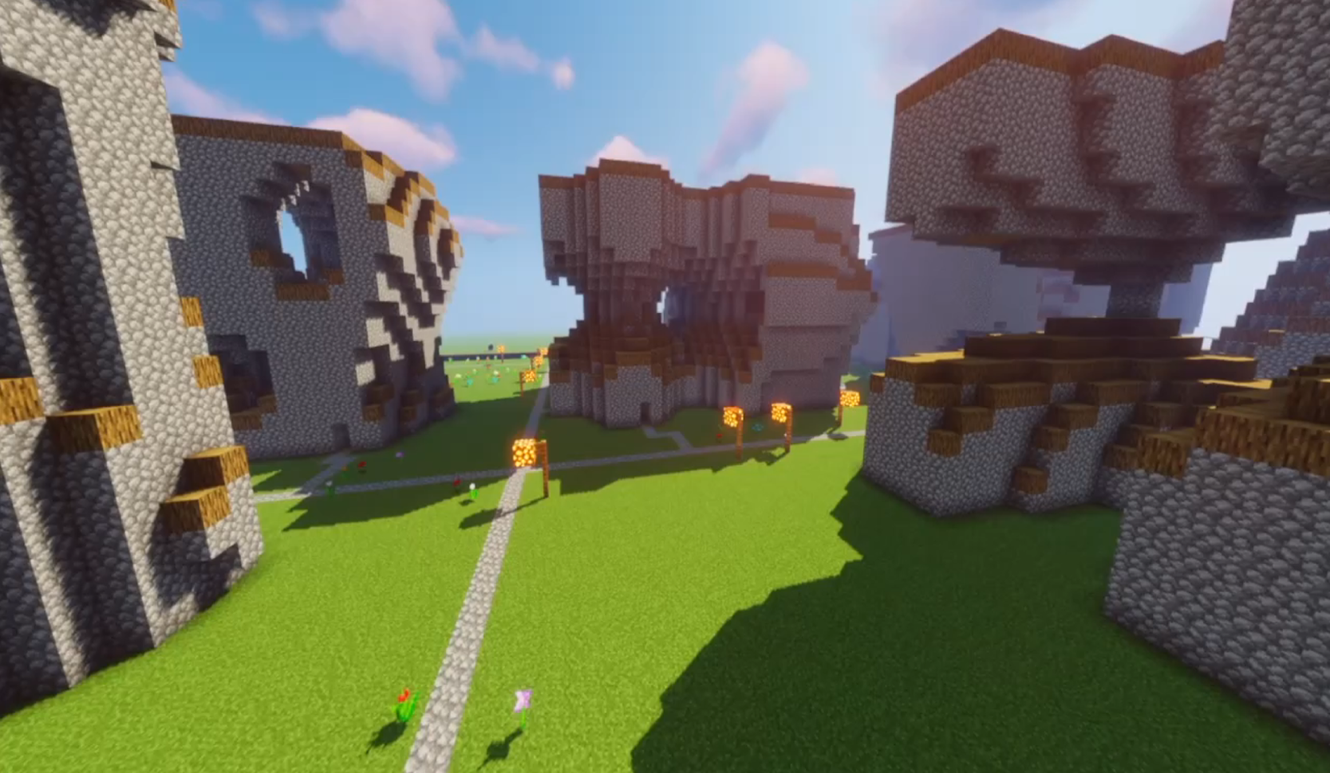
Barthet, Liapis, and Yannakakis. Open-Ended Evolution for Minecraft Building Generation IEEE Transactions on Games (2022)
Notes:
In this video we can observe the evolution of DeLeNoX. Open-ended evolution and DeLeNoX principles are used for Minecraft building Generation. See more details in the referenced paper.

Slide 31
Player (Experience)
Super Mario Bros (Pedersen et al., 2010)
Sonancia
(Lopes et al., 2015)
Sentient Sketchbook (Liapis et al., 2013)
Experience Driven
SpeedTree (IDV, 2002)
StarCraft Maps (Togelius et al., 2013)
Garden of Eden Creation Kit (Bethesda, 2009)
Ropossum
(Shaker et al., 2013)
Tanagra
(Smith et al., 2010)
Experience Agnostic
Designer (Initiative)
Autonomous
Mixed-Initiative
Notes:
[see Section 7.2.3 for further details]
Let us now focus on experience-agnostic, mixed-initiative generation and look at some indicative examples in the area

Slide 32
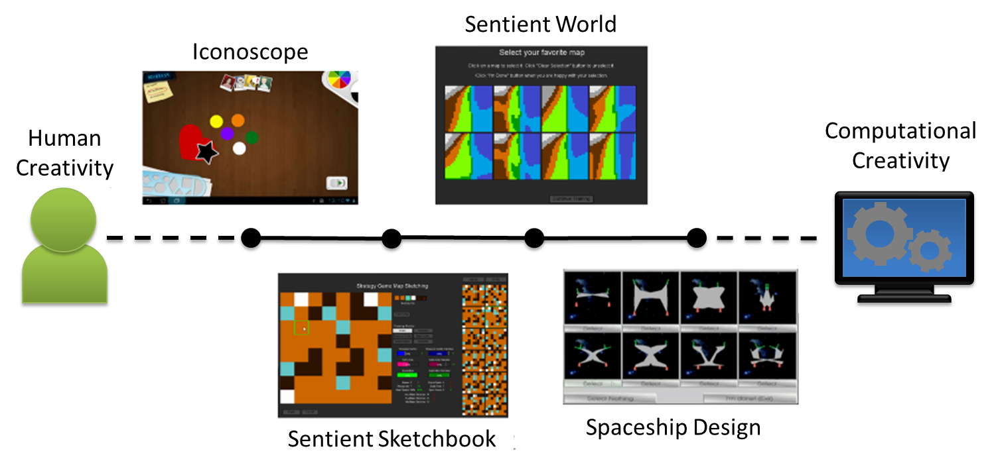
Notes:
[see Section 7.2.3 for further details]
AI-assisted game design refers to the use of AI-powered tools to support the game design and development process. AI can assist in the creation of game content varying from levels and maps to game mechanics and narratives.
The figure illustrates the mixed-initiative spectrum between human and computer initiative (or creativity) across a number of mixed-initiative design tools.
From left to right:
Iconoscope: mostly designer initiative but boosts creativity through automated suggesions
Sentient Sketchbook – active sketching of a map (more on this tool in upcoming slides)
Sentient World – a few clicks only required by the designer; mixed-intitiave design is realised by interactive evolution (more on this tool in upcoming slides)
SpeedTree – only a few parameters need to be instantiated by the designer; the tool the generates trees and vegetation autonomously

Slide 33
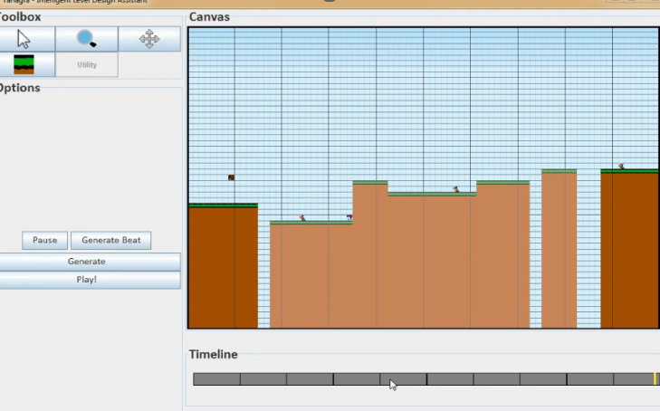
Tanagra: Constraint Solver for MI-PCG
Notes:
Tanagra is an early example of mixed-initiative platformer level generation which is based on the design principle of rhythm. Tanagra used constraint solvers to generate levels; the generation process is guided through designer initiatives. Further details about Tanagra can be found in the referenced paper by Smith et al

Slide 34
Ropossum
Physics-based puzzle “cut the rope”
evolutionary grammars for creating new puzzles
playability module for testing how (if?) to solve a puzzle
using the designer’s input in complete or partial designs
M. Shaker, M. H. Sarhan, O. A. Naameh, N. Shaker, and J. Togelius. Automatic generation and analysis of physics-based puzzle games. In Computational Intelligence in Games (CIG), 2013 IEEE Conference on.
Notes:
Another mixed-initiative example is Ropossum. In Ropossum the designer may select to design elements of Cut the Rope (Chillingo, 2010) game levels; the generation of the remaining elements are left to evolutionary algorithms to design.
For more details please refer to the cited paper

Slide 35
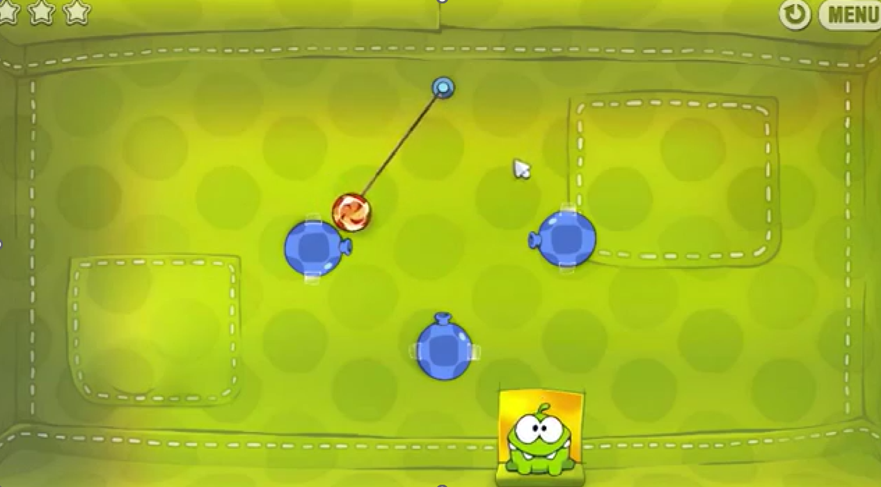
Ropossum

Slide 36
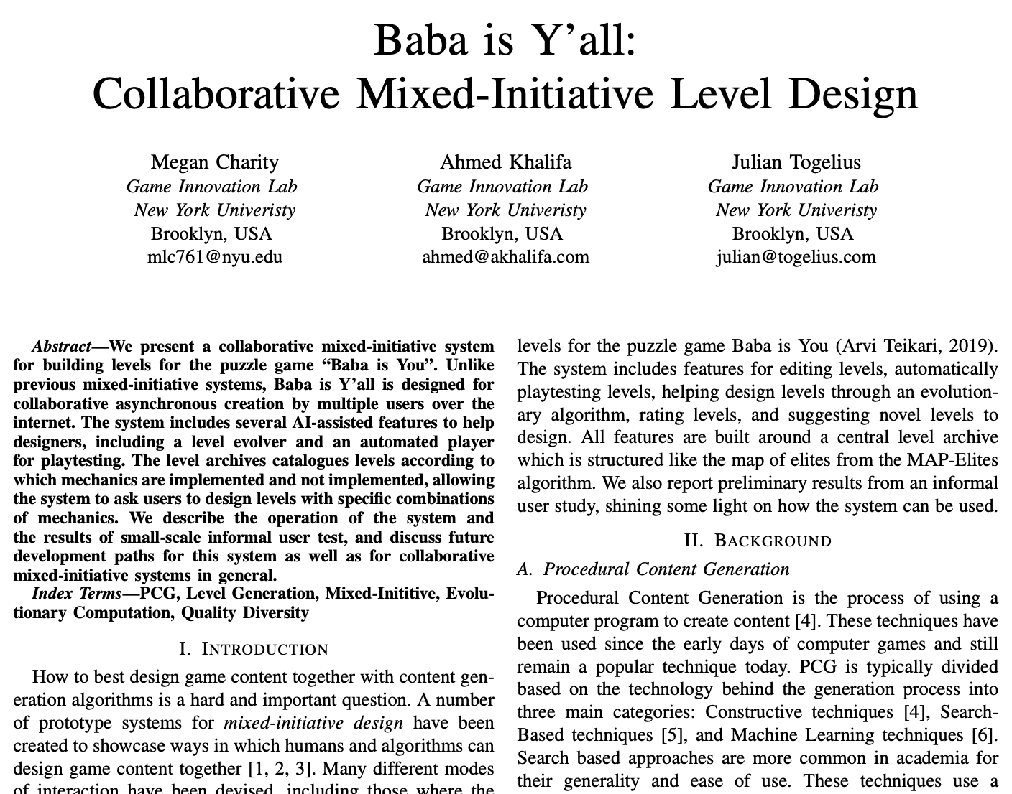

Slide 37
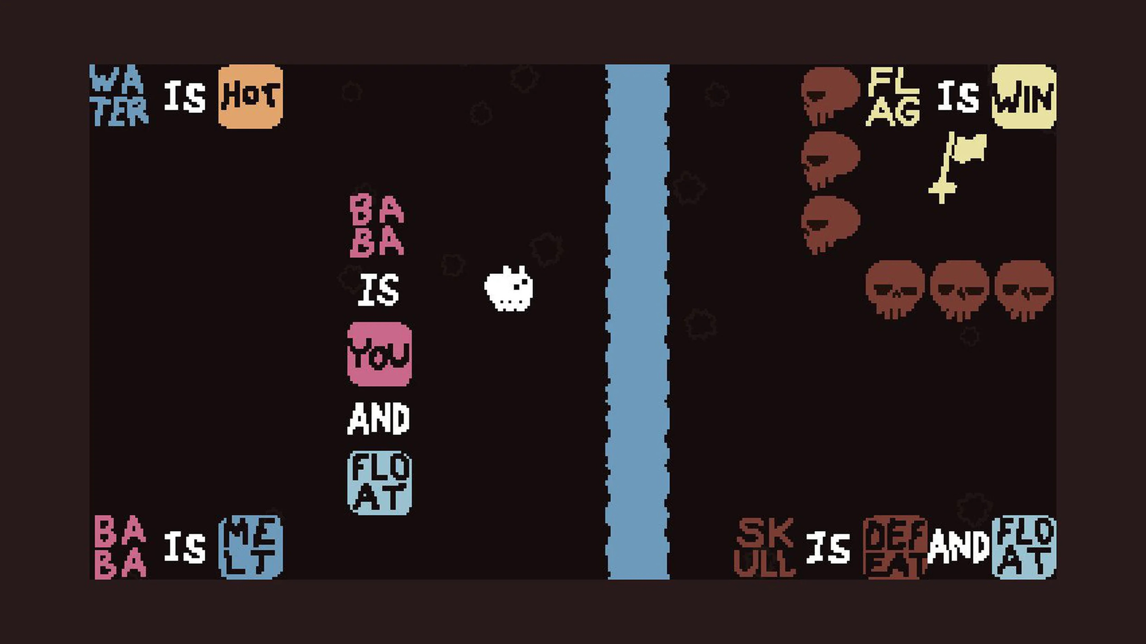

Slide 38
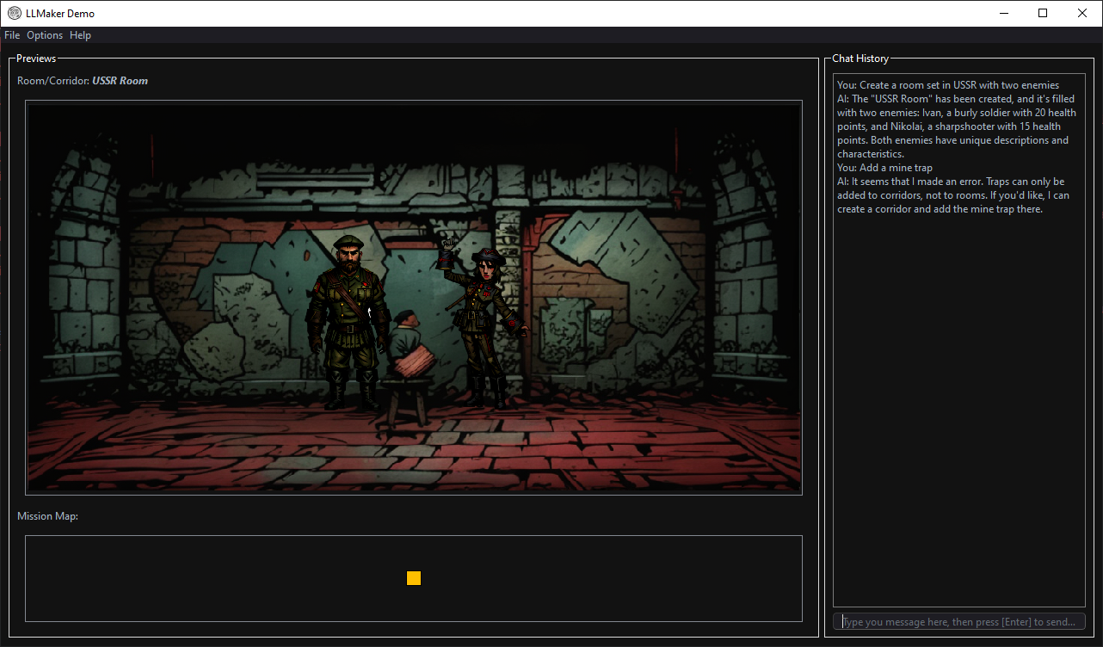
LLMaker
Gallotta, Liapis, Yannakakis, LLMaker: A Game Level Design Interface Using (Only) Natural Language, in Proc. of IEEE CoG, 2024
Notes:
A chat-based game design application
Test domain: dungeon crawler-like video game, akin to Darkest Dungeon
LLM acts as “expert”, translating user requests into commands
Function calling ensures correctness of content
Stable diffusion models generate graphical assets

Slide 39
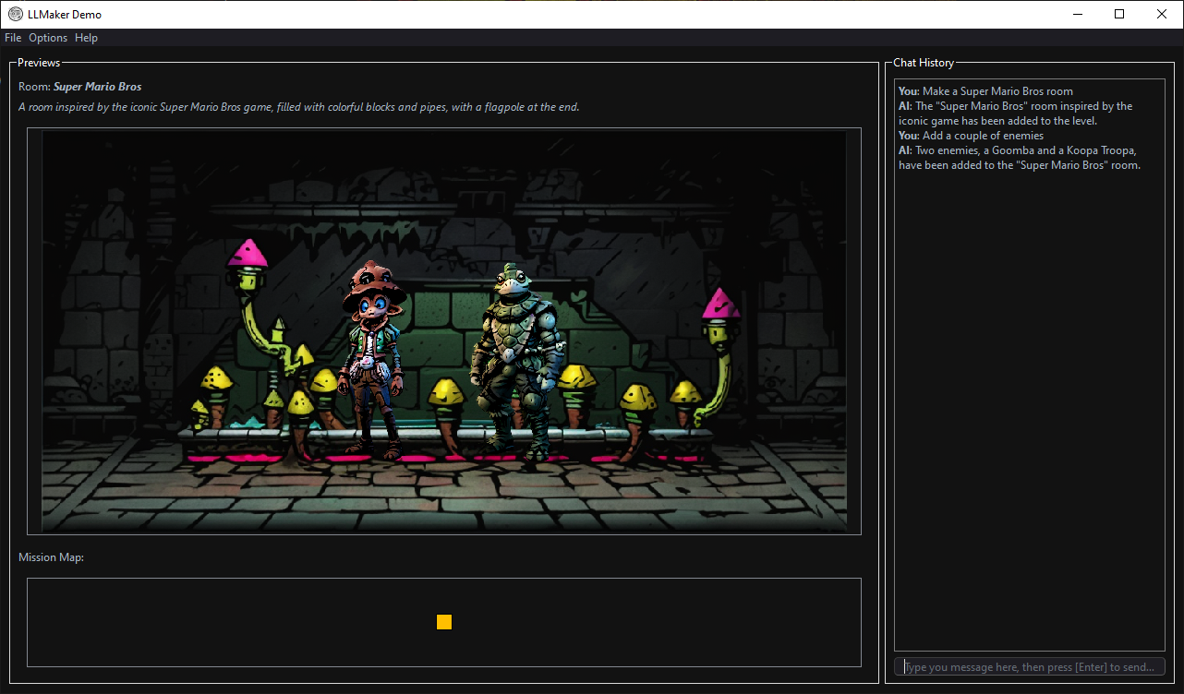
LLMaker
Gallotta, Liapis, Yannakakis, LLMaker: A Game Level Design Interface Using (Only) Natural Language, in Proc. of IEEE CoG, 2024
Notes:
A chat-based game design application
Test domain: dungeon crawler-like video game, akin to Darkest Dungeon
LLM acts as “expert”, translating user requests into commands
Function calling ensures correctness of content
Stable diffusion models generate graphical assets

Slide 40
Player (Experience)
Super Mario Bros (Pedersen et al., 2010)
Sonancia
(Lopes et al., 2015)
Sentient Sketchbook (Liapis et al., 2013)
Experience Driven
SpeedTree (IDV, 2002)
StarCraft Maps (Togelius et al., 2013)
Garden of Eden Creation Kit (Bethesda, 2009)
Ropossum
(Shaker et al., 2013)
Tanagra
(Smith et al., 2010)
Experience Agnostic
Designer (Initiative)
Autonomous
Mixed-Initiative
Notes:
[see Section 7.2.3 for further details]
Now that we have covered the experience-agnostic paradigm (either autonomous or mixed-initiative) we will focus on experience-driven generation and look at some indicative examples in the area (either autonomous or mixed-initiative).

Slide 41
Game AI
Model you!
Design your Game!
Yannakakis and Togelius, Experience-driven Procedural Content Generation, IEEE Transactions on Affective Computing, 2011.
Notes:
In a broad sense Experience-driven PCG can be viewed as the intersection of player modelling (Chapter 5) and PCG.

Slide 42
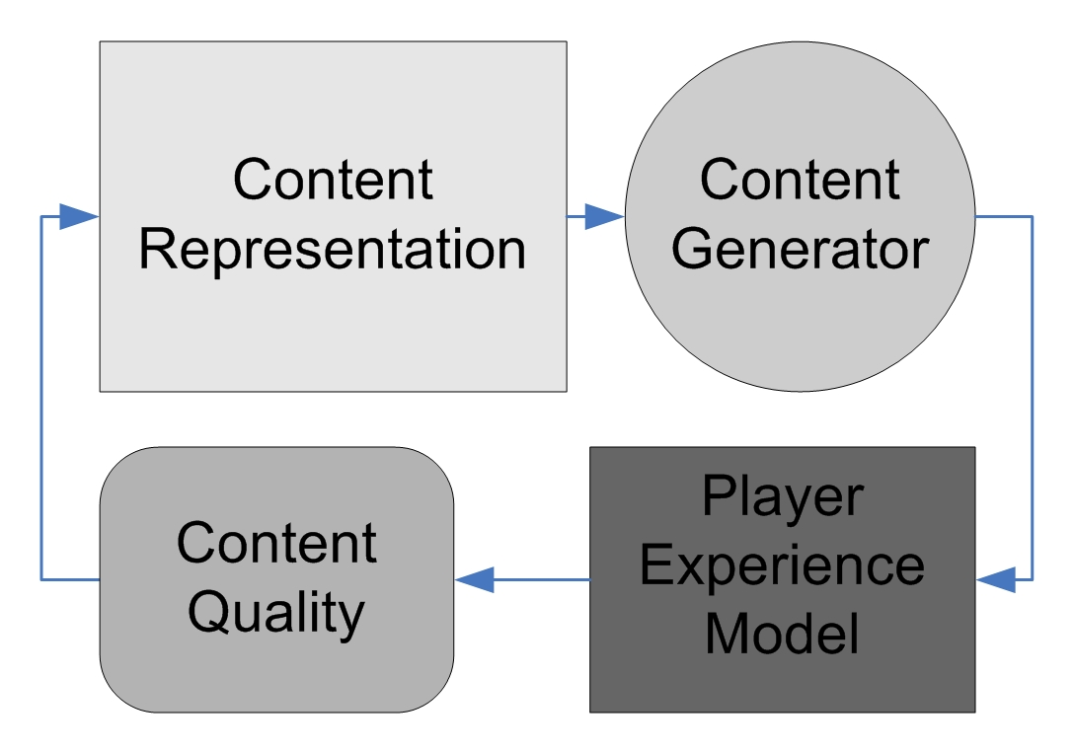
A General PCG Framework
Content is the building block of player experience
Search-based PCG: use optimization algorithms (such as evolutionary algorithms) to search the space of content
Experience-driven PCG: base evaluation function on player experience models

Slide 43
EDPCG: What is it?
“A framework for personalised generation of content in human computer interaction (in particular in games). It views (game) content as the building block of user (player) experience”
Yannakakis, G. N., & Togelius, J. (2011). Experience-driven procedural content generation. IEEE Transactions on Affective Computing, 2(3), 147-161.
Notes:
[see Section 4.4.3 for further details]
The definition of the experience-driven procedural content generation framework.

Slide 44
EDPCG Best Realizes the Affective Loop
Yannakakis and Paiva, Emotion in Games, in Handbook of Affective Computing, 2013
Manifestations
Experience
Elicitation
Experience
Detection/Modelling
Emotion stimuli
Game parameter space
Adaptation and Emotion Expression
Game Content
Game Agents
Notes:
This is an illustration of the affective loop as applied to games. The 3 core phases include: emotion elicitation, emotion detection and emotion expressions. Here are some reasons why games offer the best possible realization of the affective loop.
Emotion elicitation: games offer brilliant contextual building blocks for eliciting emotion as stimuli are variant and come from different sources such as images, sounds, stories etc.
Emotion Detection: users of games (players) are generally more that willing to provide more input of multimodal nature (via sensors) as long as that would lead to enhanced experience. In a sense, players are the best possible users for affective computing and multimodal interaction studies
Emotion Adaptation:
Users voluntarily go through a spectrum of experiences during play: these vary from the very positive to the very negative ones
Affective experiences in games are affected by players! As a result a player is used to and largely open to affect-based adaptation!
EDPCG realises the game affective loop by offering content that is “appropriate” (based on experience heuristics) for players. EDPCG is a content-based formalization of the game affective loop.

Slide 45
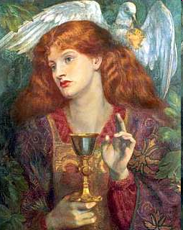
Experience-Driven
Procedural Content Generation
“… collection of affective patterns elicited, cognitive processes emerged and behavioral traits observed during interaction (gameplay)”
Notes:
As EDPCG entails and considers experiences of players we first need to define what “player experience” is.

Slide 46
Key Components
Notes:
The framework comprises of four key components which will look in further detail.

Slide 47
Content
Content
Representation
Generator
Player
Content
Experience
Quality
Model
Notes:
Since games are composed by game content that, when played by a particular player, elicits experience patterns, one needs to assess the quality of the content generated (linked to the experience of the player), search through the available content, and generate content that optimizes the experience for the player.

Slide 48
Content
Content
Representation
Generator
Player
Content
Experience
Quality
Model
Notes:
Player experience modeling: player experience is modeled as a function of game content and player.

Slide 49
Player Experience Modeling
Content evaluation functions could (should?) be based on player experience models
Predict player experience from behavior/cognition/affect and/or game content
Derived from empirical measurements of player experience
Yannakakis, G. N., & Togelius, J. (2011). Experience-driven procedural content generation. Affective Computing, IEEE Transactions on, 2(3), 147-161.

Slide 50
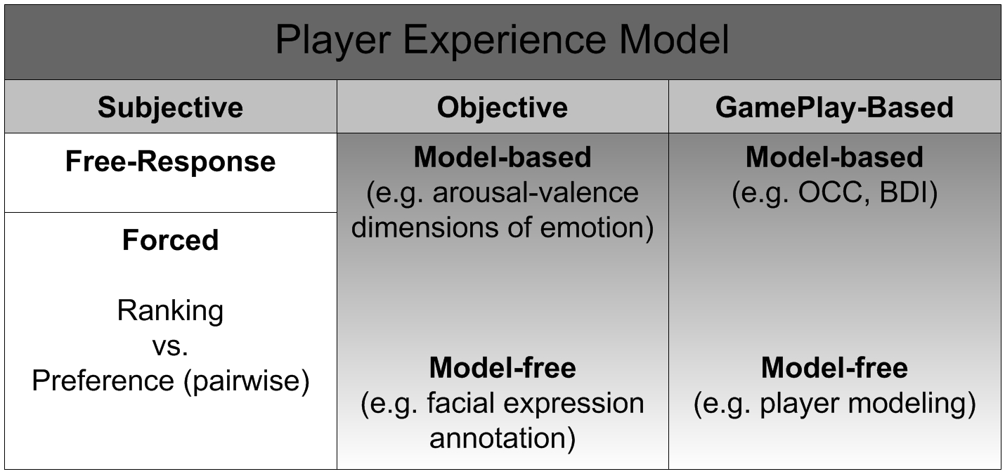
Rating
vs.
Preference
Notes:
See more details at “Yannakakis, G. N., & Togelius, J. (2011). Experience-driven procedural content generation. Affective Computing, IEEE Transactions on, 2(3), 147-161.”

Slide 51
Content
Content
Representation
Generator
Player
Content
Experience
Quality
Model
Notes:
Content quality: the quality of the generated content is assessed and linked to the modeled experience

Slide 52
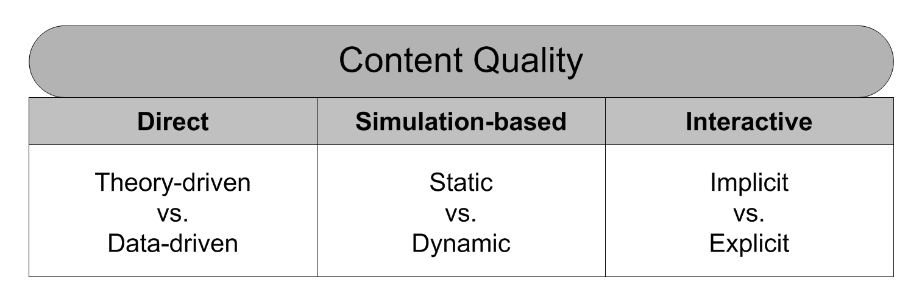
Notes:
Directly (A direct mapping between content and quality; e.g. number of jumps in a platform game)
Theory-driven: evaluation function is based on a theoretical model – e.g. Koster’s theory of fun)
Data-driven: evaluation function is derived via gameplay (or other modalities of) data
Simulation-based (An AI (maybe a human imitator) plays the game for a while and content is evaluated)
Static: evaluation function does not change over time
Dynamic: evaluation function is affected as time goes by
Interactively (Real-time evaluation via a player (or players))
Implicit: game behavior gives value to content (e.g. preference over a weapon)
Explicit: ask players to score content
See more details at “Yannakakis, G. N., & Togelius, J. (2011). Experience-driven procedural content generation. Affective Computing, IEEE Transactions on, 2(3), 147-161.”

Slide 53
Content
Content
Representation
Generator
Player
Content
Experience
Quality
Model

Slide 54
Content
Content
Representation
Generator
Player
Content
Experience
Quality
Model
Notes:
Content representation: content is represented accordingly to maximize search efficacy and robustness

Slide 55
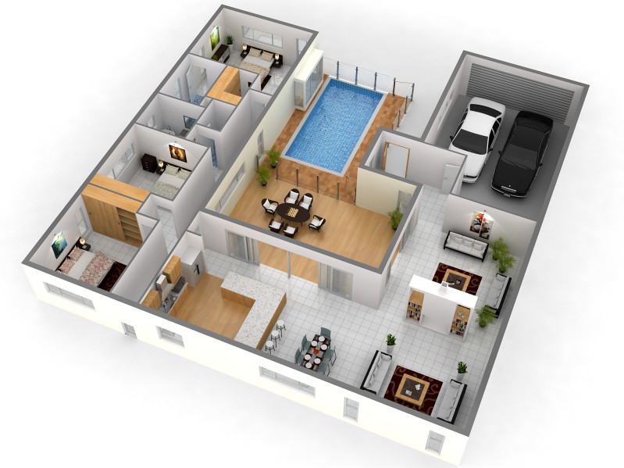
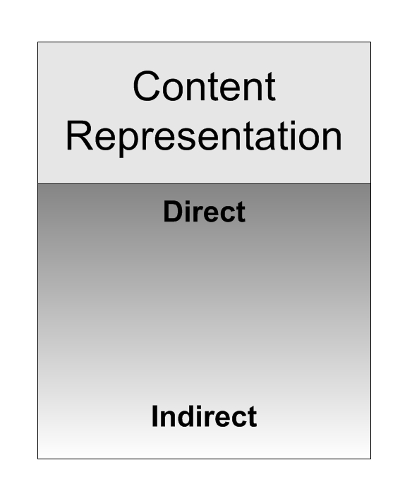
Cost
Control
Grid
Position and orientation of walls
Patterns of walls and floor
Number of rooms and doors
Random seed
Notes:
Here is an example of the different ways we could represent an apartment: all the way from very direct to very indirect approaches
In particular, the two ends of the content representation spectrum:
Grid: costly but ultimate levels of control over the generated content
Random seed: minimum cost but minimum control too
See more details at “Yannakakis, G. N., & Togelius, J. (2011). Experience-driven procedural content generation. Affective Computing, IEEE Transactions on, 2(3), 147-161.”

Slide 56
Content
Content
Representation
Generator
Player
Content
Experience
Quality
Model

Slide 57
Content
Content
Representation
Generator
Player
Content
Experience
Quality
Model
Notes:
Content generator: the generator searches through the generative space for content that optimizes the experience for the player according to the acquired model.

Slide 58
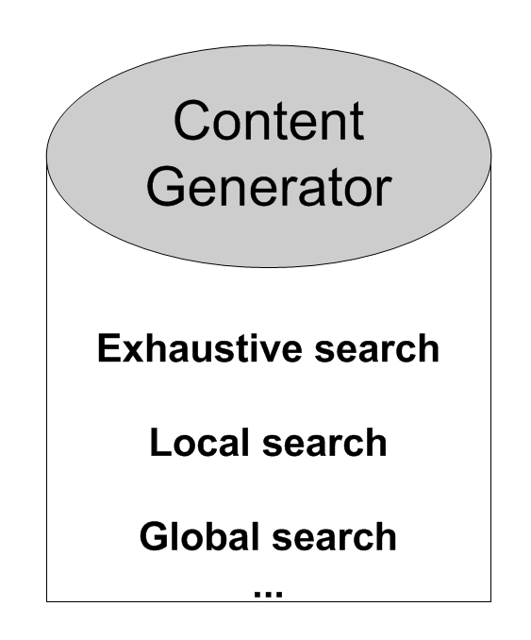
Frustration
Map
Player
Georgios
Content
Notes:
Theoretically EDPCG maintains a mapping between experience (e.g. frustration in the graph), content (e.g. a map in the example graph) and manifestations of player behaviour (e.g. Georgios in the graph). Given that such a mapping exists any optimization method would be able to alter content parameters in order to optimize particular experiences for particular players, thereby personalising the interaction via content generation.
See more details at “Yannakakis, G. N., & Togelius, J. (2011). Experience-driven procedural content generation. Affective Computing, IEEE Transactions on, 2(3), 147-161.”

Slide 59
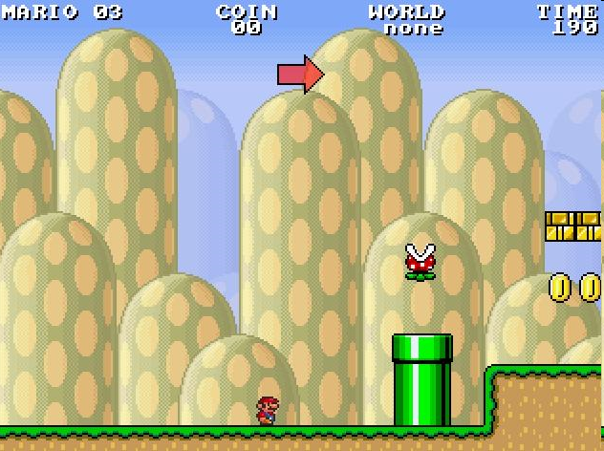
A Super Mario Bros Example
Model-free, gameplay-based PEM (pairwise preferences as outputs)
Direct (data-driven) evaluation function
Indirect content representation (a few parameters)
Search for good content via exhaustive search!
Level features and playing behavior
Player Experience
(Engagement, frustration, challenge)
Shaker, N., Yannakakis, G. N., & Togelius, J. (2010, October). Towards Automatic Personalized Content Generation for Platform Games. In AIIDE.
Notes:
For more details see
Shaker, N., Yannakakis, G. N., & Togelius, J. (2010, October). Towards Automatic Personalized Content Generation for Platform Games. In AIIDE.

Slide 60
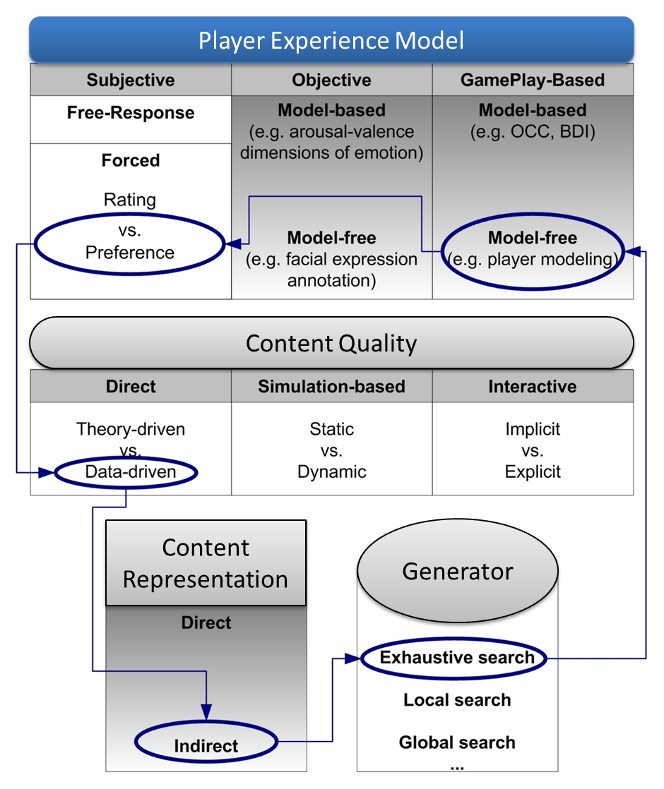
Notes:
For more details see
Shaker, N., Yannakakis, G. N., & Togelius, J. (2010, October). Towards Automatic Personalized Content Generation for Platform Games. In AIIDE.

Slide 61
Other EDPCG Examples

Slide 62
Sentient World:
Hybridizing Evolution and Gradient Search
Liapis et al. "Sentient World: Human-Based Procedural Cartography,“ EvoMusArt, 2013.
Notes:
Sentient World hybridizes artificial (interactive) evolution and gradient search (backpropagation) to generate and recommend content during a map design process. The tool allows the designer to draw a rough terrain sketch, adding extra levels of detail through stochastic and gradient search. Novelty search generates a number of dissimilar artificial neural networks that are trained to approximate a designer’s sketch and provide maps of higher resolution back to the designer. As the procedurally generated maps are presented to the designer (to accept, reject, or edit) the terrain sketches are iteratively refined into complete high resolution maps which may diverge from initial designer concepts. The tool supports designer creativity while conforming to designer intentions, and maintains constant designer control through the map selection and map editing options. Results obtained on a number of test maps show that novelty search is beneficial for introducing divergent content to the designer without reducing the speed of iterative map refinement.
For more details please refer to the cited paper

Slide 63
Constrained Novelty Search for PCG
Liapis, Yannakakis and Togelius, Constrained Novelty Search: A Study on Game Content Generation, Evolutionary Computation, 21(1), 2015, pp. 101-129
Notes:
This slide introduces the idea of constraining novelty search for the purpose of generating both novel and valuable (feasible) content in games. One way to constrain novelty search is to integrate it within a feasible-infeasible 2-population genetic algorithms (FI-2pop GA). Further details about the algorithm can be found in
Liapis, Yannakakis and Togelius, Constrained Novelty Search: A Study on Game Content Generation, Evolutionary Computation, 21(1), 2015, pp. 101-129

Slide 64
Constrained Novelty Search for PCG
Liapis, Yannakakis and Togelius, Constrained Novelty Search: A Study on Game Content Generation, Evolutionary Computation, 21(1), 2015, pp. 101-129
Notes:
A graphical representation of how the introduced constrained novelty search algorithms (FINS and FI2NS) operate in a hypothetical feasible-infeasible search space. For more details please refer to the cited paper above.

Slide 65
Sentient Sketchbook
Georgios N. Yannakakis, Antonios Liapis and Constantine Alexopoulos:
"Mixed-Initiative Co-Creativity," in Proc. of the ACM Conference on Foundations of Digital Games, 2014.
Map Sketches (strategy game, dungeon, FPS level)
Multiple solutions evolved & shown in real-time
Fitnesses on area influence, exploration and balance… and novelty
Constraints on playability handled with FI-2pop GA
Notes:
Constrained Novelty Search is a useful method for mixed-initiative PCG as it generates content that is appropriate for the task (within constraints) and also generates content that is novel thereby pushing the boundaries of the designer’s creativity. The method has been used in the Sentient Sketchbook mixed-initiative tool which is presented here. For more details please refer to the cited paper.

Slide 66
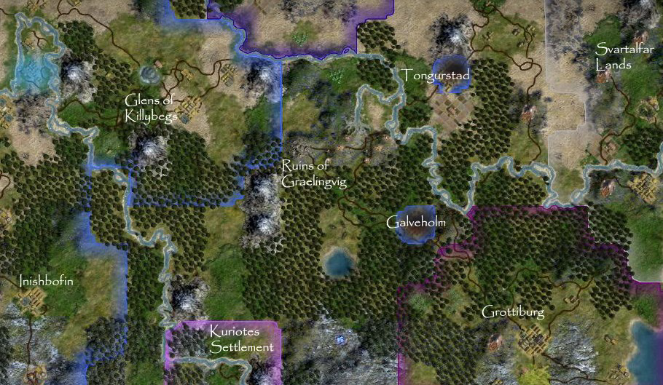
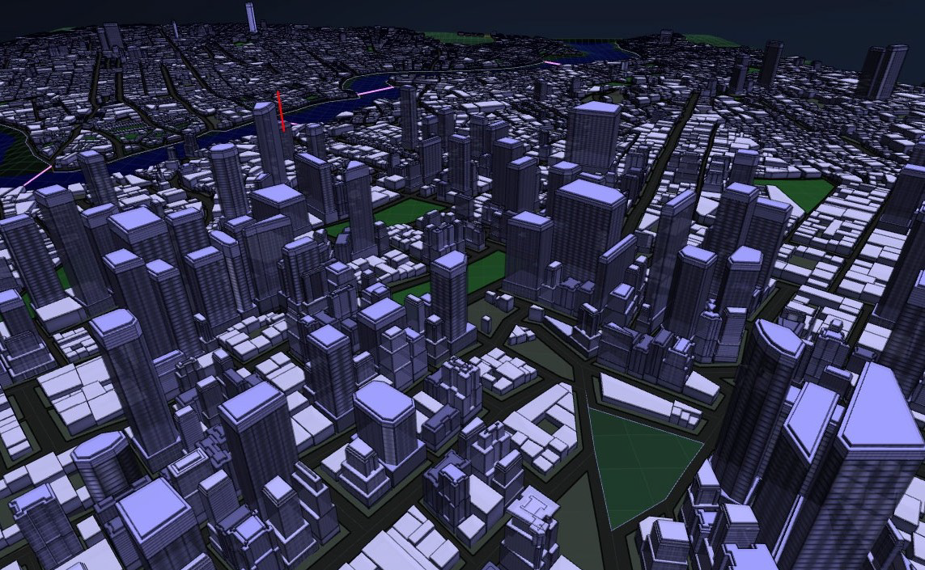
“Classical” PCG Approaches
Mostly constructive, stochastic, non-controllable, random seed, online
Mostly optional (non-vital) content such as decoration and redundant items
Interesting examples from classic games:
Elite (deterministic, offline)
Rogue (online, crucial content)
Techniques: L-trees, Fractals, …
Notes:
For reference: these are the properties of traditional PCG Algorithms we meet primarily at the game industry; and in game AI academia to a lesser degree.

Slide 67
Chapter 8: Methods For Generating Content
Notes:
[see Chapter 8 for more details]

Slide 68
PCG Methods
Good old PCG:
Constructive methods (cellular automata, noise, fractals, templates, ad-hoc methods)
Solver-based
Grammar-based
Search-based
“Generative AI”
Self-supervised learning on pixels/tiles
Self-supervised learning on strings (LLMs)
Reinforcement learning
Notes:
While many of the PCG methods are commonly thought of as AI methods, others are drawn from graphics, theoretical computer science or even biology. The various methods differ also in what types of content they are suitable to generate. The slide lists a number of PCG methods that are consider important – let us look at them in more detail starting with cellular automata

Slide 69
Constructive Methods
Notes:
[see Section 8.1 for more details]
Including
Grammar-based methods [section 8.1.1]
Cellular Automata [section 8.1.2]
Noise and fractals [section 8.1.3]
Wave Function Collapse [section 8.1.4]

Slide 70
Grammar-Based Methods
Notes:
[see Section 8.1.1 for more details]

Slide 71
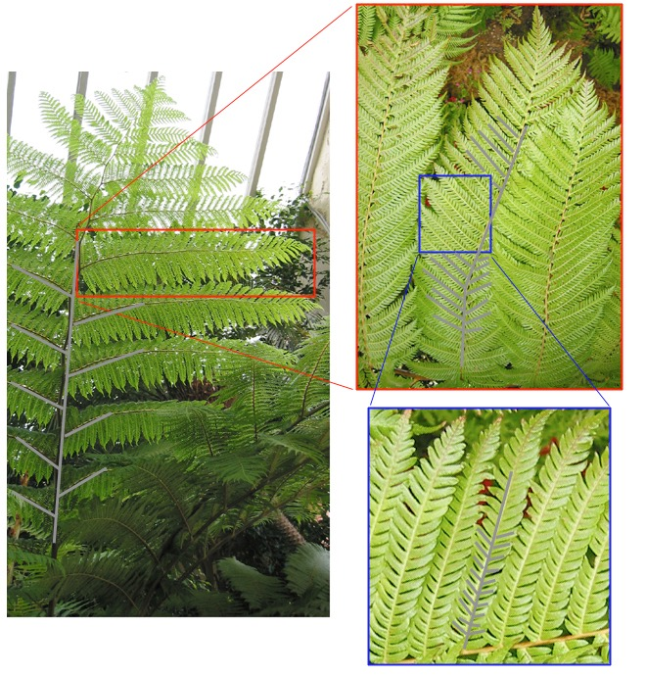
Grammar-Based Methods
Basic computer science concept, used in theory of computation
Define a grammar and an alphabet and then watch an axiom unfold into ever more complex strings
Commonly used for generating e.g. plants
Notes:
[see Section 8.1.1 for more details]

Slide 72
Self-Similarity
Nature has obviously thought out some clever way of representing complex organisms using a compact description...
...permitting individual variation...
...why is this relevant for us?

Slide 73
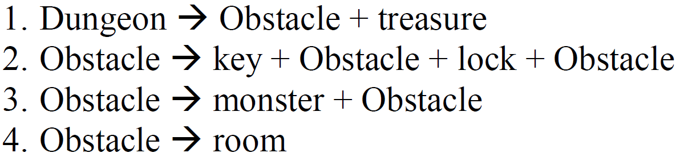
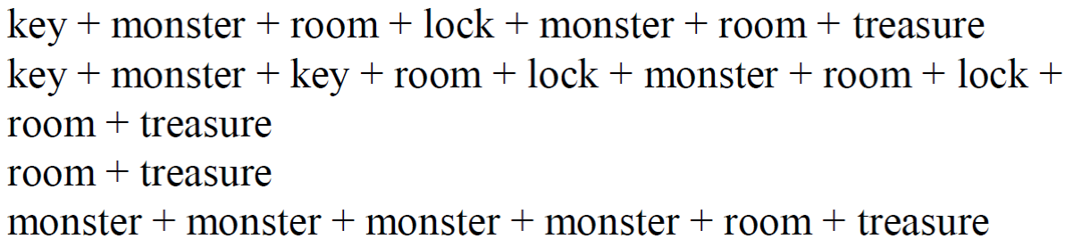
Grammars for Adventure Level Design
could give...

Slide 74
L-systems
Introduced by Aristid Lindenmeyer 1968, to model plant development
Creates strings (text) from an alphabet based on a grammar and an axiom
Closely related to Chomsky grammars (but productions carried out in parallel, not sequentially)

Slide 75
An Example L-system
Alphabet: {a, b}
Production rules (grammar): a>ab b>a
Axiom: b
b
|
a
└
a b
┘ │
a b a
┘ │ └
a b a a b
_/ / ┘ └ \
a b a a b a b a
Example of a derivation in a DOL-System

Slide 76
Types of L-systems
Context
Context-free: production rules refer only to an individual symbol
Context-sensitive: productions can depend on the symbol’s neighbors
Determinism
Deterministic: there is exactly one production for each symbol
Non-deterministic: several productions for a symbol

Slide 77
A Graphical Interpretation of L-systems
Invented/popularized by Prusinkiewicz in 1986
Core idea: interpret generated strings as instructions for a turtle in turtle graphics
Read the string from left to right, changing the state of the turtle (x, y, heading)

Slide 78
Example Graphical Systems
Alphabet: {F, f, +, -}
F: move the turtle forward (drawing a line)
f: move the turtle forward (don’t draw)
+/-: turn right/left (by some angle)

Slide 79
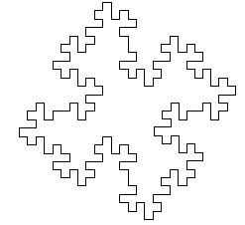
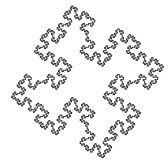

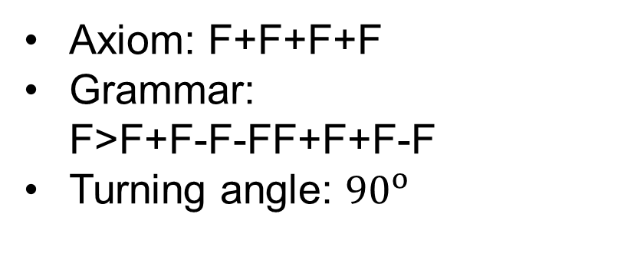
Graphical L-system
Axiom: F+F+F+F
Grammar: F>F+F-F-FF+F+F-F
Turning angle: ${90}^{o}$
n=1
n=0
n=2

Slide 80
Graphical L-systems
What’s the limit of these systems?

Slide 81
Bracketed L-systems
Alphabet: {F, f, +, -, [, ]}
[: push the current state (x, y, heading of the turtle) onto a pushdown stack
]: pop the current state of the turtle and move the turtle there without drawing
Enables branching structures!

Slide 82





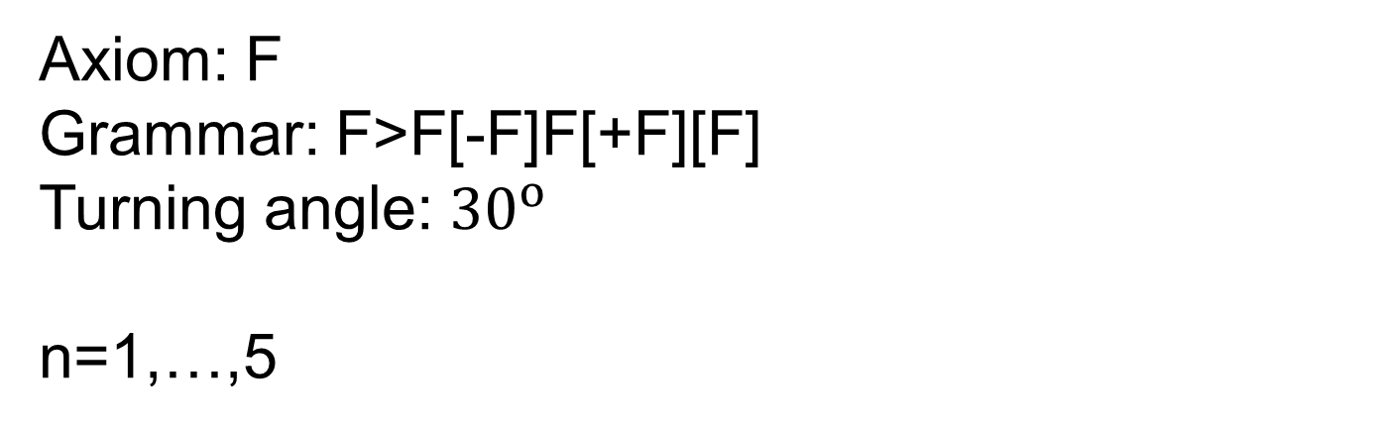
Bracketed L-systems
Axiom: F
Grammar: F>F[-F]F[+F][F]
Turning angle: ${30}^{o}$
n=1,…,5

Slide 83
3D Graphics
Turtle graphics L-system interpretation can be extended to 3D space:
Represent state as x, y, z and pitch, roll, yaw
+, -: turn (yaw) left/right
&, ^: pitch down/up
\, /: roll left/right (counterclockwise/clockwise)

Slide 84
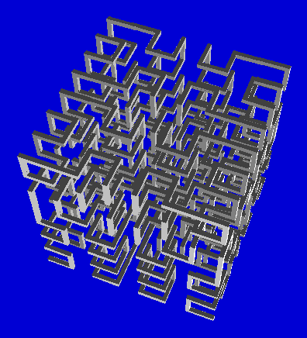
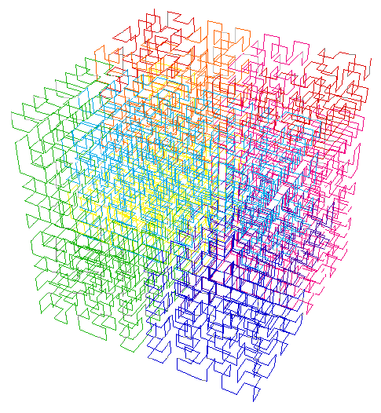
3D Interpretation of L-systems

Slide 85
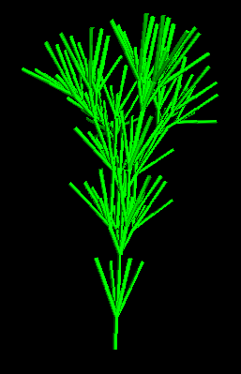
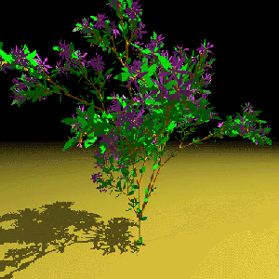
3D Interpretation of Bracketed L-systems

Slide 86
Coralize: 3D Corals in Unity Abela, R., Liapis, A. and Yannakakis, G.N., 2015. A constructive approach for the generation of underwater environments. In Proceedings of the FDG workshop on Procedural Content Generation in Games.

Slide 87
2D L-systems

Slide 88

Terrain Interpretation of 2D L-systems
Each group of four letters is interpreted as instructions for lowering or raising the corners of a square
E.g. A=+0.5, B=-0.5
A
B
B
A

Slide 89
Terrain Interpretation of 2D L-systems
In next iteration, the 2D L-system is rewritten once, and each square is divided into two
“Doubling the resolution”
A
B
A
B
B
A
B
A
A
B
A
B
B
A
B
A

Slide 90
Terrain Interpretation of 2D L-systems
Six rewritings of A>ABBA, B>AABB

Slide 91
Cellular Automata
Notes:
[see Section 8.1.2 for more details]

Slide 92
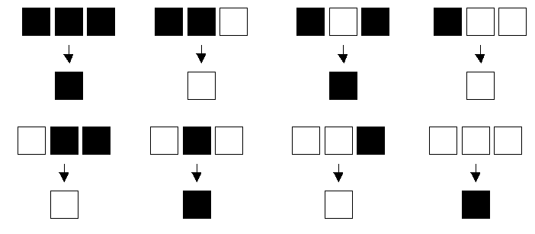
Cellular Automata
Computational paradigm based on local interaction
Used in artificial life and complexity studies
The value of each cell in iteration n+1 is based on the value of neighboring cells in iteration n and some rule
Notes:
[see Section 8.1.2 for more details]

Slide 93
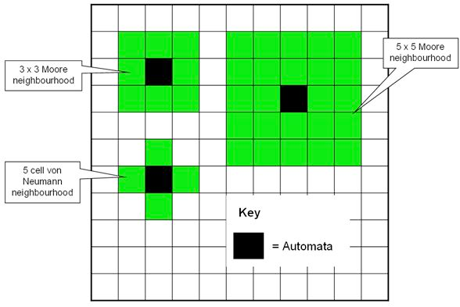
2D Cellular Automata

Slide 94
An Example
Cellular automata for real-time generation of infinite cave levels
Lawrence Johnson, Georgios N. Yannakakis and Julian Togelius
FDG PCG Workshop 2010

Slide 95

This…
A CA-based algorithm for generating infinite 2D caves
simple
real-time
looks good
somewhat controllable

Slide 96
The Motivation
Cave Crawler : a cooperative abusive dungeon crawler
Never ends – therefore needs to produce infinite caves...

Slide 97
CA Cave Generation
Start with a square grid (e.g. 50*50) – all floor
Randomly switch a proportion of cells from floor to rock
Run a CA n times, where each cell is set to:
Rock: if at least T neighbors are rock
Floor: otherwise
Fill in the interior of rock formations

Slide 98
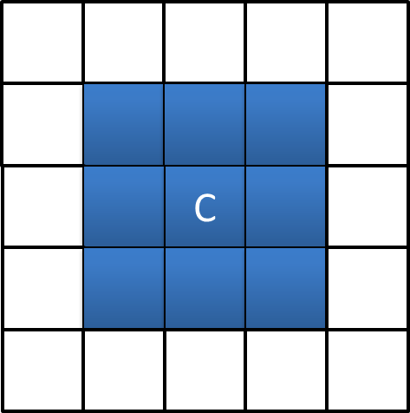
Core CA Mechanic
3x3
Moore Neighbourhood

Slide 99
CA Parameters
r : initial proportion of rock cells (0.5)
n : CA iterations (4)
T : neighborhood value threshold that defines a rock (5)
M : Moore neighbourhood size (1)

Slide 100
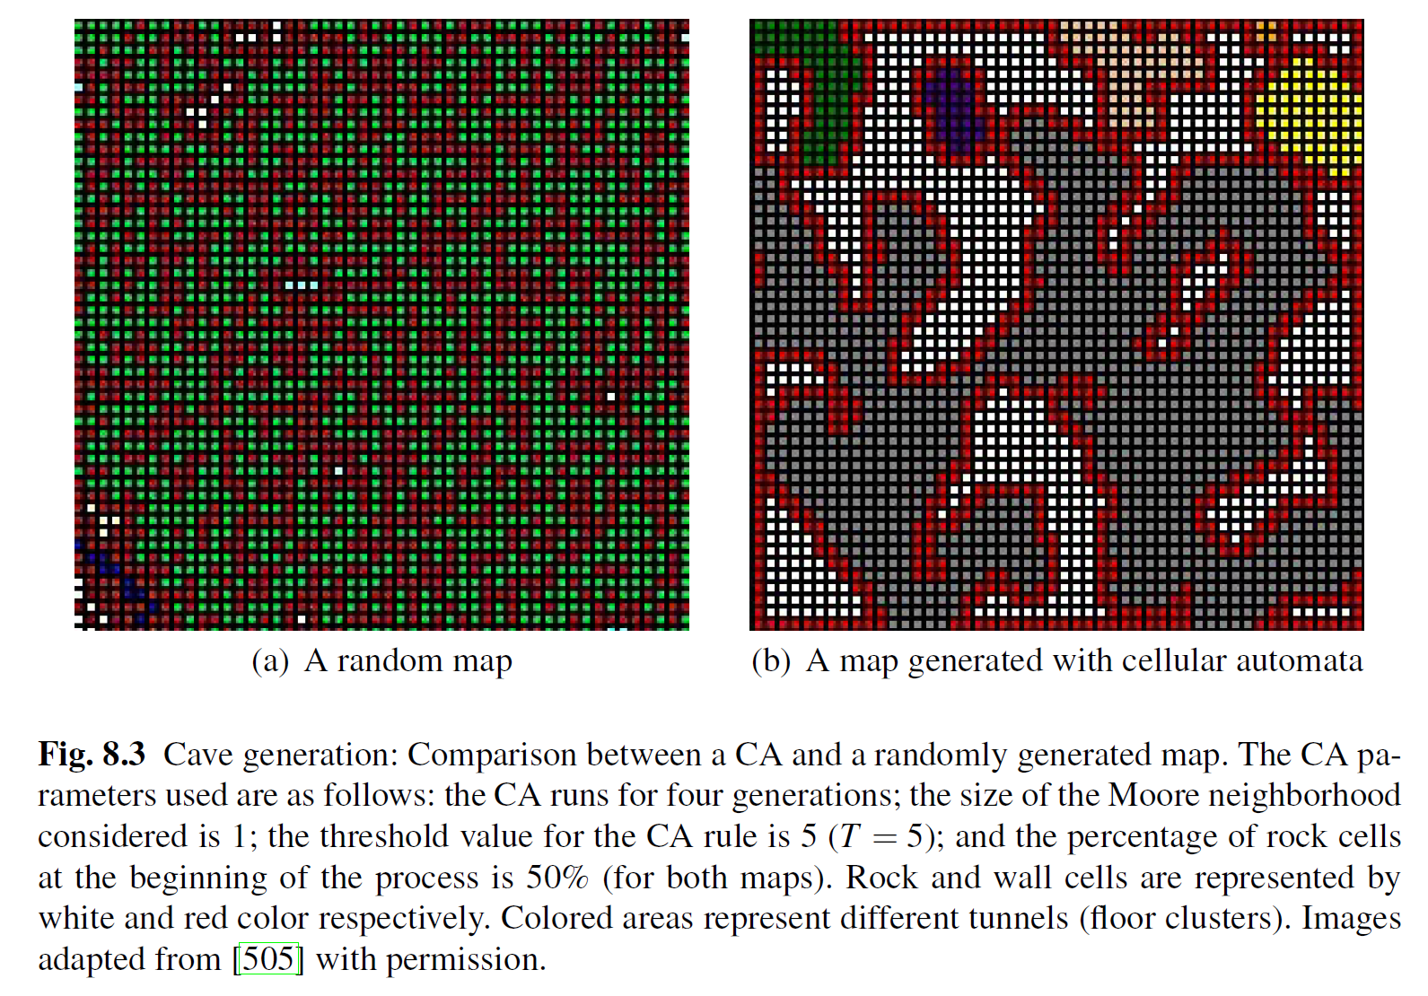

Slide 101
Adjacent Rooms
The infinite cave needs to be contiguous - and you need to be able to turn back! (Visited rooms stored as random seeds)
Generate all four neighbors of a new room
Dig tunnels from the central room to the new rooms at the shortest points
Run the CA m times (2) on all five rooms together to smooth out edges

Slide 102


Slide 103
Controllable?
Parameters can be varied… …but what do they mean?

Slide 105
3D L-systems + CA

Slide 106
Noise and Fractals
Notes:
[see Section 8.1.3 for more details]

Slide 107

Noise and Fractals
Noise algorithms (often fractal) → fast, easy, scale-invariant; limited controllability.
Common representation: 2D matrix of real numbers.
Textures → intensity maps (values = pixel brightness).
Terrains → heightmaps (values = elevation over baseline).
Interpolation: fills in details when render resolution → heightmap resolution.
Voxel representation: 3D grid (e.g., Minecraft) → allows caves, overhangs; needs more storage.
Midpoint displacement algorithm (figure): generates landscapes via recursive subdivision & random displacement, reducing variation each step.
Notes:
[see Section 8.1.3 for more details]

Slide 108





Noise and Fractals
Diamond-Square Algorithm
Extension of midpoint displacement to 2D (aka cloud fractal or plasma fractal)
Works on a square matrix
Initialization: all cells = 0; corners = random values (e.g., [−1,1]).
Algorithmic steps:
Diamond step – midpoint of four corners = average + random offset.
Square step – edge midpoints = average of neighbours + random offset.
Recursion: repeat for 4 sub-squares until minimum size (3×3); reduce randomness each recursion for smoother terrain.
Notes:
[see Section 8.1.3 for more details]

Slide 109
Wave Function Collapse
Notes:
[see Section 8.1.4 for more details]

Slide 110

Wave Function Collapse
Popular in the indie space
A constraint-solving method that learns constraints from limited examples
Alternative interpretation: self-supervised learning from small samples
Notes:
[see Section 8.1.4 for more details]

Slide 111
Evolutionary Algorithms and Search-Based PCG Togelius, J., Yannakakis, G.N., Stanley, K.O. and Browne, C., 2011. Search-based procedural content generation: A taxonomy and survey. IEEE Transactions on Computational Intelligence and AI in Games, 3(3), pp.172-186.
Notes:
[see Section 8.2 for more details]

Slide 112
Search-Based PCG
Use evolutionary computation to search the design space for good artifacts (e.g. levels)
Technically, we could use other stochastic search / optimization algorithms
Major issues:
Representing the content
Devising a good evaluation / fitness function
Notes:
[see Section 8.2 for more details]
The search-based approach to PCG has been intensively investigated in academic PCG research in recent years.
In search-based procedural content generation, an evolutionary algorithm or some other stochastic search or optimization algorithm is used to search for content with the desired qualities.
The basic metaphor is that of design as a search process: a good enough solution to the design problem exists within some space of solutions, and if we keep iterating and tweaking one or many possible solutions, keeping those changes which make the solution(s) better and discarding those that are harmful, we will eventually arrive at the desired solution.

Slide 113
The Algorithm
Lots of different types of evolutionary algorithms: Genetic Algorithms, Evolution Strategies, Evolutionary Programming
And evolution-like algorithms: Particle Swarm Optimization, Differential Evolution
Keep It Simple, Stupid!
Often, simple μ+λ ES with no crossover and no self-adaptation works well enough
Notes:
The first core component of the search-based approach is the search algorithm per se. This is the “engine” of a search-based method. Often relatively simple evolutionary algorithms work well enough, however sometimes there are substantial benefits to using more sophisticated algorithms that take e.g., constraints into account, or that are specialized for a particular content representation.

Slide 114
Representing Content (e.g. a dungeon)
Directly: grid
More indirectly: position and orientation of walls
Even more indirectly: patterns of walls and floor
Very Indirectly: number of rooms and doors
Indirectly: random seed
Freedom/Locality
Cost
Notes:
The second core component of the search-based approach is content representation
This is the representation of the artifacts you want to generate, e.g., levels, quests or winged kittens. The content representation could be anything from an array of real numbers to a graph to a string. The content representation defines (and thus also limits) what content can be generated, and determines whether effective search is possible

Slide 115
How to Evaluate Content Quality
Directly
A direct mapping between content and quality; e.g. number of jumps in a platform game
Simulation-based
An AI (maybe a human imitator) plays the game for a while and content is evaluated
Interactively
Real-time evaluation via a player (or players)
Togelius, J., Yannakakis, G. N., Stanley, K. O., & Browne, C. (2011). Search-based procedural content generation: A taxonomy and survey. Computational Intelligence and AI in Games, IEEE Transactions on, 3(3), 172-186.
Notes:
The third core component of the search-based approach is the design of one or more evaluation functions
I.e. This is a function from an artifact (an individual piece of content) to a number indicating the quality of the artifact.
There are three main ways to evaluate content: directly, simulation-based and interactively

Slide 116
How to Evaluate Content Quality
Directly
Theory-driven: evaluation function is based on a theoretical model – e.g. Koster’s theory of fun
Data-driven: evaluation function is derived via gameplay (or other modalities of) data
Simulation-based
Static: evaluation function does not change over time
Dynamic: evaluation function is affected as time goes by
Interactively
Implicit: game behavior gives value to content (e.g. preference over a weapon)
Explicit: ask players to score content
Togelius, J., Yannakakis, G. N., Stanley, K. O., & Browne, C. (2011). Search-based procedural content generation: A taxonomy and survey. Computational Intelligence and AI in Games, IEEE Transactions on, 3(3), 172-186.
Notes:
The taxonomy of content evaluation expanded. See Section 8.2 for more details

Slide 117





Notes:
A graphical representation of the different ways an algorithm can evaluate content
Directly (A direct mapping between content and quality; e.g. number of jumps in a platform game)
Theory-driven: evaluation function is based on a theoretical model – e.g. Koster’s theory of fun)
Data-driven: evaluation function is derived via gameplay (or other modalities of) data
Simulation-based (An AI (maybe a human imitator) plays the game for a while and content is evaluated)
Static: evaluation function does not change over time
Dynamic: evaluation function is affected as time goes by
Interactively (Real-time evaluation via a player (or players))
Implicit: game behavior gives value to content (e.g. preference over a weapon)
Explicit: ask players to score content

Slide 118
Search-Based PCG Example #1 How would we generate levels for Super Mario Bros?
Notes:
The following example is based on the paper: Steve Dahlskog and Julian Togelius: Patterns as Objectives for Level Generation. PCG Workshop 2013

Slide 119
The Mario AI Benchmark
Reasonably faithful clone of SMB 1/3
APIs for level generators and AI controllers
Steve Dahlskog and Julian Togelius: Patterns as Objectives for Level Generation. PCG Workshop 2013

Slide 120
Representation
A number of “vertical slices” are identified from the original SMB levels
Levels are represented as strings, where each character correspond to a pattern
Steve Dahlskog and Julian Togelius: Patterns as Objectives for Level Generation. PCG Workshop 2013

Slide 121
Evaluation
25 patterns are identified in the original SMB levels
e.g. enemy hordes, pipe valleys, 3-paths…
The fitness function counts the number of patterns found in the level
Steve Dahlskog and Julian Togelius: Patterns as Objectives for Level Generation. PCG Workshop 2013

Slide 122
Steve Dahlskog and Julian Togelius: Patterns as Objectives for Level Generation. PCG Workshop 2013

Slide 123
Steve Dahlskog and Julian Togelius: Patterns as Objectives for Level Generation. PCG Workshop 2013
Notes:
A number of generated levels with their corresponding fitness

Slide 124
Search-Based PCG Example #2 How would we create new game rules?

Slide 125
Creating Game Rules
Rules are also content…
Will need simulation-based evaluation - you can only judge game rules by playing the game
Has been attempted for simple Pac-Man-like games (Togelius 2008), GVGAI games (Nielsen et al 2015)
Perhaps most convincingly for board games (Browne 2008)

Slide 126
Notes:
The Ludi game rule generator – see more details in Section 4.5.6

Slide 127

Yavalath
Notes:
The Yavalath game generated by Ludi (by Cameron Browne) – a grammar-based representation

Slide 128

Yavalath

Slide 129


Slide 130

From Ludi to Ludii

Slide 131

From Ludi to Ludii

Slide 132
Search-Based PCG Example #3 How would we design L-systems?

Slide 133
Evolving L-systems
How can we combine L-systems with evolutionary computation?

Slide 134
Evolving L-systems
Evolving the axiom
Evolving the grammar:
Change the shape of one or more production rules, or
Add/remove/replace productions
Evolving the interpretation:
Evolve production probabilities
Evolve other aspects (e.g. turning angles)

Slide 135
Evolving L-systems
One example: Ochoa evolved the consequent of a single production rule
starting from F>F[-F]F[+F]F
Mutation: replace single symbols, or blocks of a few symbols
Crossover: swap complete “sub-trees” (like in genetic programming)

Slide 136
Fitness Functions
Phototropism
Bilateral symmetry
Proportion of branching points

Slide 137














Evolved Systems
Branching points
Symmetry
All 3
Phototropism
Phototropism + Symmetry

Slide 138
























Evolved Systems

Slide 139












Evolved Systems

Slide 140
…and this was an extremely simple L-system!

Slide 141
Evolved 2D L-system Terrains

Slide 142
Evolved 2D L-system Terrains
Very short specification, yet infinite resolution!

Slide 143
Quality-Diversity Methods
Notes:
[see Section 8.3 for more details]

Slide 144
PCG through Quality Diversity
Generating many diverse good solutions
Needs a fitness function, and one or several behavioral characteristics (or simply metrics)
Very useful for search-based PCG!
Daniele Gravina, Ahmed Khalifa, Antonios Liapis, Julian Togelius and Georgios N. Yannakakis. Procedural Content Generation through Quality Diversity. IEEE CoG 2019

Slide 145

Map-Elites

Slide 146

PCGQD Examples: CMA-ME

Slide 147

PCGQD Examples: CMA-ME

Slide 148


PCGQD Examples: Super Mario

Slide 149

PCGQD Examples: Super Mario

Slide 150

PCGQD Examples: Talakat

Slide 151

PCGQD Examples: Talakat

Slide 152


PCGQD Examples: Talakat
A* agent
Dexterity Metric: measured with an agent with impaired maneuvering
Strategy Metric: measured with an agent with limited planning ahead
@amidos2006
www.akhalifa.com/talakat/

Slide 153

PCGQD Examples: Talakat

Slide 154

PCGQD Examples: Maze Generation
Sfikas, Liapis and Yannakakis: “Monte Carlo Elites: Quality-Diversity Selection as a Multi-Armed Bandit Problem” in Proceedings of the Genetic and Evolutionary Computation Conference, 2021

Slide 155



PCGQD on Architecture & Urban Design
Sfikas, Liapis, Yannakakis A General-Purpose Expressive Algorithm for Room-based Environments, in Proceedings of FDG, 2022
Galanos, Liapis, Yannakakis, ARCH-Elites: Quality-Diversity for Urban Design, GECCO, 2021

Slide 156
Solver-Based Methods
Notes:
[see Section 8.4 for more details]

Slide 157

Solver-Based Methods
Instead of using evolutionary algorithms, use constraint solvers and specify constraints
Example: Answer Set Programming (ASP)
Declarative programming for search problems
Based on logic programming (syntax very similar to Prolog)
Finding an answer set is equivalent to solving a satisfiability problem
Notes:
[see Section 8.4 for more details]

Slide 158


PCG via Machine Learning
Notes:
[see Section 8.3 for more details]
As machine learning has made its way into absolutely everything over the past decade, this is also true for PCG.
One can train generators on existing content, to be able to produce more content. Here we cover the family of PCG algorithms introduced as PCG via Machine learning (PCGML) by Summerville et al. in 2017. The more recently popular term generative AI as applied to game content largely overlaps with the PCGML paradigm. After all, PCGML investigates the generative capacity of algorithms that adopt machine learning methods and train themselves on (large) content corpora to be able to generate new content.

Slide 159
PCG via Machine Learning
Basic idea of Procedural Content Generation via Machine Learning (PCGML): train machine learning models on corpuses of existing content, then generate new content
Many methods useful, including n-grams, Markov chains, and… yes, even deep learning and LLMs
Reference: Summerville et al. (2018): Procedural Content Generation via Machine Learning (PCGML)

Slide 160
N-Grams
Notes:
[See section 8.5.1 for mode details]

Slide 161
N-Grams
Capture the statistic co-occurrence of sequential characters
n: number of previous characters a new character depends on
Commonly used for predictive text
Can also be used for linear game content
Notes:
See section 8.5.1 for mode details

Slide 162
N-Grams
1-D generation technique
Learn to generate next character based on the previous ones
Used in Language Modeling
NULL > O (0.2), A (0.2), B (0.4), E (0.1), END (0.1)
Unigram Model
A > B (1.0)
B > E (0.5), O (0.1), A (0.1), END (0.3)
E > B (0.3), END (0.7)
O > O (0.5), B (0.5)
Bigram Model
AB > B (1.0)
BE > E (0.5), O (0.1), A (0.1), END (0.3)
Trigram Model

Slide 163

N-Grams in Super Mario
Mario level viewed as a group of slices
Notes:
An example of PCGML via n-grams for Super Mario level generation

Slide 164
N-Grams in Super Mario
Unigram: Count each slice and convert to probability
?/15
?/15
?/15
?/15
?/15

Slide 165
N-Grams in Super Mario
Unigram: Count each slice and convert to probability
9/15
2/15
1/15
1/15
1/15

Slide 166
N-Grams in Super Mario
Bigram: For every slice, count the next upcoming different slice and convert to probability
?/9
?/9
?/9
Input
Input

Slide 167
N-Grams in Super Mario
Bigram: For every slice, count the next upcoming different slice and convert to probability
7/9
1/9
1/9
Input
1/2
1/2
Input

Slide 168
N-Grams in Super Mario
Mario level is a group of slices
Train unigram, bigram, and trigram over all 15 Mario levels
Use trained N-Grams to generate new levels
Why?

Slide 169

Steve Dahlskog, Julian Togelius, and Mark J. Nelson (2014): Linear levels through n-grams. In proceedings of MindTrek
Notes:
An example of PCGML via n-grams – see reference for further details

Slide 170
Neural Networks
Notes:
[See section 8.5.1 for mode details]
Given the many uses of neural networks in machine learning, and the many different neural network architectures, it is little wonder that neural networks are also highly useful for machine learning-based PCG. The following slides present neuroevolution, CNNs and LSTMs as paradigms for NN-based PCGML

Slide 171
Neuroevolution
Evolving the weights of neural networks, either interactively or according to some automatic fitness function
Can be used for PCG: predicting some aspect of a level (e.g. enemies in Super Mario Bros) from other aspects (e.g. bricks and question mark blocks)
Analogically: The different layers of a level are akin to different instruments in a song

Slide 172
Neuroevolution for Mario
Notes:
Reference : Amy K. Hoover, Julian Togelius, and Georgios N. Yannakakis. Composing video game levels with music metaphors through functional scaffolding. In First Computational Creativity
and Games Workshop, ICCC, 2015.

Slide 173
Amy K. Hoover, Julian Togelius and Georgios N. Yannakakis (2015): Composing Video Game Levels with Music Metaphors through Functional Scaffolding. ICCC Workshop on Computational Creativity and Games.
Notes:
An example of PCGML via neuroevolution – see reference for further details

Slide 174
Convolutional Neural Nets
Commonly used for classification and prediction from high dimensional matrices, such as images
Makes use of the convolution operation to find recurring features in images while minimizing the number of parameters
Can be used for PCG: predicting level features from other features (e.g. resources from base locations)

Slide 175
CNNs for StarCraft Resources
Scott Lee, Aaron Isaksen, Christoffer Holmgård and Julian Togelius (2016): Predicting Resource Locations in Game Maps Using Deep Convolutional Neural Networks. EXAG.
Notes:
An example of PCGML via CNNs – see reference for further details

Slide 176
Long Short-Term Memory
Commonly used for sequence recognition and prediction, for example for audio or text
Often used for generative text, through predicting the next word or letter based on some training set
Can be used for PCG: predicting the next element in a sequence, e.g. a level segment or a word in a description

Slide 177
LSTM for Mario
Notes:
An example of PCGML via LSTMs

Slide 178
LSTM for Magic Cards
Summerville and Mateas 2016: Mystical tutor: A magic: The gathering design assistant via denoising sequence-to-sequence learning
Notes:
An example of PCGML via LSTMs – see reference for details

Slide 179
Generative Adversarial Networks
Notes:
[See Section 8.5.3 for further details]

Slide 180
Generative Adversarial Networks
Train two networks intermittently: a generator and a discriminator
The discriminator is trained to distinguish real artifacts from fake (generated) ones
The generator is trained to generate artifacts that fool the discriminator
Essentially the same idea as competitive coevolution

Slide 181

Generative Adversarial Networks

Slide 182
GANs for Mario Level Generation
Train a GAN on a Mario level, so that it can produce level segments
Search the latent space of the trained GAN for level segments with particular properties
Approach called Latent Variable Evolution
Notes:
See more details in Section 8.5.3 and the referenced paper.

Slide 183
Notes:
Original image from the paper

Slide 184

GANs for Mario Level Generation
Notes:
Phase II (Evolution) re-visualised for the purposes of the book.

Slide 185
GANs for Mario Level Generation

Slide 186
GANs for Mario Level Generation

Slide 187
GANs for Mario Level Generation

Slide 188
LLMs
Notes:
See Section 8.5.4 for more details

Slide 189
LLMs
Text-to-image, text-to-text, text-to-music, text-to-code etc works well…
Can we use text-conditioning in our content generation?
Could we simply ask a model to create a new game for us?

Slide 190





LLMs
Large Language Models (LLMs) have demonstrated impressive capabilities for a variety of tasks, from chatting to generating computer code. But what about generating working game levels?
Todd, Earle, Nasir, Togelius (2023): Level Generation Through Large Language Models. PCG Workshop at FDG.
Notes:
And, more specifically, do the things we’ve learned about LLMs in NLP domains apply to PCG?

Slide 191

Opportunities and Challenges
“Give me a challenging level with 7 boxes”
“Give me a level for Sokoban and another level for Super Mario Bros”
Controllability
Generalizability

Slide 192

(Ancient) LLMs Can Make Sokoban Levels
Valid, playable, novel Sokoban levels sampled from GPT-2
Notes:
An example from Todd, Earle, Nasir, Togelius (2023): Level Generation Through Large Language Models. PCG Workshop at FDG.

Slide 193



MarioGPT
Notes:
Another LLM-based PCG example: MarioGPT. See reference for more details

Slide 194



Text-Guided 3D Minecraft Generation
Previous controllable level generators are controlled via domain-specific computable metrics (e.g. solution length, number of enemies, symmetry).
Could we allow for more open-ended control via natural language?
Can we leverage a model trained with knowledge over many domains?
“Super Mario Bros level in Minecraft”
generative model
Earle et al. (2024). Dreamcraft: Text-guided generation of functional 3D environments in Minecraft. In Proceedings of the 19th International Conference on the Foundations of Digital Games (pp. 1-15).
Notes:
Another LLM-based PCG example: see reference for further details.

Slide 195

Text-Guided 3D Minecraft Generation
NeRF parametrizes a 3D grid, predicting block types
Discretize grid using “straight through” trick → discrete blocks
Project the one-hot grid into a point cloud comprising in-game textures
Differentiably render resultant voxel grid.

Slide 196

Text-Guided 3D Minecraft Generation
Notes:
Tree is made out of wood, dirt and slime

Slide 197

The $5 Model
Merino, Romanov, Charity, Rajesh, Togelius (2023): The 5 dollar model: Generating Game Maps and Sprites from Sentence Embeddings
Notes:
The 55 Model: Another LLM-based PCG example: see reference for further details.

Slide 198

The $5 Model
Merino, Romanov, Charity, Rajesh, Togelius (2023): The 5 dollar model: Generating Game Maps and Sprites from Sentence Embeddings

Slide 199

ArchiText: Text to Architecture
Galanos, T., Liapis, A., & Yannakakis, G. N. (2023). Architext: Language-Driven Generative Architecture Design. arXiv preprint arXiv:2303.07519.
Notes:
ArchiText: Another LLM-based PCG example for architecture and level design: see reference for further details.

Slide 200

CrawLLM
Zammit, Liapis, Yannakakis (2024) CrawLLM: Theming Games with Large Language Models. Proceedings of IEEE CoG 2024.
Notes:
CrawLLM video demo. Another LLM-based PCG example: see reference for further details.
LLMs in game re-theming, a process that adapts game assets to new settings and narratives.
CrawLLM, combines dungeon crawling and card combat mechanics.
The gameplay structure guides the construction of prompts for LLMs to generate new themes, stories, characters, and locations, which then directs the generation of corresponding visual assets.
This approach enabled the game's aesthetics to emerge from its underlying narrative.
Video shows a playable version of the game with 20 pre-generated, non-curated themes.

Slide 201

ScriptDoctor
Earle et al, “Automatic Generation of PuzzleScript Games via Large Language Models and Tree Search”, arxiv 2025
Fewshot-prompt LLM with existing games, feed back parse/compile issues.
Feed back results from tree search-based solver agent.
Notes:
ScriptDoctor. Another LLM-based PCG example: see reference for further details.

Slide 202


ScriptDoctor
Earle et al, “Automatic Generation of PuzzleScript Games via Large Language Models and Tree Search”, arxiv 2025
Most generated games were mazes, or sokoban-likes.
A few were actually interesting and (seemingly) novel.

Slide 203
Notes:
Overview of PCGML work; see more details at Summerville et al. (2018): Procedural Content Generation via Machine Learning (PCGML) and particularly the latest edition of the PCGML book:
Matthew Guzdial, Sam Snodgrass, and Adam J. Summerville. Procedural Content Generation Via Machine Learning: An Overview. Springer, 2025.

Slide 204
Reinforcement Learning
Notes:
[See Section 8.6 for more details]

Slide 205

Procedural Content Generation via Reinforcement Learning (PCGRL)
Khalifa, A., Bontrager, P., Earle, S., & Togelius, J. (2020). PCGRL: Procedural content generation via reinforcement learning. In Proceedings of the AAAI Conference on Artificial Intelligence and Interactive Digital Entertainment.
Notes:
[See Section 8.6 for more details]

Slide 206



PCGRL
Earle, S., Edwards, M., Khalifa, A., Bontrager, P., & Togelius, J. (2021). Learning controllable content generators. IEEE CoG

Slide 207

Controllable PCGRL

Slide 208

3D PCGRL
Jiang, Z., Earle, S., Green, M., & Togelius, J. (2022). Learning Controllable 3D Level Generators. In Proceedings of the 17th International Conference on the Foundations of Digital Games.

Slide 209

Diffusion Models

Slide 210
The Path of Destruction
Can we learn iterative generators from data?
Approach: destroy the level in a myriad ways, use the reverse of the destruction steps as a dataset to train on
Basically, learn to repair, and see creativity as repair from a random state
Matthew Siper, Ahmed Khalifa, Julian Togelius (2022): Path of Destruction: Learning an Iterative Level Generator from a Small Dataset. IEEE SSCI

Slide 211

PoD Agents Generating Levels
Notes:
CONT HERE

Slide 212

Shu, Liu and Yannakakis, Experience-Driven PCG via Reinforcement Learning: A Super Mario Bros Study, IEEE Conference on Games, 2021
Combining ED(PCG)RL: EDRL
Notes:
Combining EDPCG (see chapter 7) and PCGRL yields the ED(PCG)RL – EDRL framework. See referenced paper for more details.

Slide 213

(Moderate diversity
over time)

Slide 214



Wang, Liu and Yannakakis, The Fun Facets of Mario: Multifaceted Experience-Driven PCG via Reinforcement Learning, In Proc. of FDG, 2022

Slide 215
Chapter 9: PCG By Content Type
Notes:
[See Chapter 9 for more details]
In the last part of this presentation we briefly outline the possible content types that a PCG algorithm can generate in a game.

Slide 216






Audio
Visuals
Narrative
Levels
Gameplay
Rules
Liapis, Yannakakis, Togelius: "Computational Game Creativity," in Proceedings of the Fifth International Conference on Computational Creativity, 2014.
Notes:
Generally speaking, Liapis et al. identified six creative domains (or else facets) within games that we will follow for our discussion in this section. These include level architecture (design), audio, visuals, rules (game design), narrative, and gameplay. In this chapter we will cover the first five facets and we purposely exclude the gameplay facet. Creative gameplay is directly associated
with play and as such is covered in Chapter 3.
In the next slides we will see some indicative examples on each of the creative facets within games.

Slide 217
Levels
Notes:
[See section 9.1 for more details]
The generation of levels is by far the most popular use of PCG in games. Levels can be viewed as necessary content since every game has some form of spatial representation or virtual world within which the player can perform a set of actions. The properties of the game level, in conjunction with the game rules, frame the ways a player can interact with the world and determine how the player can progress from one point in the game to another. The game’s level design contributes to the challenges a player faces during the game. While games would often have a fixed set of mechanics throughout, the way a level is designed can influence the gameplay and the degree of game challenge. For that reason, a number of researchers have argued that levels coupled with game rules define the absolutely necessary building blocks of any game; in that regard the remaining facets covered below are optional. The variations of possible level designs are endless: a level representation can vary from simple two-dimensional illustrations of platforms and coins—as in the Super Mario Bros (Nintendo, 1985) series—to the constrained 2D space of Candy Crush Saga (King, 2012), to the three-dimensional and large urban spaces of Assassin’s Creed (Ubisoft, 2007) and Call of Duty (Infinity Ward, 2003), to the 2D elaborated structures of Angry Birds (Rovio, 2009), to the voxel-based open gameworld of Minecraft (Mojang 2011).
Image: PCG for levels to generate dungeons as in Diablo

Slide 218


Complete Game Generation – Orchestration
Antonios Liapis, Georgios N. Yannakakis, Mark J. Nelson, Mike Preuss and Rafael Bidarra: "Orchestrating Game Generation" in Transactions on Games, 2019.
Notes:
[see Section 9.1 for more details]
Game generation refers to the use of PCG algorithms for computationally designing new complete games. The vast majority of PCG studies so far, however, have been very specific to a particular game facet or domain. It is, for instance, either a level that is generated or the audio for some level but rarely both. Meanwhile it is surprising to think that the relationship between the different facets is naturally interwoven. A characteristic example of the interwoven nature among game facets: player actions—viewed as a manifestation of game rules—are
usually accompanied by corresponding sound effects such as the sound of Mario jumping in Super Mario Bros (Nintendo, 1985). Now let us think of a PCG algorithm that introduces a new rule to the game—hence a new player action. The algorithm automatically constrains the sound effects that can be associated to this new action based on a number of factors such as the action’s duration, purpose and overall contribution to the game plot. Actions and sounds appear to have a cause and effect (or hierarchical) relationship and a PCG algorithm would naturally prioritize the creation of the action before it generates its sound. Most relationships between facets, however, are not strictly hierarchical or unidirectional. For example, a game
level can be successful because of a memorable landmark as much as the gameplay it affords. Similarly, the narrative of a game relies on a multitude of factors including the camera placement as well as the visuals and the sounds.
Orchestration of creative domains is the process of meaningfully generating content together (top-down – to free-form)
For more details please refer to the cited paper

Slide 219

Visuals
Notes:
[See Section 9.2 for more details]
Games are, by definition, visual media unless the game is designed explicitly to not have visuals—e.g., the Real Sound: Kaze no Regret (Sega, 1997) adventure audio game. The visual information displayed on the screen conveys messages to the player which are dependent on the graphical style, color palette and visual texture. Visuals in games can vary from simple abstract and pixelized representations as the 8-bit art of early arcade games, to caricaturized visuals as in Limbo (Playdead, 2010), to photorealistic graphics as in the FIFA series (EA Sports, 1993).
Image: Impressionism Neural Style Transfer that redraws key scenes in the short-movie Come Swim (dir. Kristen Stewart)

Slide 220

Audio
Brown, Daniel. "Mezzo: An adaptive, real-time composition program for game soundtracks." Proceedings of the AIIDE Workshop on Musical Metacreativity. 2012.
Notes:
[See Section 9.3 for more details]
Even though audio can be seen as optional content it can affect the player directly and its impact on player experience is apparent in most games . Audio in games has reached a great level of maturity as demonstrated by BAFTA Game Awards and MTV video music awards for best video game soundtrack. The audio types one meets in games may vary from fully orchestrated soundtrack (background) music, as in Skyrim (Bethesda, 2011), to sound effects, as the dying or pellet-eating sounds of Pac-Man (Namco, 1980), to the voice-acted sounds of Fallout 3 (Bethesda, 2008).
A notable example of adaptive music creation in games is the work of Brown (see video and refer to the cited article for more details)

Slide 221
Narrative
Notes:
[See Section 9.4 for more details]
Many successful games are relying heavily on their narratives; the clear distinction however, between such narratives and traditional stories is the interactivity element that is offered by games. The study of computational (or procedural) narrative focuses on the representational and generational aspects of stories as those can be told via a game. Stories can play an essential part in creating the aesthetics of a game which, in turn, can impact affective and cognitive aspects of the playing experience. In terms of procedurally generated narrative, planning approaches target typicality as in the case of Facade (see screenshot) which tries to tell a story of a couple having marriage problems.

Slide 222

Narrative
Orkin, J., and Roy, D. 2007. The restaurant game: Learning social behavior and language from thousands of players online. Journal of Game Development 3(1):39–60.
Notes:
Another game narrative example: Orkin and Roy (2007) use a lexicon of actions and utterances from data of over 5000 players in a simple restaurant game to train virtual agents’ verbal responses based on N-grams;

Slide 223
Game
design
Rules
Browne, Cameron. "Yavalath." Evolutionary Game Design. Springer London, 2011. 75-85.
Notes:
[see Section 9.5 for more details; See also earlier slides of this deck - this is a reminder slide about Yavalath and Ludi]
The game rules frame the playing experience by providing the conditions of play—for instance, winning and losing conditions—and the actions available to the player (game mechanics). Rules constitute necessary content as they are in a sense the core of any game, and a game’s rules pervade it.
In terms of Procedural Generation of Rules, perhaps the most successful work is that of Cameron Browne where the computer generates the layout and rules of complete board games. Here we see Yavalath, a commercially available game generated entirely by a computer (including its name). Yavalath has been ranked within the top #100 abstract board games ever!
Top figure: the evolved grammar that represents the Yavalath game (hex tiling of size 5) and its simple rules:
Lose: 3 tokens in a row
Win: 4 tokens in a row

Slide 224
Gameplay
Notes:
[see Part II for more details]
Game exploits: Creative gameplay can also be found when the players discover bugs in the game and exploit them to their advantage, such as placing a bucket on the head of an NPC in Skyrim and robbing them blind.

Slide 225

Gameplay
Notes:
There is also freeform/subversive gameplay, which is about playing the game completely disregarding the game's intentions, such as proposing in Minecraft. Imagine computational gamers doing that? Wouldn’t that be considered creative?

Slide 226

Gameplay
Denzinger, J.; Loose, K.; Gates, D.; and Buchanan, J. 2005. Dealing with parameterized actions in behavior testing of commercial computer games. In Proc. of the IEEE Symposium on Computational Intelligence and Games , 37–43.
Notes:
There is obviously a lot of work on AI agent control in games. EC is particularly interesting as it is prone to find bugs in the game and exploit them.
Creative gameplay example: In FIFA the evolutionary algorithm found that the best way to score a goal was by forcing a penalty kick. For more details please refer to the cited paper

Slide 227

Gameplay
G. N. Yannakakis, and J. Hallam, “Evolving Opponents for Interesting Interactive Computer Games,” in Proceedings of the 8th International Conference on the Simulation of Adaptive Behavior (SAB’04); From Animals to Animats 8, pp. 499-508, Los Angeles, CA, USA, July 13-17, 2004. The MIT Press.
Notes:
Another creative gameplay example: Pac-man game interestingness: Ghosts are interesting if they are 1) Challenging, 2) Diverse and 3) Spatially Curious
See cited paper from more details

Slide 228

From Novelty Search to Surprise Search
Gravina, Liapis, and Yannakakis: “Surprise Search: beyond Novelty and Objectives" in Proceedings of GECCO, 2016
From Novelty Search to Surprise Search
Notes:
Beyond novelty search as a means of generating novel content Gravina et al were inspired by the self-surprise mechanism of humans during creative problem solving. They created a computational model of surprise which can drive evolutionary search with the aim to both solve problems unconventionally and generate unexpected content in games.
Surprise search maintains a predictive model (m) of where search (iin the behavioural space) is expected to be and rewards behaviors that deviate from this prediction (surprise score s). To predict future behaviours surprise search considers h generations in the past.
Further details on surprise search can be found in the referenced paper.

Slide 229

Surprising Weapons!
Gravina, Liapis and Yannakakis: "Constrained Surprise Search for Content Generation," in Proceedings of the IEEE Conference on Computational Intelligence and Games (CIG). 2016.
Visuals
Gameplay
Notes:
An application of constrained surprise search is on weapon generation in Unreal Tournament 2004. As in constrained novelty search the FI-2pop algorithm is used to constrain surprise search. A number of weapon parameters are generated so as to satisfy particular constraints (e.g. balance) while maximizing the surprise score. The outcomes are both useful for designers (i.e. balanced weapons) and surprising at the same time. For more details refer to the cited paper.

Slide 230

Audio
Visuals
Levels
Rules
Cook, Michael, and Simon Colton. "Multi-faceted evolution of simple arcade games." In IEEE CIG, pp. 289-296. 2011.
Notes:
[See Section 9.6 for more details]
An example of an attempt towards complete game generation: ANGELINA’s Puzzling Present game. The game features an invert gravity mechanic that allows a player to overcome the high obstacle on the left and complete the level. Image obtained with permission from http://www.gamesbyangelina.org/

Slide 231

AudioInSpace: From Music to Weapons!
Hoover, Cachia, Liapis, Yannakakis, "AudioInSpace: A Proof-of-Concept Exploring the Creative Fusion of Generative Audio, Visuals and Gameplay," in EvoMusArt, 2015
Audio
Visuals
Level
design
Notes:
Another example of game orchestration is AudioinSpace – the game fuses visuals and audio generation. For more details please refer to the cited paper

Slide 232







Orchestrating Level and Game Design
Karavolos, Liapis, and Yannakakis: “Learning Patterns of Balance in a Multi-Player Shooter Game," in Proceedings of the Foundations on Digital Games, 2017.
Levels
Rules
Notes:
A convolutional neural network (CNN) architecture used for fusing levels and weapons in first-person shooters. The network is trained to predict whether a combination of a level and a weapon would yield a balanced game or not. The CNN can be used to orchestrate the generation of a balanced level given a particular weapon and vice versa. Please refer to the cited paper for more details.

Slide 233
Evaluating Content Generators
Notes:
[See Section 9.7 for more details]
Creating a generator is one thing; evaluating it is another. Regardless of the method followed all generators shall be evaluated on their ability to achieve the desired goals of the designer. Arguably, the generation of any content is trivial; the generation of valuable content for the task at hand, on the other hand, is a rather challenging procedure. (One may claim, however, that the very process of generating valuable content is also, by itself, trivial as one can design a generator that returns a random sample of hand-crafted masterpieces.) Further, it is more challenging to generate content that is not only valuable but is also novel or even inspiring.

Slide 234

How Can we Evaluate a Content Generator?
Generally speaking, there are three ways:
Visualization (e.g. expressive range)
AI players (playtesting / personas)
Human players (testing, QA, annotations)
Notes:
[See Section 9.7 for more details]
Figure: The expressive range of the Ropossum level generator for the metrics of linearity and density.
For more details see: Mohammad Shaker, Mhd Hasan Sarhan, Ola Al Naameh, Noor Shaker, and Julian Togelius. Automatic generation and analysis of physics-based puzzle games. In Computational Intelligence in Games (CIG), 2013 IEEE Conference on. IEEE, 2013.

Slide 235
Readings: Part III
gameaibook.org
Notes:
See Section 9.8 for further reading and Section 9.9 for exercises related to PCG.

