Slide 1


Artificial Intelligence and Games
Model
Notes:
These are the slides accompanying the book Artificial Intelligence and Games through the gameaibook.org website

Slide 2

Readings: Part IV
gameaibook.org

Slide 3
Game AI
Play Games
Generate Content
Model Players
G. N. Yannakakis and J. Togelius, “Artificial Intelligence and Games,” Springer Nature, 2025.
Notes:
As a reminder: “Model Players” is identified as one of the three major roles of AI in games in this book.

Slide 4
Game AI
Play Games
Generate Content
Model Players
G. N. Yannakakis and J. Togelius, “Artificial Intelligence and Games,” Springer, 2025.
Notes:
The focus of this slide deck is on the role of AI for modelling players

Slide 5
Overview
Player Modeling (Chapter 10)
  Why Model Players?
  What is Player Modeling?
  A Taxonomy
From Observations to Models of Players (Chapter 11)
  What is the Mode’s Input Like?
  What is the Mode’s Input Like?
  Methods for Player Modeling
Player Modeling Exemplified (Chapter 12)
  Player Embeddings
  Player Behavior
  Player Experience
Notes:
The overview of the slide-deck

Slide 6
Chapter 10: Player Modeling
Notes:
[see Chapter 10 for more details]

Slide 7
Why Model Players?
Notes:
[see Section 10.1 for more details]
Let us first attempt to define why player modeling is within the focus of this book

Slide 8
Goals and Aims
Goal
“…understand how the interaction with a
game is experienced by players.”
Why use AI for Player modelling?
Understanding player experience
Understanding player behavior
Notes:
[see Section 10.1 for more details]
The primary goal of player modeling is to understand how the interaction with a game is experienced by individual players. Thus, while games can be utilized as an arena for eliciting, evaluating, expressing and even synthesizing experience, we argue that the main aim of the study of players in games is the understanding of players’ cognitive, affective and behavioral patterns. Indeed, by the very nature of games, one cannot dissociate games from player experience.

Slide 9

Why Model Players?
Why not?
Player Experience is the holy grail for design and development
But most importantly because…
Notes:
[see Section 10.1 for more details]

Slide 10

Why Model Players?
The perfect game is tailored to you!
We are different (and many more than before)
If you learn to play…. it is only fair that the game learns you
Notes:
[see Section 10.1 for more details]
Image: Player Modeling example in the stealth horror game Hello Neighbor. In that game the AI learns from each of your moves. The neighbor keeps track of the player all the time and learns from your mistakes. Your neighbour will, in turn, teach AI how you can be defeated.

Slide 11
What is Player Modeling?
Notes:
[see Section 10.1 for more details]
Let us first attempt to define what player modeling is within the focus of this book

Slide 12
Playing
(Part II)
Modeling
(Part IV)
 | Playing (Part II) | Modeling (Part IV)
Human Demonstrations | Motivation Games as AI testbeds, AI that challenges players, Believable and human-like agents Examples Imitation Learning, Testing, Procedural Personas, Opponent Modeling | Motivation Player Modeling (Behavior and Experience) Examples Personalization, Game/Team Balancing, Difficulty Adjustment, Monetization
AI Demonstrations | Motivation Simulation-based testing, Game demonstrations Examples Exploration Agents, Opponent Modeling | Motivation Modelling AI-controlled collaborators, adversaries, assistants, teammates Examples Group Player Modeling, Team Balancing, Context-rich Player Modeling
Human
Demonstrations
AI
Demonstrations
Notes:
Defining player modeling. The two possible goals (playing, modeling) AI can aim for
and the two data sources (human, AI) it can model. We provide a summary of motivations and
some indicative examples for each of the four options. Player modeling covered in this part of the
book primarily studies humans as modeled from human demonstrations (top right box).

Slide 13
Playing
(Part II)
Modeling
(Part IV)
 | Playing (Part II) | Modeling (Part IV)
Human Demonstrations | Motivation Games as AI testbeds, AI that challenges players, Believable and human-like agents Examples Imitation Learning, Testing, Procedural Personas, Opponent Modeling | Motivation Player Modeling (Behavior and Experience) Examples Personalization, Game/Team Balancing, Difficulty Adjustment, Monetization
AI Demonstrations | Motivation Simulation-based testing, Game demonstrations Examples Exploration Agents, Opponent Modeling | Motivation Modelling AI-controlled collaborators, adversaries, assistants, teammates Examples Group Player Modeling, Team Balancing, Context-rich Player Modeling
Human
Demonstrations
AI
Demonstrations
Notes:
Player modeling covered in this part of the book primarily studies humans as modeled from human demonstrations (top right box).

Slide 14
Player Modeling
Player Modeling
  Non human players
  Human players
Player Modeling vs Opponent Modeling
Player Modeling vs Player Profiling
  Modeling: complex dynamic phenomenon
  Categorization of players based on static information
Notes:
We could detect behavioral, emotional or cognitive aspects of both human players and non-human players, or non-player characters. However, in this book we focus on aspects that can be detected from, modeled from, and expressed in games with human players.
Sometimes the terms player modeling and opponent modeling are used interchangeably when a human player is modeled. However, opponent modelling is a more narrow concept referring to predicting behavior of an adversarial player when playing to win in an imperfect information game like Poker or StarCraft (Blizzard Entertainment, 1988)
We also make a distinction between player modeling and player profiling. The former refers to modeling complex dynamic phenomena during gameplay interaction, whereas the latter refers to the categorization of players based on static information that does not alter during gameplay. Information of static nature includes personality, cultural background, gender and age. We put an emphasis on the former, but will not ignore the latter, as the availability of a good player profile may contribute to the construction of reliable player model.

Slide 15
Player Modeling
The study of computational means for the modeling of a player’s experience or behavior which is based on theoretical frameworks about player experience and/or data derived from the interaction of the player with a game
Notes:
Our definition in this book

Slide 16
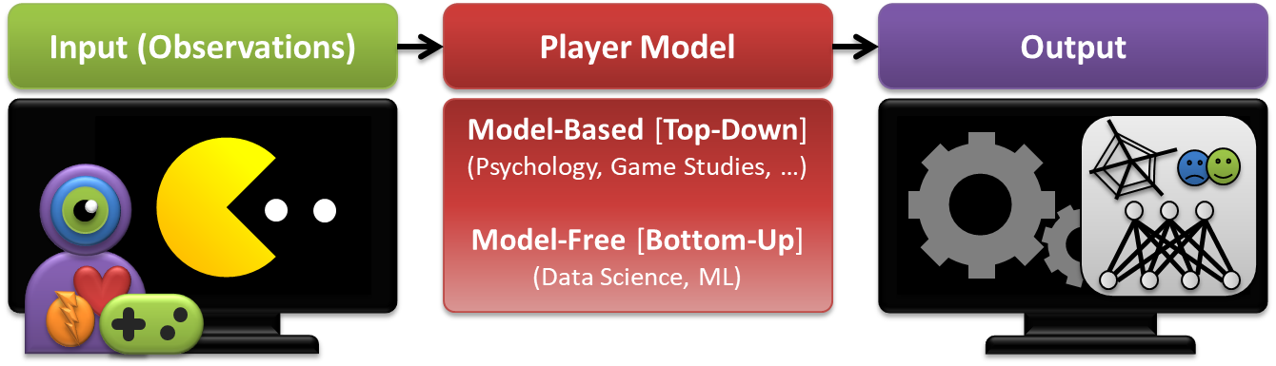
PM in a Nutshell
Yannakakis et al., Player Modeling, in Dagstuhl Seminar on AI/CI in Games, 2013
Notes:
A high-level overview of a player model. The model senses inputs from the player (observations)
such as gameplay patterns, physiological signals or the visual feed, and predicts labeled
outputs related to player behavior (e.g., completion times), experience (e.g., player motivation) or
even unlabeled player embeddings.

Slide 17









Player Modeling – Academia
Notes:
IEEE TAC, TCIAIG special issues
FDG/CIG/CHI/AIIDE special sessions, workshops and panels

Slide 18


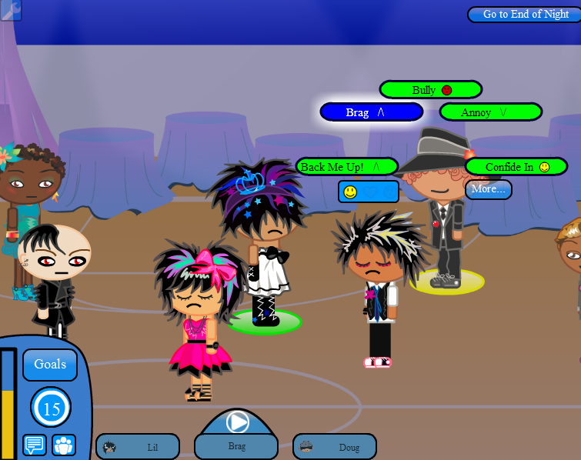



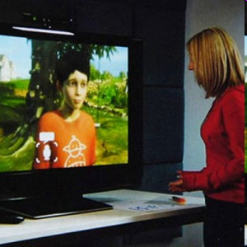
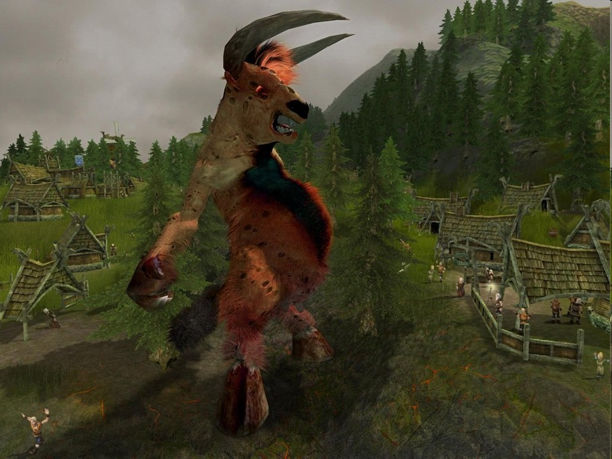


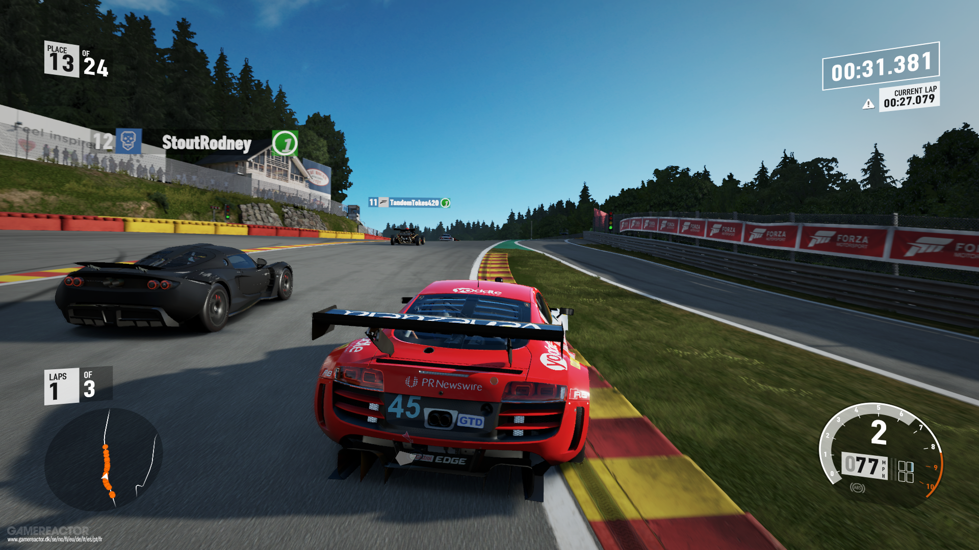
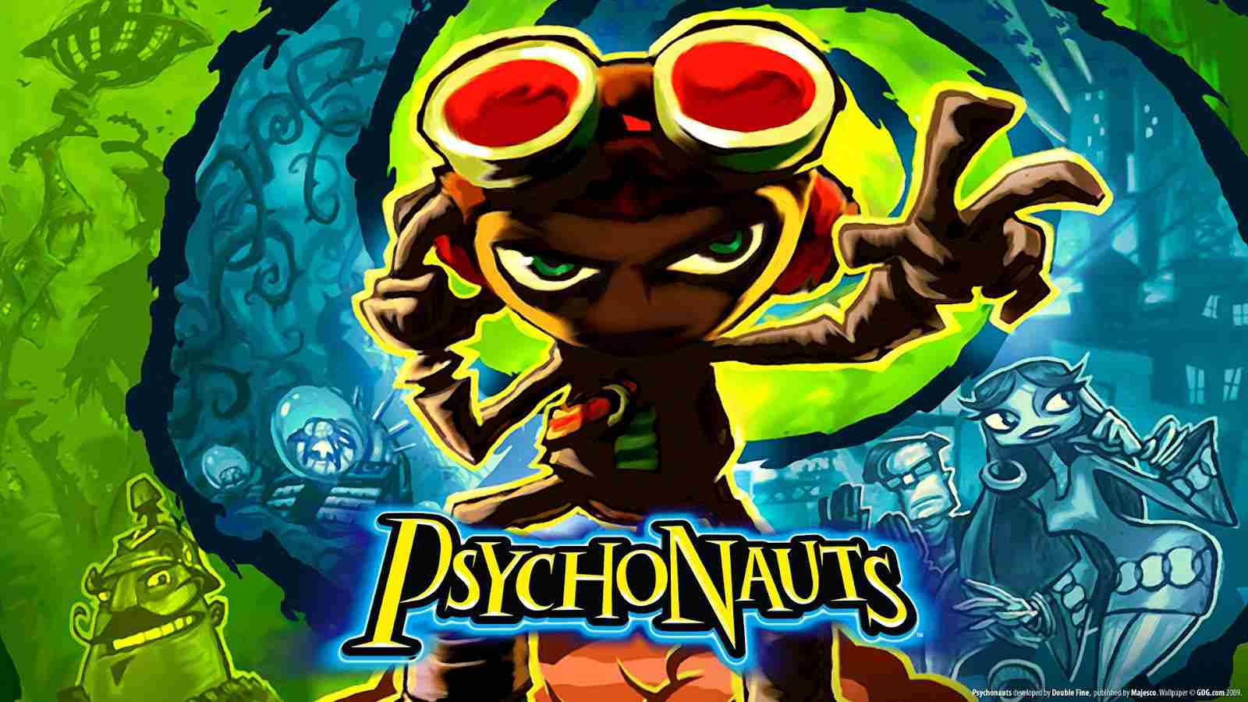
Player Modeling – Industry
Notes:
Arousal-driven appearance of non-player characters (NPCs) Left 4 Dead 2
The fearful combat skills of the opponent NPCs in F.E.A.R.,
The avatars’ emotion expression in the Sims series and Black and White
The emotional play-through for characters in Psychonauts
The emotional responses of game characters in Prom Week and Façade
The personality-based adaptation in Silent Hill: Shattered Memories
The affect-based cinematographic representation of multiple cameras in Heavy Rain
The aesthetically pleasing locations of World of Warcraft
Affect-centred game narratives such as the one of Final Fantasy VII
…

Slide 19
A Player Modeling Taxonomy
Notes:
[see Section 10.3 for more details]

Slide 20
Role
Behavior
Goal
Experience
Analysis
Designer
Design
Static
Player
Adaptive
Approach
Free [Bottom-Up]
Model
Based [Top-Down]
I/O
Static
Observation
Dynamic
Objective
Labeling
Subjective
Notes:
This is the high level player modelling (PM) taxonomy we cover in Chapter 10 of the book
The taxonomy contains 6 key dimensions that affect the design and deployment of a player model; some dimensions are binary while some represent aspects that usually lie somewhere on a continuum of that dimension. We start discussing the possible roles of PM [see Section 10.3.1]; we then discuss a critical dimension related to the player modeling approach used [see Section 10.3.2] and we conclude the presentation of the taxonomy with aspects related to the input and output (I/O) of the player model.

Slide 21
Role
Behavior
Goal
Experience
Analysis
Designer
Design
Static
Player
Adaptive
Notes:
Roles: Given that the core aim of a player model is to uncover phenomena associated with players we can make an important distinction of the roles of such models in games: roles associated primarily to player behavior vs. roles associated primarily
to player experience

Slide 22


Player Modelling
Experience
Behaviour
G. N. Yannakakis and J. Togelius, “Artificial Intelligence and Games,” Springer Nature, 2025.
Notes:
[see Section 10.3.1 for more details]
While player behavior and player experience are interwoven notions there is a subtle difference between them.
Player behavior points to what a player does in a game whereas player experience refers to how a player feels during play

Slide 23


Behavior
Experience
 | Behavior | Experience
 | Use Cases Churn Prediction Toxicity and Cheat Detection Skill Stratification Examples TrueSkill, Toxicity Detection in For Honor | Use Cases Player Motivations Viewer and Player Engagement Experience Stratification Examples Motivation Profiles in Tom Clancy’s The Division
Analysis
Notes:
The six key roles of player modeling associated with the goal of player behavior opposed
to player experience modeling, across the tasks of analysis, design and adaptation as identified in
our taxonomy. Each role (box) contains a number of popular use cases, This figure can be seen as
zooming in on the top right corner of Fig. 10.1 (Slide 12 of this deck) which defines what player modeling is.

Slide 24
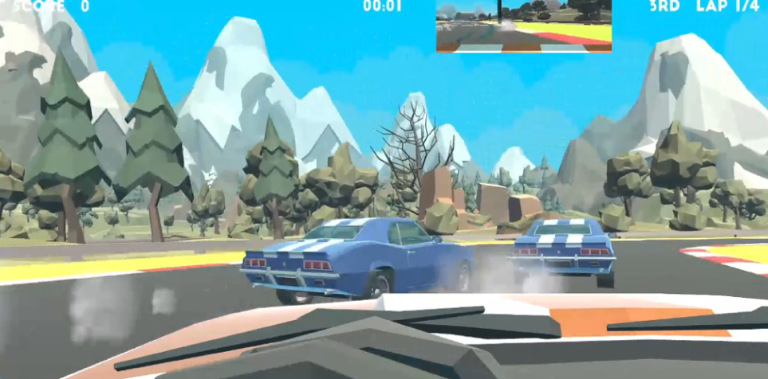
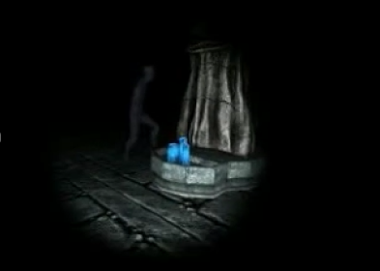
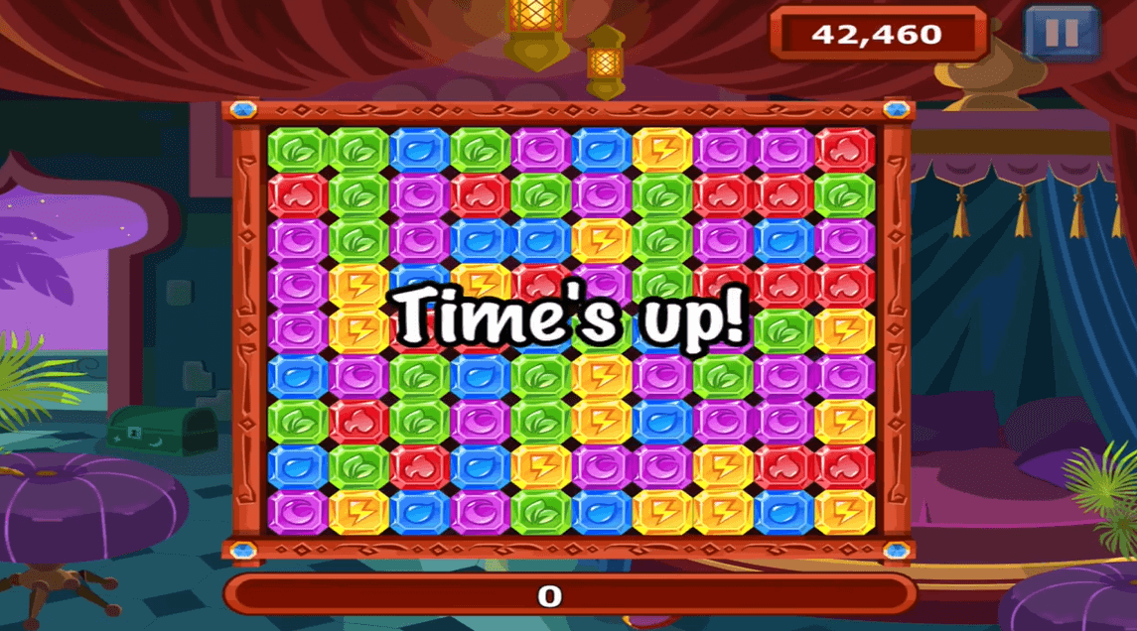
Behavior
Experience
 | Behavior | Experience
 | Use Cases Churn Prediction Toxicity and Cheat Detection Skill Stratification Examples TrueSkill, Toxicity Detection in For Honor | Use Cases Player Motivations Viewer and Player Engagement Experience Stratification Examples Motivation Profiles in Tom Clancy’s The Division
 | Use Cases Game Testing Game Design Monetization Examples Monetization Strategies in Diamond Dash and Monster World | Use Cases Experience Debugging Experience-Driven Design Tools Examples Sonancia: Tension-based Generation Affective Personas in Solid Rally
Analysis
Design
Notes:
The six key roles of player modeling associated with the goal of player behavior opposed
to player experience modeling, across the tasks of analysis, design and adaptation as identified in
our taxonomy. Each role (box) contains a number of popular use cases, This figure can be seen as
zooming in on the top right corner of Fig. 10.1 (Slide 12 of this deck) which defines what player modeling is.

Slide 25

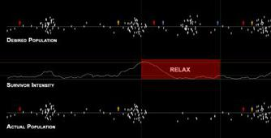
Behavior
Experience
 | Behavior | Experience
 | Use Cases Churn Prediction Toxicity and Cheat Detection Skill Stratification Examples TrueSkill, Toxicity Detection in For Honor | Use Cases Player Motivations Viewer and Player Engagement Experience Stratification Examples Motivation Profiles in Tom Clancy’s The Division
 | Use Cases Game Testing Game Design Monetization Examples Monetization Strategies in Diamond Dash and Monster World | Use Cases Experience Debugging Experience-Driven Design Tools Examples Sonancia: Tension-based Generation Affective Personas in Solid Rally
 | Use Cases Dynamic Game Balancing Online Matchmaking Personalized Content Examples TrueMatch, Antagonist Mr. Peterson in Hello Neighbor | Use Cases Dynamic Game Experience Tailored Experience via NPCs Personalized Content Examples AI Director in Left 4 Dead, Content Adaptation in Nevermind, Profile-based Gameplay in Silent Hill
Analysis
Design
Adaptation
Notes:
The six key roles of player modeling associated with the goal of player behavior opposed
to player experience modeling, across the tasks of analysis, design and adaptation as identified in
our taxonomy. Each role (box) contains a number of popular use cases, This figure can be seen as
zooming in on the top right corner of Fig. 10.1 (Slide 12 of this deck) which defines what player modeling is.

Slide 26
Role
Behavior
Goal
Experience
Analysis
Designer
Design
Static
Player
Adaptive
Approach
Free [Bottom-Up]
Model
Based [Top-Down]
Notes:
[see Section 10.3.2 for more details]
Next, we discuss a critical dimension related to the player modeling approach used: Model-Based (Top-Down vs. Model-Free (Bottom-Up)

Slide 27
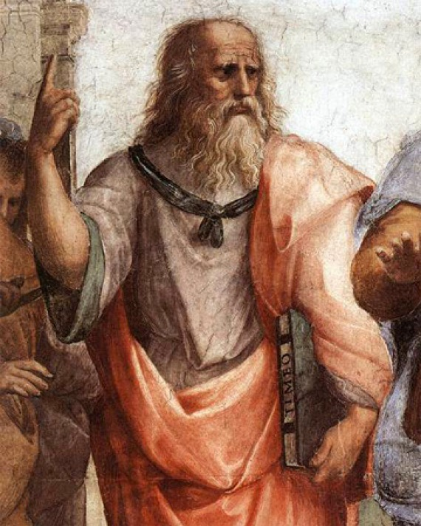
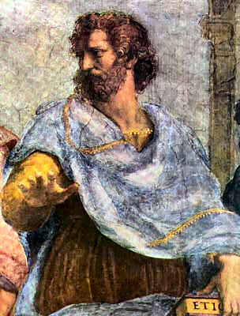
Player Model
Model-Based [Top-Down]
(Psychology, Cognitive Science, Game Studies, …)
Model Free [Bottom-Up]
(Data Science, Machine Learning)
Notes:
A high-level classification of the available approaches for player modeling can be made between model-based (or top-down) and model-free (or bottom-up) approaches. The above definitions are inspired by the analogous classification in RL by which a world model is available (i.e., model-based) or not (i.e., model-free). Given the two ends of this continuum hybrid approaches between them can naturally exist. The gradient red color of the player model box in this Figure illustrates the continuum between top-down and bottom-up approaches.

Slide 28
Player Model
Model-Based [Top-Down]
(Psychology, Cognitive Science, Game Studies, …)
Model-Based
Notes:
[see Section 10.3.2.1 for more details]
In a model-based or top-down approach a player model is built on a theoretical framework. As such, researchers follow the modus operandi of the humanities and social sciences, which hypothesize models to explain phenomena. Such hypotheses are usually followed by an empirical phase in which it is experimentally determined to what extent the hypothesized models fit observations; however, such a practice is not the norm within player experience research. While user experience has been studied extensively across several disciplines, in this book we identify three main disciplines we can borrow theoretical frameworks from and build models of player experience:
Psychology and affective sciences
Neuroscience
Game studies and game research

Slide 29
Neuroscience
Notes:
[see Section 10.3.2.1 for more details]
A number of studies have relied on the working hypothesis of an underlying mapping between the brain, its neural activity and player experience. However, this relationship is not well explored and the presumptive mapping is largely unknown. We will now cover briefly some key assumptions and evidence that might be relevant to top-down player modelling.

Slide 30
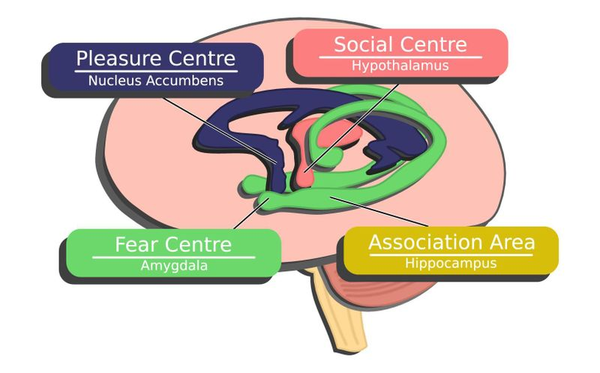
Neurobiology of Play
Neuroscience – via fMRI
Interest (or curiosity): visual cortex (hippocampus) and endomorphin.
Explorer (Barter) / Easy Fun (Lazzaro) / Curiosity (Malone) → Wonder: endomorphin (pleasure center)
Achiever (Bartle) → Achievement: dopamine (pleasure center).
Hardcore gamers / Hard Fun (Lazzaro) → Fiero: dopamine (pleasure center)
Serious Fun (Lazzaro) → Excitement: adrenaline (fear center)
Socialiser (Bartle) / People Fun (Lazzaro) → Enjoyment: oxytocin (social center) and dopamine (pleasure center)
Bateman, Chris, and Lennart E. Nacke. "The neurobiology of play" Proceedings of the International Academic Conference on the Future of Game Design and Technology. ACM, 2010.
Notes:
[see Section 10.3.2.1 for more details]
Please refer to the cited work for more details

Slide 31
Psychology and Affective Sciences
Notes:
[see Section 10.3.2.1 for more details]
Within top-down player modeling we will first cover a number of key notions and definitions within psychology and affective sciences

Slide 32
Where it all started…
Theory of “Pathos”, Rhetoric
On the soul

Slide 33
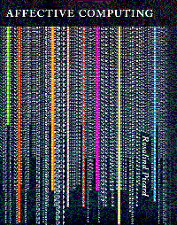
Psychology and Affective Sciences
“Affective computing is the study and development of systems and devices that can recognize, interpret, process, and simulate human affect” (Wiki)
Term coined by R. Picard (1999)
Notes:
[see Section 10.3.2.1 for more details]

Slide 34
Emotion
Emotion is a subjective, conscious experience characterized primarily by psychophysiological expressions, biological reactions, and mental states. (Wikipedia)
NB: Emotion (and affect) is a construct with fuzzy boundaries!

Slide 35

Cognitive Appraisal
Cognitive appraisal
You see a shark!
Physiological Manifestation(s)
High adrenaline, increased HR, pupil dilation, increased skin conductivity
Action(s)
You scream, swim away, fight (?!)
Notes:
Emotion occurs in the following order:
Cognitive appraisal—The individual assesses the event cognitively, which cues the emotion.
Physiological changes—The cognitive reaction starts biological changes such as increased heart rate or pituitary adrenal response.
Action—The individual feels the emotion and chooses how to react.
For example:
Jenny sees a shark.
Jenny cognitively assesses the shark in her presence. Cognition allows her to understand it as a danger.
Her brain activates adrenaline gland which pumps adrenaline through her blood stream resulting in increased heartbeat.
Jenny screams and runs away.

Slide 36
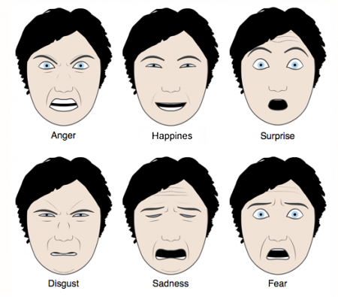
Emotion Representation – Ekman
Emotions
Are discrete (states)
Are measurable
Can be identified through their physiological or bodily manifestations
The 6 basic emotions are culture-independent

Slide 37
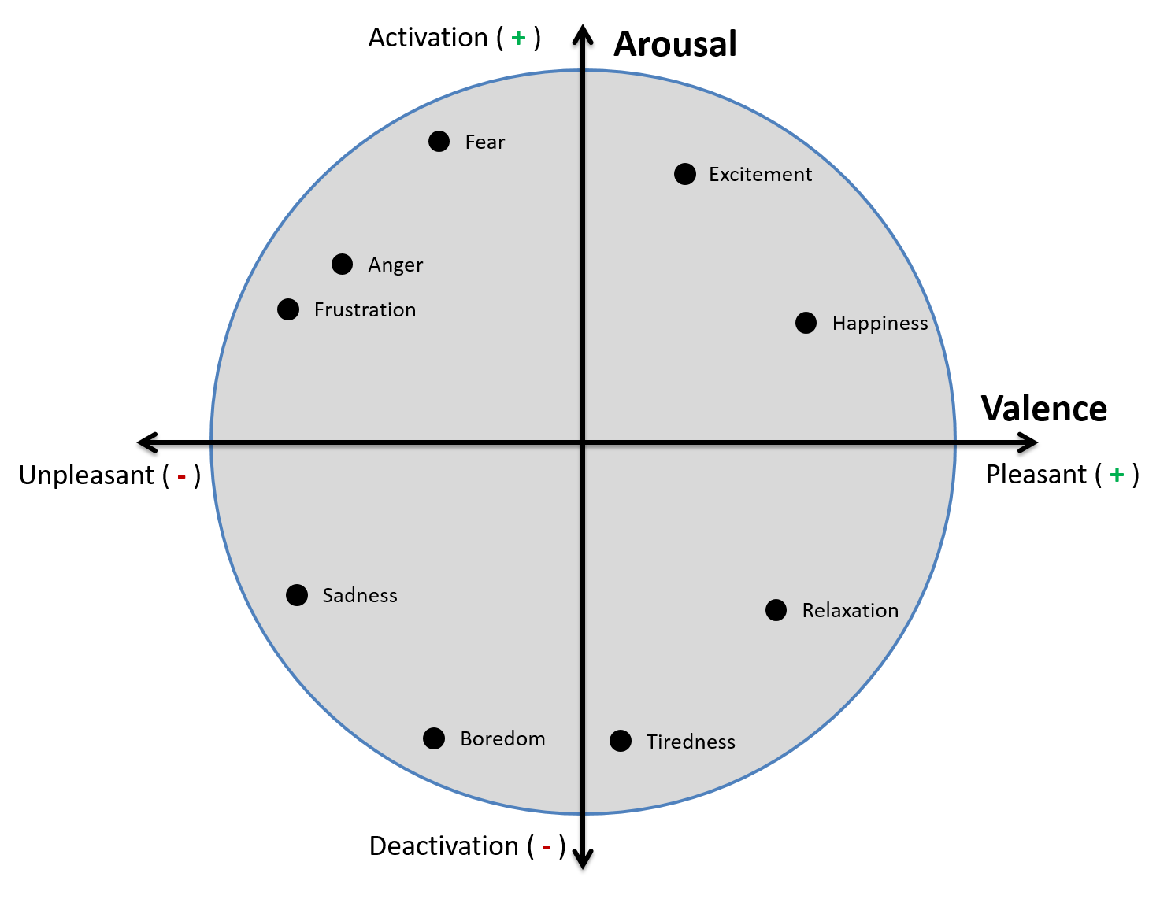
Emotion Representation – Russell
Emotions
Are scalar values
Represented in a 2-d plane: arousal vs. valence
Are measurable
Can be identified through physiological or bodily manifestations
Notes:
The Circuplex Model by Russell

Slide 38
Games Best Realizes the Affective Loop
Yannakakis and Paiva, Emotion in Games, in Handbook of Affective Computing, 2013
Manifestations
Experience
Elicitation
Experience
Detection/Modelling
Emotion stimuli
Game parameter space
Adaptation and Emotion Expression
Game Content
Game Agents
Notes:
This is a reminder slide about affective Loop and affective interaction
This is an illustration of the affective loop as applied to games. The 3 core phases include: emotion elicitation, emotion detection and emotion expressions. Here are some reasons why games offer the best possible realization of the affective loop.
Emotion elicitation: games offer brilliant contextual building blocks for eliciting emotion as stimuli are variant and come from different sources such as images, sounds, stories etc.
Emotion Detection: users of games (players) are generally more that willing to provide more input of multimodal nature (via sensors) as long as that would lead to enhanced experience. In a sense, players are the best possible users for affective computing and multimodal interaction studies
Emotion Adaptation:
Users voluntarily go through a spectrum of experiences during play: these vary from the very positive to the very negative ones
Affective experiences in games are affected by players! As a result a player is used to and largely open to affect-based adaptation!
EDPCG realises the game affective loop by offering content that is “appropriate” (based on experience heuristics) for players. EDPCG is a content-based formalization of the game affective loop.

Slide 39
Game Studies, Game Design and GUR
Notes:
[see Section 5.3.1.3 for more details]
Finally we will cover a number of key notions and definitions within game studies and game research relevant to top-down player modelling.

Slide 40

“Fun”
“Fun” and friends
  Learnability
  The right difficulty level
  Challenge – Curiosity – Fantasy
  Hard Fun / Easy Fun / X Fun / ...
  Adrenalin / Dopamine
  Arousal / Positive Emotions
  Flow
  …

Slide 41
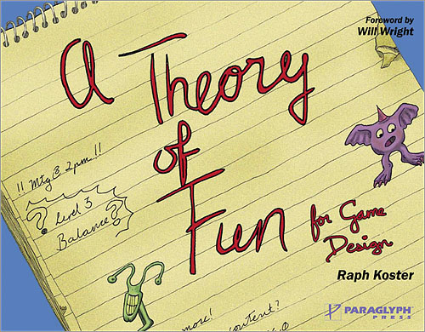

Dame Design - A Theory of Fun (Koster, 2005)
Fun = Learning
Complex training signals / patterns → Learning Difficulty → Frustration → No Fun!
Seen (and mastered) training signals / patterns → Boredom → No Fun!

Slide 42

Evolving Game Rules Based on Koster
Fun of an AI agent
=
Learnability during the game
Togelius, J., & Schmidhuber, J. (2008, December). An experiment in automatic game design. In Computational Intelligence and Games, 2008. CIG'08. IEEE Symposium On (pp. 111-118). IEEE.
Notes:
See cited paper for more details

Slide 43
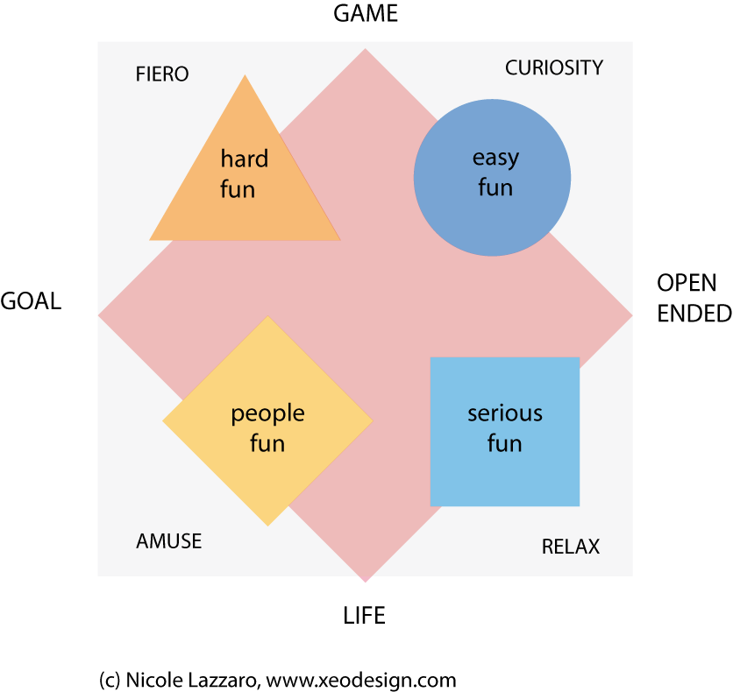
Lazzaro’s 4 Fun-factor Model
Notes:
HARD FUN
Playing to see how good I really am
Playing to beat the game
Having multiple objectives
Requiring strategy rather than luck
EASY FUN
Exploring new worlds with intriguing people
Excitement and adventure
Wanting to figure it out
Seeing what happens in the story, even if I have to use a walk through
Feeling like me and my character are one
SERIOUS FUN (Altered states)
Clearing my mind by clearing a level
Feeling better about myself
Avoiding boredom
Being better at something that matters
PEOPLE FUN
It’s the people that are addictive not the game.
I want an excuse to invite my friends over.
I don’t like playing games, but it’s a fun way to spend time with my friends.
I don’t play, but it’s fun to watch

Slide 44
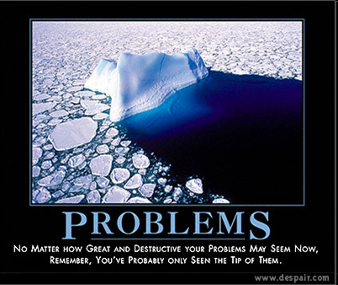
Problems with “Fun”
Way too many
Complex – composite of other things…
  Engagement, interest, immersion, …? Who knows?
Quasi/Fake Emotion (not real!)
Nowhere in any model of emotion
No device can measure “fun”
But
People can still express it…
Ask 4-yo children if they are immersed….

Slide 45
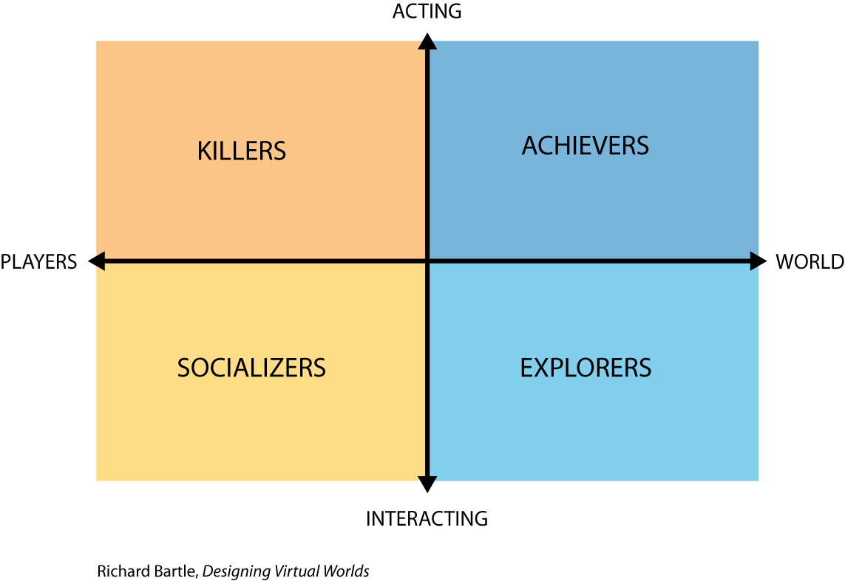
Player Archetypes
Bartle, Richard A. Designing virtual worlds. New Riders, 2004.
Notes:
[Please refer to the cited book of Bartle for more details]
KILLERS:
Focus: winning / competition
Engaged by: ranks, leaderboards
ACHIEVERS
Focus: attaining status and achieving preset goals quickly/completely
Engaged by: achievements
SOCIALIZERS
Focus: Socializing / develop network of friends/contacts
Engaged by: friend lists/newsfeed/chat
EXPLORERS
Focus: exploring/discover the unknown
Engaged by: fuzzy achievements…

Slide 46
Flow (Csikszentmihalyi, 1975)
Flow is the state of “happiness”
When in Flow:
1. focused concentration on the present moment
2. loss of reflective self-consciousness
3. sense of personal control or agency over the situation or activity
4. a distortion of temporal experience (subjective experience of time is altered)
5. experience of the activity as intrinsically rewarding
Notes:
Characteristics of the flow state

Slide 47
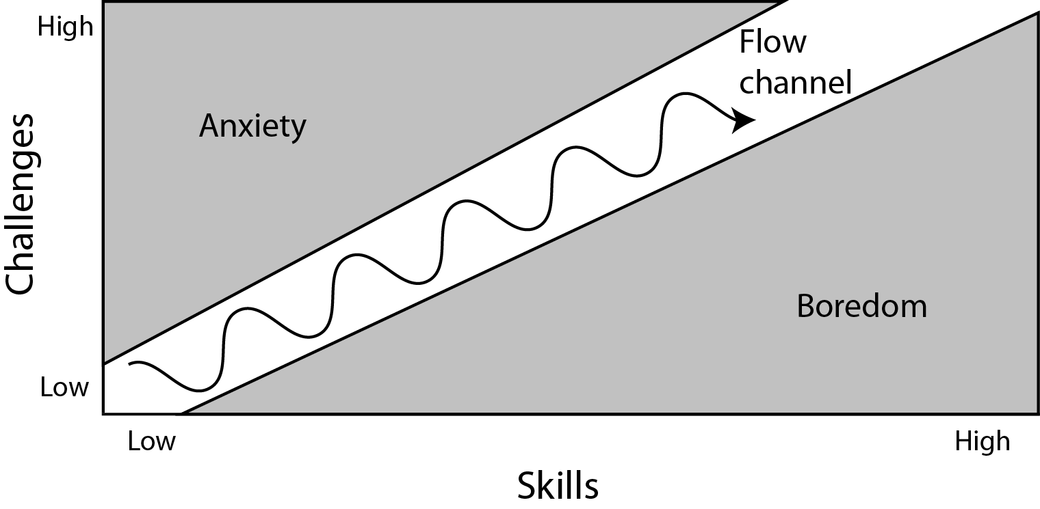
Flow (Csikszentmihalyi, 1975)
Notes:
An illustration of the flow channel

Slide 48
Malone (1981) : Challenge, Curiosity and Fantasy
Challenge
Uncertainty of achieving a goal due to e.g. variable difficulty level, multiple level goals, hidden information, and randomness.
Fantasy
Show (or evoke) images/situations/context not present
  Extrinsic: depends on the skill used in a game
  Intrinsic: related to the use of that skill.
Curiosity
What will happen next to the game?
  Sensory curiosity
  Cognitive curiosity – it can be aroused via incomplete/inconsistent knowledge structures
T. Malone, Toward a Theory of Intrinsically Motivating Instruction, Cognitive Science, 1981
Notes:
[Please refer to the cited paper for more details]

Slide 49
Entertainment Modelling based on Malone
Prey/Predator Games
G. N. Yannakakis, and J. Hallam, “Modeling and Augmenting Game Entertainment through Challenge and Curiosity,” International Journal on Artificial Intelligence Tools, vol. 16, issue 6, pp. 981-999, December 2007.
Notes:
[Please refer to the cited paper for more details]
The graphs depict the function between entertainment (y), in-game challenge (Ε{t_k}) and in-game curiosity (σ{t_k}) in Pac-Man like games. The function is modelled through an artificial neural network (left image) or a neuro-fuzzy model (right image). Both models are trained via preference learning on self-reported pairwise preferences of entertainment from players of the game. Note the inverse U-shaped functions confirming Malone’s assumption that average levels of challenge and curiosity yield, on average, higher degrees of entertainment.

Slide 50
Entertainment Modelling based on Malone
Playware Playground
G. N. Yannakakis, and J. Hallam, “Modeling and Augmenting Game Entertainment through Challenge and Curiosity,” International Journal on Artificial Intelligence Tools, vol. 16, issue 6, pp. 981-999, December 2007.
Notes:
[Please refer to the cited paper for more details]
The graphs depict the function between entertainment (y), in-game challenge (S: game speed) and in-game curiosity (H: opponent appearance entropy) in physical interactive games (left image). The function is modelled through an artificial neural network (right image) trained via neuroevolutionary preference learning on self-reported pairwise preferences of entertainment from players of the game. Note the inverse U-shaped function confirming Malone’s assumption that average levels of challenge and curiosity yield, on average, higher degrees of entertainment.

Slide 51

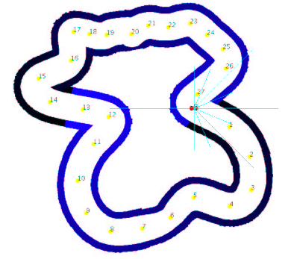
Evolving Racing Tracks Based on Malone
Togelius, J., De Nardi, R., & Lucas, S. M. (2007). Towards automatic personalised content creation for racing games. In Computational Intelligence and Games, 2007. CIG 2007. IEEE Symposium on (pp. 252-259). IEEE.
Notes:
[Please refer to the cited paper for more details]

Slide 52
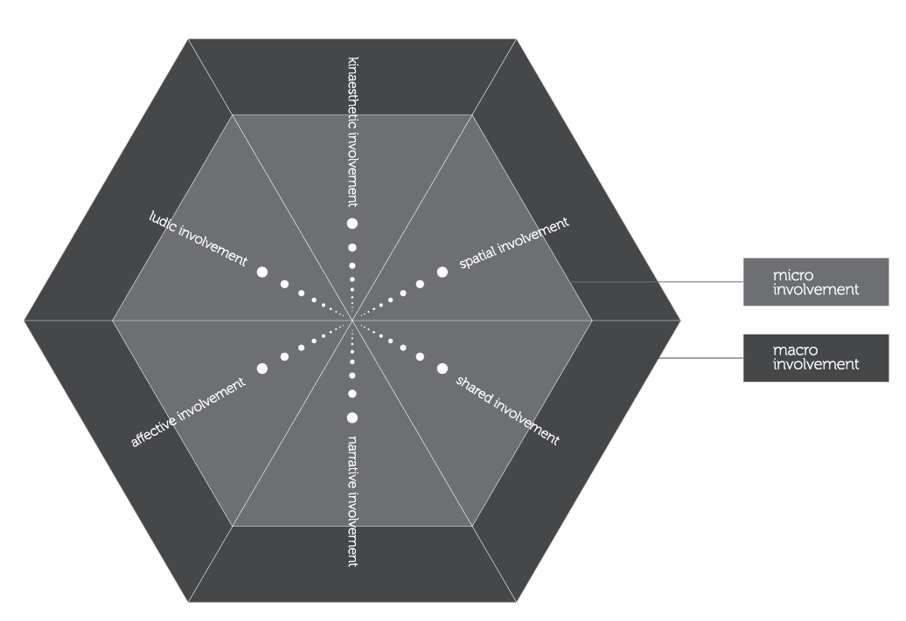
Player Incorporation Model (Calleja, 2011)
Gordon Calleja. In-game: from immersion to incorporation. MIT Press, 2011.
Notes:
[Please refer to Calleja’s book for more details]
Micro: moment to moment aspects of involvement
Macro: long-term aspects

Slide 53
Player Model
Model Free [Bottom-Up]
(Data Science, Machine Learning)
Model-free: From Theory to Data
Notes:
[see Section 10.3.2.2 for more details]
Model-free approaches follow the modus operandi of the exact sciences, in which observations are collected and analyzed to generate models without a strong initial assumption on what the model looks like or even what it captures.
Any ML technique or statistical approach can be used for the construction of the mapping between the input and the output of the model. While supervised learning (and its variants) is the dominant player modelling paradigm, RL and unsupervised learning are applicable.
Chapter 11 [text and slides] offer more details regarding the various methods that are applicable depending on the availability of human demonstrations and labels of player states.

Slide 54

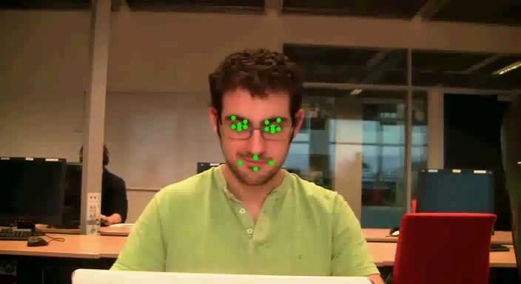
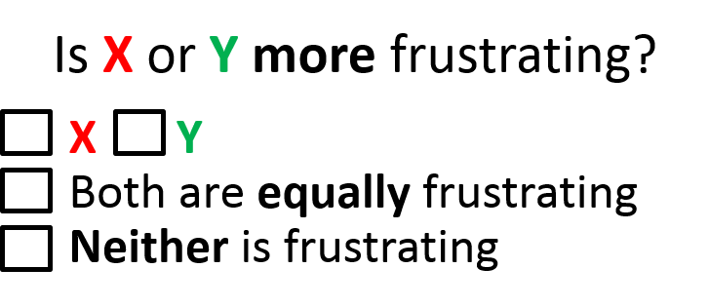
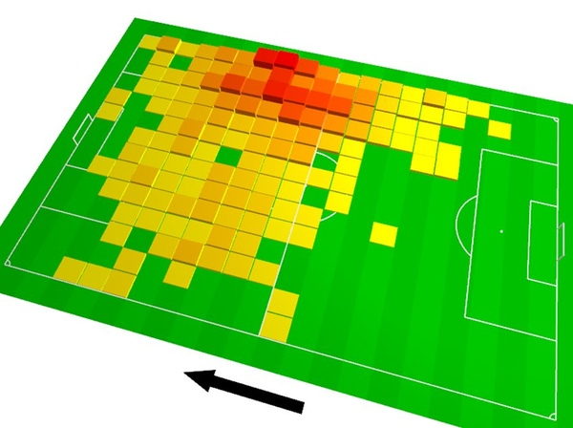
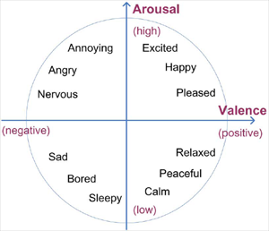
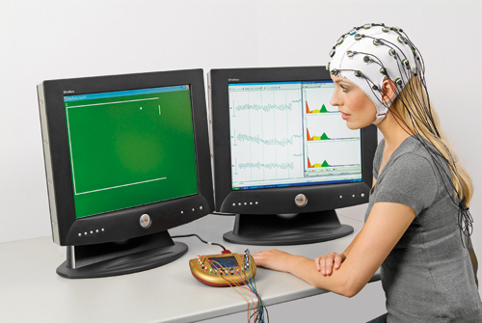
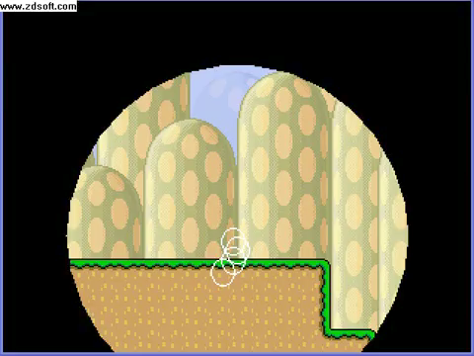
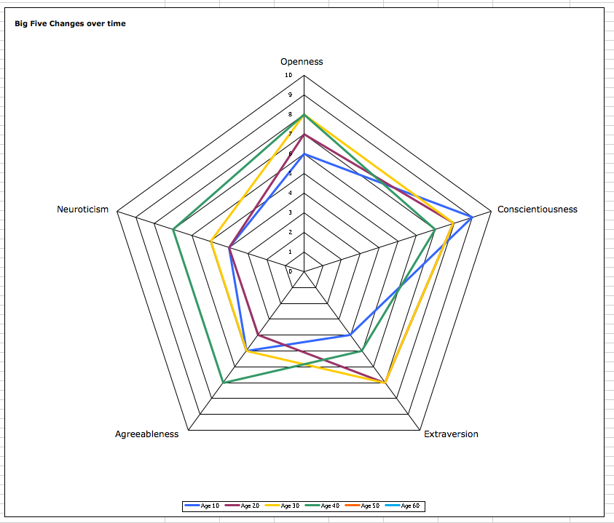


Model-Free PM in a Nutshell
Yannakakis et al., Player Modeling, in Dagstuhl Seminar on AI/CI in Games, 2013
Input (Observations)
Output
Player Model
Sad?
G. N. Yannakakis, P. Spronck, D. Loiacono and E. Andre, “Player Modeling,” in Togelius et al., (Eds.) Dagstuhl Seminar on Artificial and Computational Intelligence in Games, 2013.
Notes:
[see section 10.3.2.2 for more details]
On the left (input) there is rich input that comes from multiple modalities of player signals (manifestations of experience) including gameplay data, physiology, gaze tracking etc.
On the right (output) there are labels of experience (annotators) in various formats
In between there is a computational model (AI) that maps between the two

Slide 55

Game Analytics
Notes:
[please refer to the depicted books by Seif El-Nasr et al. for more details]
Recently the growing deployment of game telemetry tools started offering researches large sets of game
and player data. This data availability has opened up the horizons of behavioral data
mining in games (game data mining) and gradually introduced the subfield
of game data science.

Slide 56
Basic Definitions
Game analytics: application of analytics to game development and research.
Goal: support decision making, at operational, tactical and strategic levels for design, art, programming, marketing, user research, etc.
Game metrics: interpretable measures of something related to games
  User/Player metrics
      User: customer, gameplay community
      Gameplay: interface, in-game
  System metrics

Slide 57
What’s the Problem?
Understanding players
  Behaviour
  Player Experience
How do people play a game?
Do they play the game as intended?

Slide 58
What’s the Problem?
Debugging costs!
  Code debugging
  Experience debugging
Play testing costs!
Non-linear games
  Testing is challenge
Improve next game release costs!
…

Slide 59
Game Data Visualization
Notes:
A core aspect of game analytics is the way we visualise data once we obtain it – we will dedicate a few slides on this aspect of data analysis in games

Slide 60
Descriptive Statistics in Games
Very important to visualise data prior to further processing
Lots of information is hidden in basic statistics and analytics

Slide 61
An Example: Tomb Raider: Underworld
A. Drachen, A. Canossa, and G. N. Yannakakis, “Player Modeling using Self-Organization in Tomb Raider: Underworld,” inProceedings of the IEEE Symposium on Computational Intelligence and Games, Milan, September, 2
Notes:
[for more details please refer to the cited paper]
Percentages of the four causes of death in Tomb Raider: Underworld over the game’s 7 levels
Sample size: 10,000 players
Causes of death:
D_m: melee death from enemies
D_r: ranged death from enemies
D_e: environment
D_f: falling

Slide 62
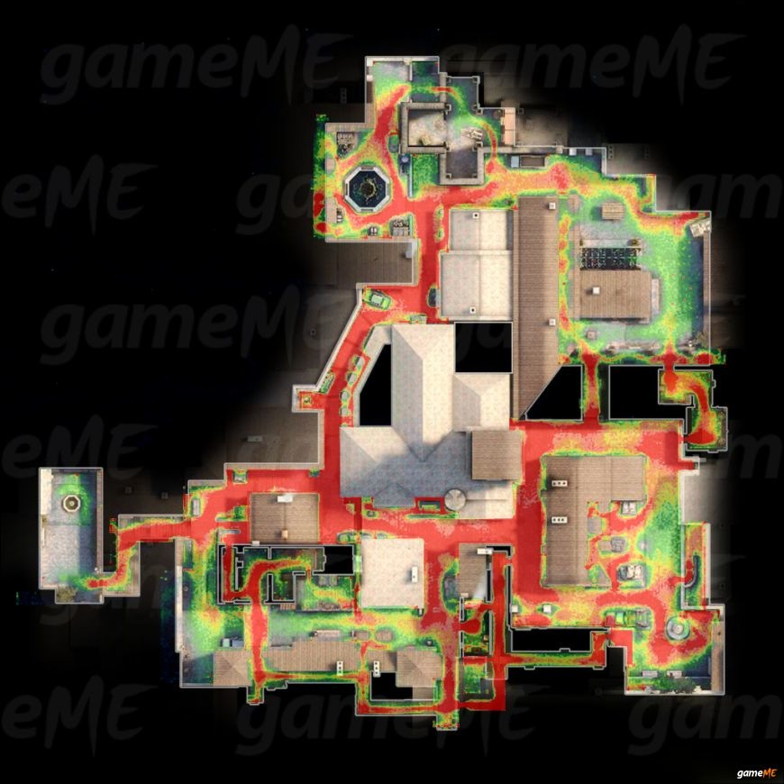
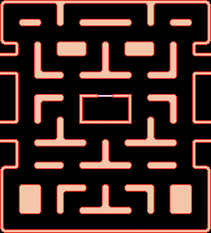
Heatmaps
Plot specific information over the map of a level
Typically, counts of a particular event in a map location
The higher the count, the higher the temperature
Notes:
A heatmap is one of the most popular ways of vizualising game/player data. A heatmap reveals the relation between the distribution of the data and the game level.

Slide 63

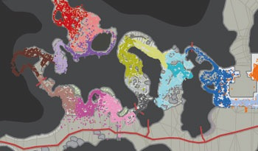
Heatmaps in Halo
Source: How Microsoft Labs Invented a New Science of Play, Thompson, Wired, 2007
Number of deaths
Player navigation
Notes:
An example of dissimilar heatmaps in Halo

Slide 64
Heatmap in Just Cause 2
Drachen and Shubert. Spatial Game Analytics, in El-Nasr et al (Eds.) Game Analytics: Maximizing the value of Player Data.
Notes:
A heatmap example in Just Cause 2 (Sqare Enix Europe)
More than 22.3 Million events
Larger is white
Please refer to the cited paper for more details

Slide 65
Menu Heatmap
Drachen and Schubert. Spatial Game Analytics, in El-Nasr et al (Eds.) Game Analytics: Maximizing the value of Player Data.
Notes:
The image depicts a menu heatmap of user clicks from game Youda Lewel Shop using the Playtomic heatmap function. A heatmpap as such can provide useful information on the use of buttons vs. the non-use of alternate use of buttons or other visual conten. In this example several players clicked on the dress to change it but the dress cannot change in this game.

Slide 66
Player Click Heatmaps
Drachen and Schubert. Spatial Game Analytics, in El-Nasr et al (Eds.) Game Analytics: Maximizing the value of Player Data.
Notes:
Another example of a menu heatmap of user clicks from game Stackwick Legacy using the Playtomic heatmap function

Slide 67
Trajectory
Analysis
Notes:
Trajectory analysis is a decisive step from the spatial to the spatiotemporal space!
Example depicted in the image: DNA viewer used by Ubisoft
While most players would take the parachute path during the tutorial (desired path) some would take the ground path which is far less fun.
Ubisoft fixed the level so that no player takes the ground path and hence the game is more engaging for everyone.

Slide 68
Game Analytics as a Service
Can be viewed as a service to
Game Developers (publishers, designers, programmers etc.)
Third Parties (recommendation systems, adverts, etc.)
Players (own performance, tailored challenges, game aids, etc.)
Ben Medler. Visual Game Analytics, in El-Nasr et al (Eds.) Game Analytics: Maximizing the value of Player Data.
Notes:
Please refer to the cited paper for more details

Slide 69

Mining Data in Games
Tracking data in games is a common practice
The amount of data is usually huge
One does not simply spot patterns in the data
Data mining provides methods for finding regularities and anomalies
Drachen, Anders, Christian Thurau, Julian Togelius, Georgios N. Yannakakis, and Christian Bauckhage. "Game data mining." In Game analytics, pp. 205-253. Springer, London, 2013.

Slide 70
Game Data Mining:
What can it do for you?
Supplementary approach to traditional testing
Imitate human playing styles
Identify player profiles
Spot cheating
Spot game design flaws (e.g. “sweet spots” and frustrating sections)

Slide 71
Game Data Mining:
What can it do for you?
Tell you when and why players stop playing
Enable player-driven adaptive games
Overall, help you make better games
  Project management
  Marketing
  Customer care

Slide 72
Game Data Mining:
What can it do for you?
A few examples
Find weak spots in the design of game
Which assets that are not getting used
Figure out how players spend their time when playing
Predict when they will stop playing
Predict what they will do while playing
Discover gold farmers in an MMORPGs
Explore and use of social grouping
Figure out how to convert non-paying to paying users
Notes:
2 main uses: understanding players (behaviour, style, experience) and testing (Players vs game design)
Testers vs alpha players | Code and experience debugging | Nonlinear games

Slide 73
Hybrids
Notes:
[see Section 10.3.2.3 for more details]

Slide 74
Player Modelling: Limitations
Yannakakis et al., Player Modeling, in Dagstuhl Seminar on AI/CI in Games, 2013
Model-based (theory-driven):
  The majority of models have not been tested on or derived from interactive media
  Models are not cross-validated (they should be!)
  Agent-based models (OCC, BDI) – rather limited to agent-based interaction (it’s limited in games)
Model-free (data-driven):
  Big data, crowdsourcing, elegant ML (e.g. deep learning / sequence mining), sensor technology
  Supreme and obvious given the availability of big data and crowdsourcing
  Problems: quality / quantity of data
  Problems: garbage in – garbage out

Slide 75
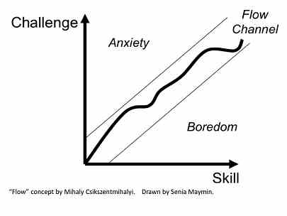
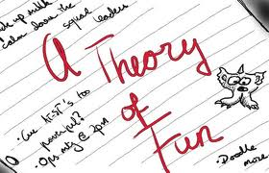


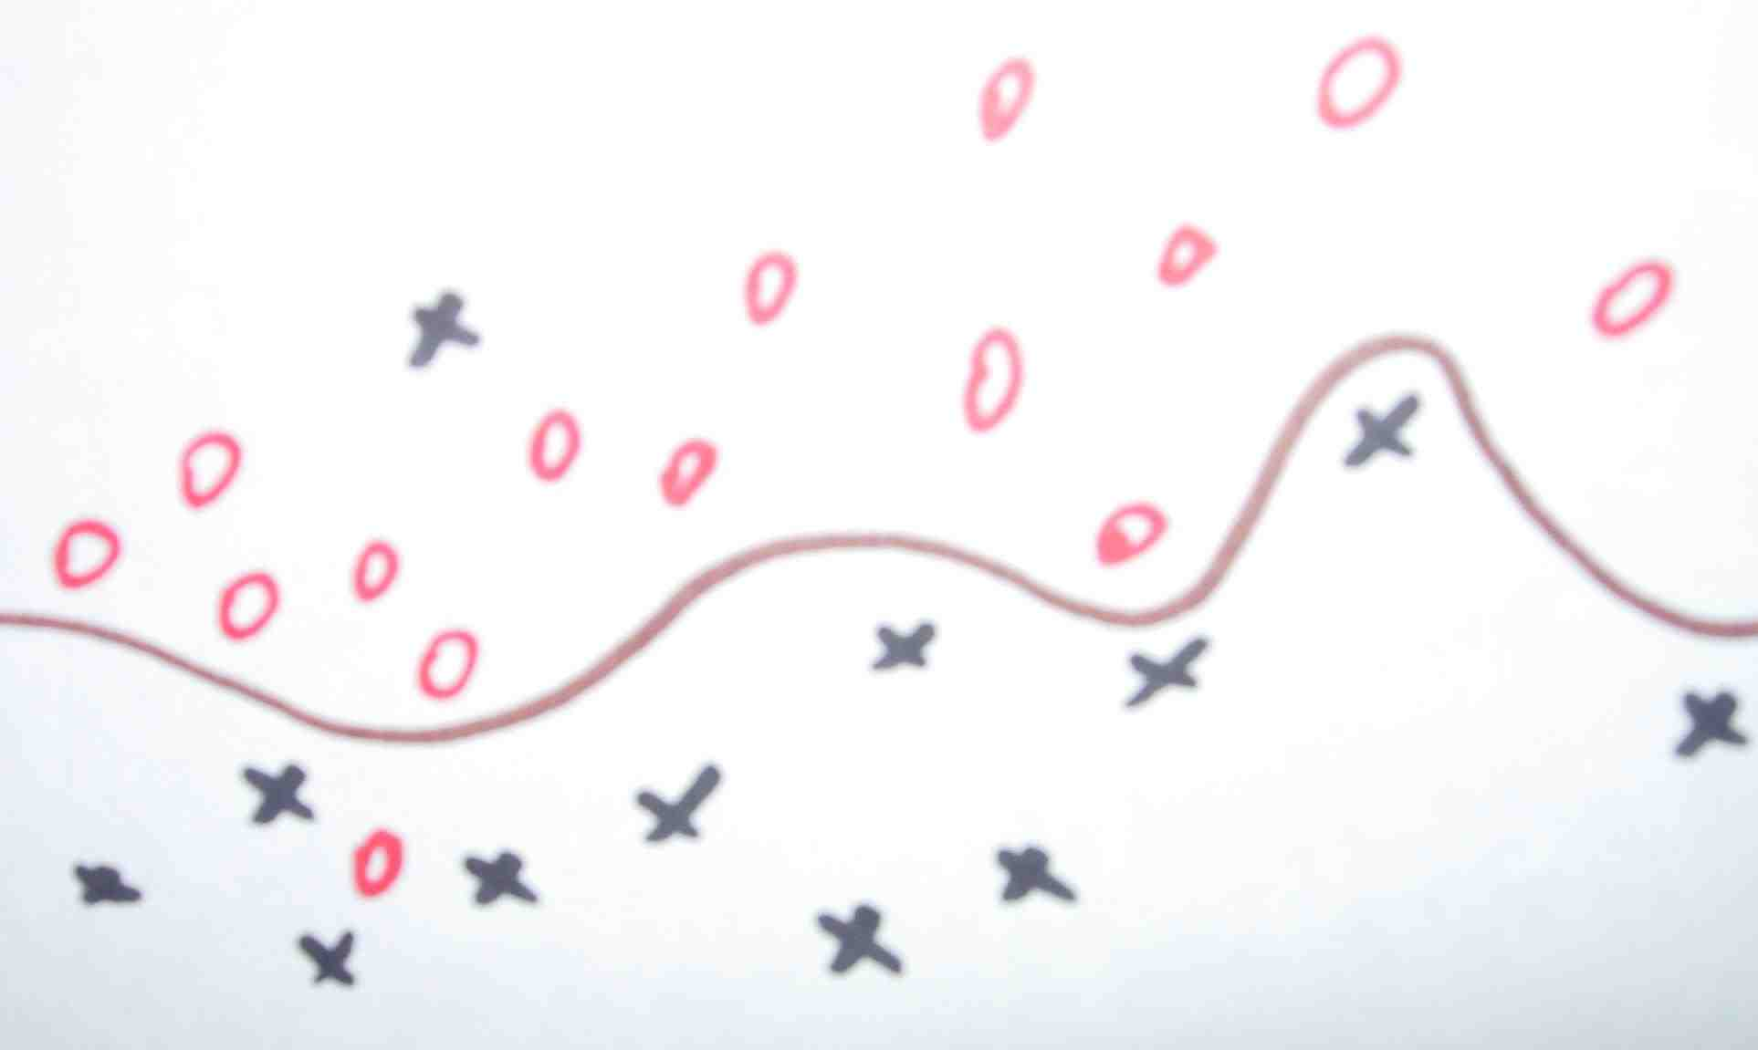


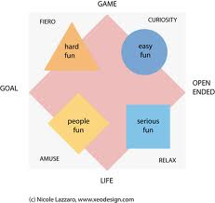
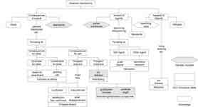


Player Modelling: Hybrid Approaches
Yannakakis et al., Player Modeling, in Dagstuhl Seminar on AI/CI in Games, 2013
Theory (model-based) | Data (model-free)
Notes:
[see Section 10.3.2.3 for more details]
The space between a completely model-based and a completely model-free approach can be viewed as a continuum along which any player modeling approach might be placed. While a completely model-based approach relies solely on a theoretical framework that maps a player’s responses to game stimuli, a completely model-free approach assumes there is an unknown function between modalities of user input and player states that a machine learner (or a statistical model) may discover, but does not assume anything about the structure of this function. Relative to these extremes, the vast majority of studies in player modeling may be viewed as hybrids that synergistically combine elements of the two approaches.

Slide 76
Role
Behavior
Goal
Experience
Analysis
Designer
Design
Static
Player
Adaptive
Approach
Free [Bottom-Up]
Model
Based [Top-Down]
I/O
Static
Observation
Dynamic
Objective
Labeling
Subjective
Notes:
This is the high-level player modelling (PM) taxonomy we cover in Chapter 10 of the book
We conclude the presentation of the taxonomy with the two aspects related to the input and output (I/O) of the player model: observation and labeling.

Slide 77
Observation
Notes:
[see Section 10.3.3 for more details]

Slide 78
Observation: Static vs. Dynamic
Dynamic observation: refers to any data of the player and their game that vary temporally
Examples: physiological responses, in-game responses, current game state, player skill.
Static observation: refers to any data that contains static information of the player that normally includes aspects of their profile
Examples: game preferences, preferred modes of play.
NB. Several aspects of a player profile can be potentially dynamic (e.g., age and style) but normally those aspects change at a slow rate.
Notes:
[see Section 10.3.3 for more details]
The core differences between static and dynamic observations that may serve as a model’s input are also detailed in Section 11.1

Slide 79

Labeling: What is the value of experience?
Notes:
[see Section 10.3.3 for more details]
To model the experience of the player one needs to have access to labels of that experience. Those labels ideally need to be as close to the ground truth of experience as possible. The ground truth (or gold standard) in affective sciences refers to a hypothesized and unknown label, value, or function, that best characterizes and represents an affective construct or an experience. Labels are normally provided through manual annotation which is a rather laborious process. Manual annotation is however necessary given that we require some estimate of the ground truth for subjective notions such as the emotional states of the player. The accuracy of that estimation is regularly questioned as there are numerous factors contributing to a deviation between a label and the actual underlying player experience.

Slide 80

A thesis: experience is intrinsically ordinal (relative)
The thesis is supported by theoretical arguments and empirical evidence across disciplines
It reframes the way player experience is viewed, represented and analysed computationally
Yannakakis, Cowie, Busso, The Ordinal Nature of Emotions: An Emerging Approach, IEEE Trans. on Affective Computing, 2018 [Outstanding IEEE TAC Paper, Nominated Best of IEEE Paper]

Slide 81

Basically do this…if you can!
To Fun
To Fun Not!
  Reliability+
  Validity+
  Generality+

Slide 82
Chapter 11: From Observations to Models of Players
Notes:
[see Chapter 11 for more details]

Slide 83
What is the Model’s Input Like?
Notes:
[see Section 11.1 for more details]

Slide 84
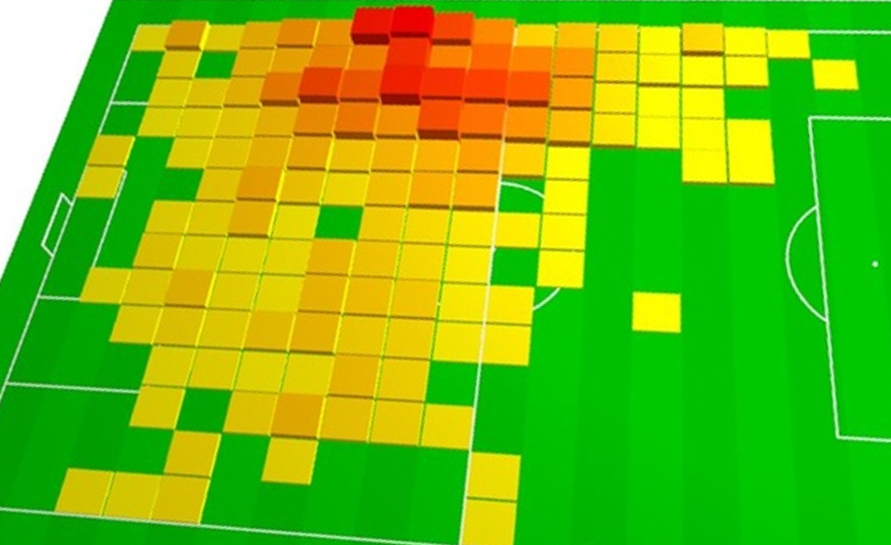
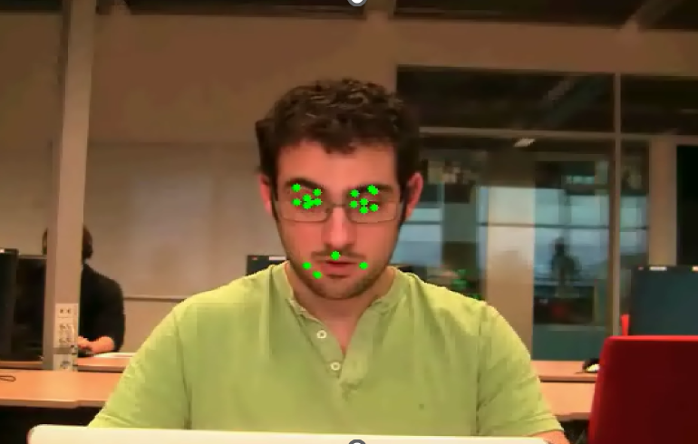
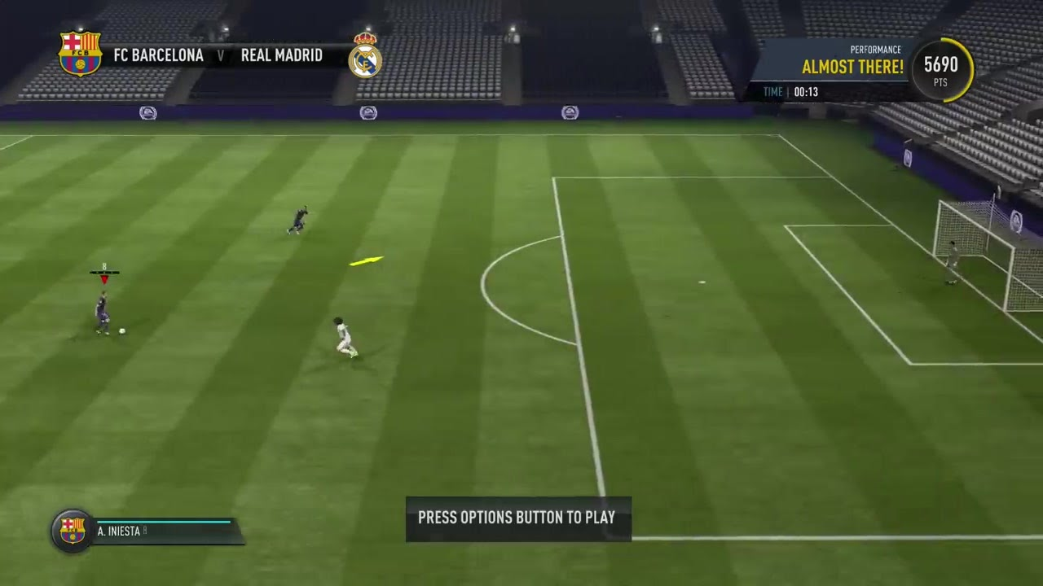

Input (Observations)
Player Model
Output
Input (Observations)
Gameplay
Objective
Context
Player Profile
Notes:
[see Section 11.1 for more details]
The various options for the input (observations) of a player model as discussed in Section
11.1. The observations of the model may include gameplay or objective data, the game context,
and information about the player’s profile. The dotted box indicates that the player profile is the
only input type containing static information.

Slide 85
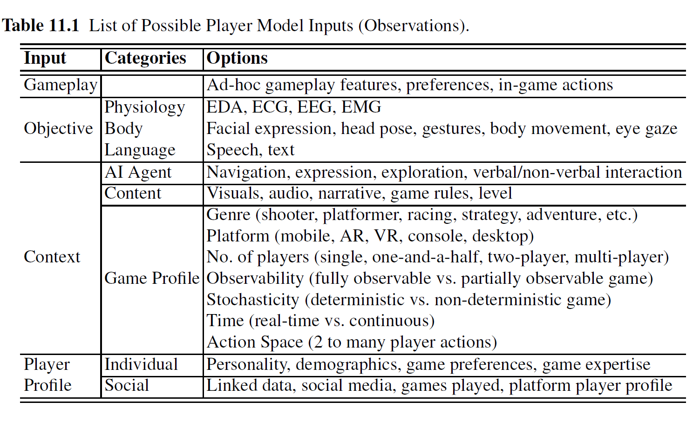
Input (Observations)
Notes:
[see Section 11.1 for more details]

Slide 86
Gameplay

Slide 87
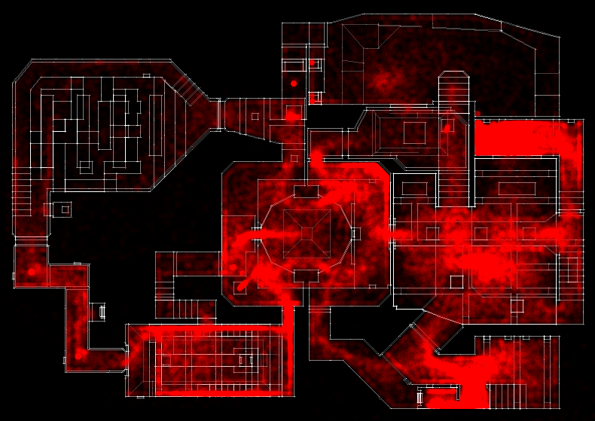
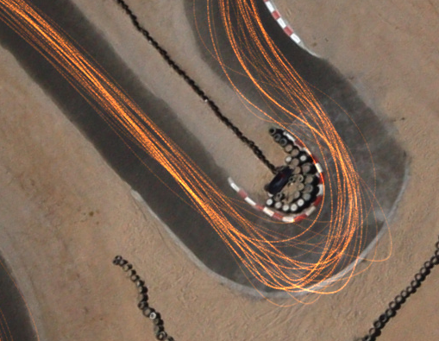
Gameplay Input
Player game preferences, behavioral patterns, player metrics, heatmaps
Examples: tactics, strategy, play patterns, clickthroughs, deaths, weapon selection, character selection, etc…
Considerations: we can’t tell much beyond player behavior…
Notes:
[see Section 11.1.1 for more details]
One of the most popular uses of gameplay-based player models is for game (and
player) balancing. Two of the most widely used game balancing systems are Microsoft’s
TrueSkill and TrueMatch. [Top Image] A screenshot from the matchmaking process of Halo Infinite (Microsoft Game Studios, 2021). The game features TrueSkill II for player skill assessment and TrueMatch for matchmaking. Screenshot made by the authors.

Slide 88

Objective Input
Bodily and physiological manifestations of gameplay
Pros: reliable measures of user experience
Challenges: many; let’s see them in more detail
Notes:
[see Section 11.1.2 for more details]

Slide 89
Objective Input – sensing
Cameras
  Face
  Body movement
  Eye movement
Other sensors/devices
  Physiology (heart rate, skin conductance, …)
  Muscle activation (EMG)
  Brain activity (EEG)
  Speech

Slide 90
Physiology
Common features: summarization, time and frequency domain
Pros: directly linked to arousal – immediate response
Challenges: signal denoising/normalization; control for subjectivity of physiological responses, law of initial values, habituation, rebound
Notes:
Challenges of physiological signals
Measuring physiology can be obtrusive and noisy
The less intrusive the sensor, generally, the less accurate
Law of initial values: response depends of current status
Habituation: when the stimulus is presented repeatedly, the physiological responsivity decreases (linked to changes in effect response?)
Rebound: after the stimulus, signals return to lower levels than before the stimulus
Subject dependent levels: baselines

Slide 91
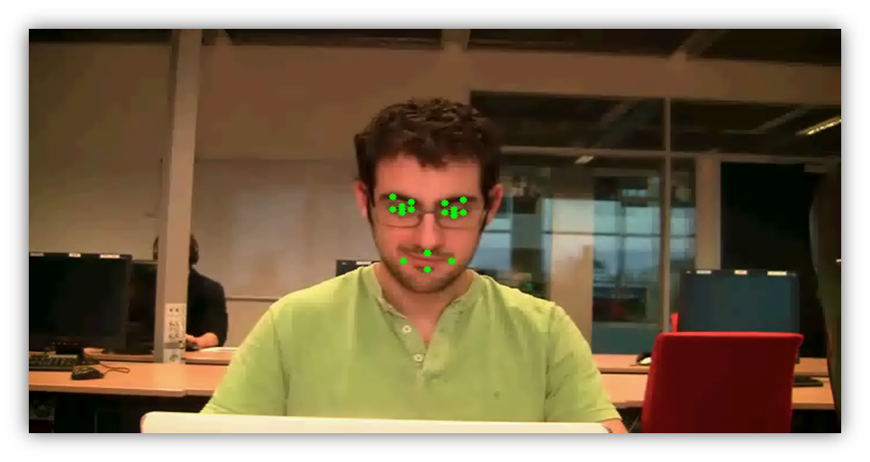
Visual Cues
Common features: action unit detection, head pose stats
Pros: every laptop has a camera, off-the-shelf cheap solution, natural interaction
Challenges: do we really express emotions (facially) while playing? Head-pose might be more relevant? Models rely on posed/acted expressions
Notes:
Most research on emotion modelling from facial expressions is based on posed expressions
What are gamers’ facial expressions though?
Research area scarcely explored

Slide 92

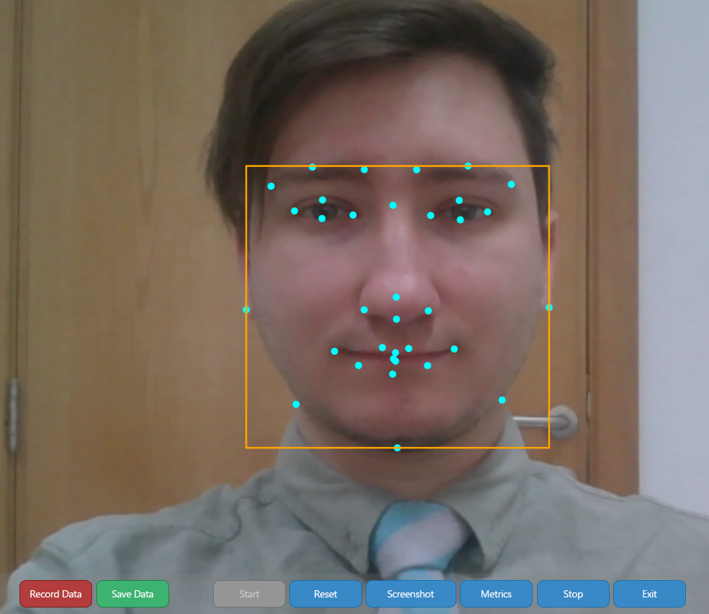
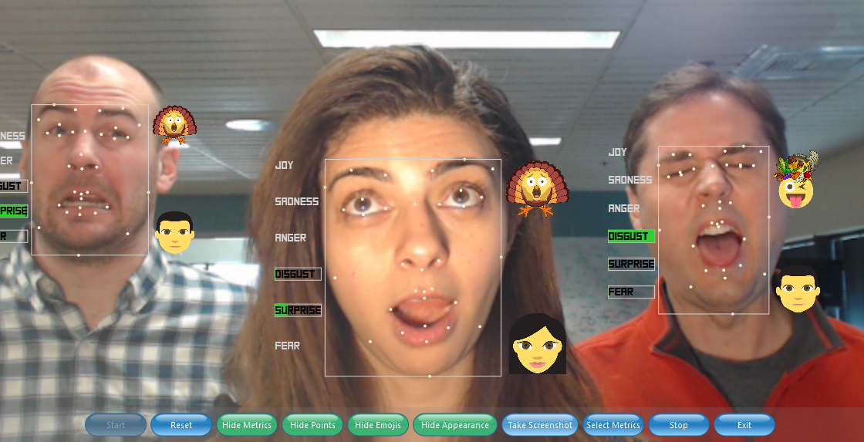
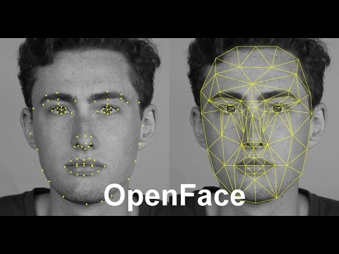
Tools for Video-Based Affect Detection
https://cmusatyalab.github.io/openface/
Notes:
[see more in Section 11.1.2]
The images depict a number of available tools for video-based affect detection. In particular
Intel realsense – gesture recognition [top right]
Affectiva’s AffDex – facial features detection and emotion detection [left]
Openface – facial features detection [bottom right]

Slide 93
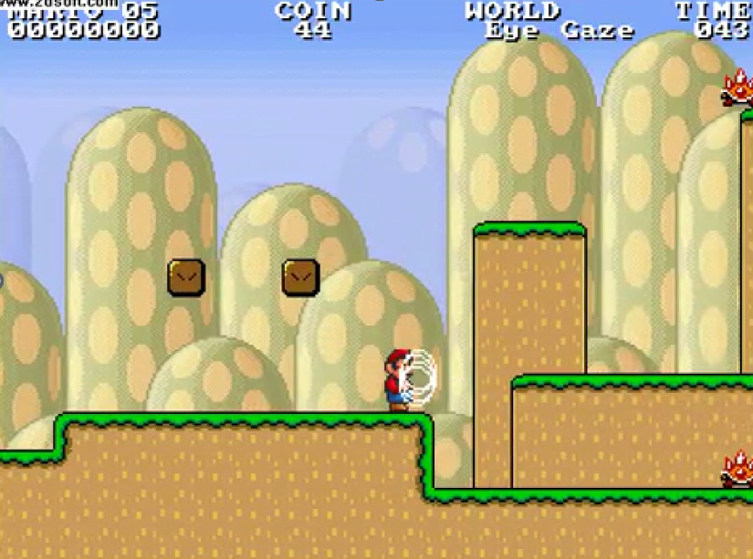
Eye-tracking
Common features: blinks and gaze fixation (indicators of attention and engagement); total time spent looking at particular objects
Pros: you know where your player looks at/focuses on/pays attention to
Challenges: practicality, lab conditions (illumination), pupilometry doesn’t really work in games
J. Munoz, G. N. Yannakakis, F. Mulvey, D. Witzner, G. Gutierrez and A. Sanchis, “Towards Gaze-Controlled Platform Games,”in Proceedings of 2011 IEEE Conference on Computational Intelligence and Games, 2011.
Notes:
[see more in Section 11.1.2]

Slide 94
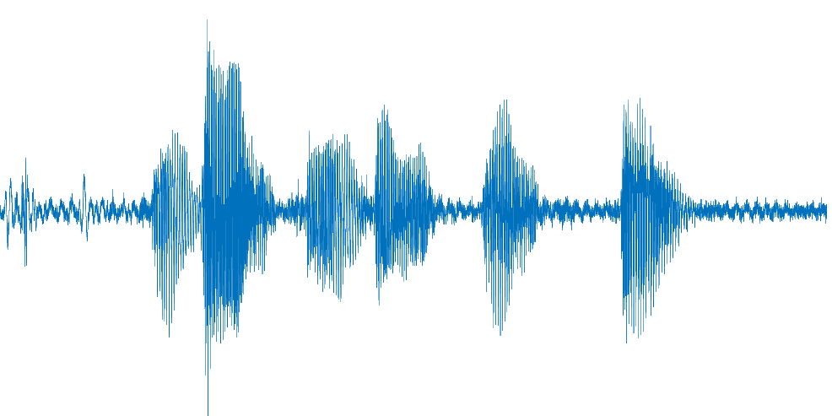
Speech
Common features: frequency-based, detection of spoken words and other communication components (e.g. laughter and pauses)
Pros: speech (pitch, loudness, quality) is linked to emotions (arousal/valence); useful in game-child interaction studies
Challenges: verbal cues are rare; environment noise; multi-player games
Notes:
[see more in Section 11.1.2]

Slide 95

Tools for Speech/Music-based Feature Extraction
https://audeering.com/technology/opensmile/
Eyben, Wöllmer and Schuller: “openSMILE – The Munich Versatile and Fast Open-Source Audio Feature Extractor”, In Proc. ACM Multimedia (MM), ACM, Florence, Italy, ACM, ISBN 978-1-60558-933-6, pp. 1459-1462, October 2010.
Notes:
[see more in Section 11.1.2]

Slide 96


Notes:
A great example of a biofeedback-adaptive game is Nevermind by Erin Reynolds. The game features a number of sensors for the multimodal tracking of players. The sensors detect the level of stress of a player which is used to modify the content of the game.

Slide 97
Game Context
Notes:
[see Section 11.1.3 for more details]
The game’s context is the 3rd category of input a player model may consider. Game context refers to the game’s genre, the platform used, and the game’s characteristics that collectively define the momentanous state of the game during play and excludes any gameplay aspects.
Context is very important in player modelling. Let us suppose you detect high arousal (e.g. through the player’s skin conductance) at a particular moment in the game. What would high arousal actually mean without knowing what happened in the game? Was it player excitement or player frustration?

Slide 98
Context Matters!
Aviezer, Hillel, et al. "Angry, disgusted, or afraid? Studies on the malleability of emotion perception." Psychological science 19.7 (2008): 724-732.
Notes:
[see Section 11.1.3 for more details]
The images depict a famous example within the affective computing literature: four different emotional states can be identified across the four images even though the facial expression of the person remains the same. What changes is the context!
The world around (and within) us is tied to our emotional reactions. Affect can be seen as appraisal of game events! While very detailed information is easily available, we have no standard (or general) way of extracting features for affect detection. In particular those are:
Game dependent
Genre dependent
Player dependent

Slide 99
Player Profile
Notes:
[see Section 11.1.4 for more details]

Slide 100

Player Profile
Player profile
  Information about ones’ personality, demographics, culture, age, gender, experience with games etc…
  In general information that does not change due (or not altered via) games – at least not that rapidly…
A player profile can form additional input(s) to a player model
Notes:
[see Section 11.1.4 for more details]
A player profile includes all the information about the player which is static and it is not directly (nor necessarily) linked to gameplay. This may include information on player personality (such as expressed by the Five Factor Model of personality, culture dependent factors, and general demographics such as gender and age. A player’s profile may be used as input to the player model to complement the captured in-game behavior with general attributes about the player. Such information may lead to more precise predictive models about players.

Slide 101
Reminder: Player Profile vs. Player Model
What are the differences?
  A profile is built on static data and not influenced by the game
  A model is built on dynamic data from the gaming interaction and is (temporally) influenced by the game
Notes:
[see Section 11.1.4 for more details]

Slide 102
What is the Model’s Output Like?
Notes:
[see Section 11.2 for more details]

Slide 103

Notes:
[see Chapter 11.2 for more details]
PM viewed from an output perspective. Emphasis is put on the three possible output types a player model might have (behavior, experience, embedding) depicted in purple.
The dotted box indicates that player embedding is the only output type that does not rely on labeled data.
Each output type is conditioned by a number of labeling principles (i.e., the light blue boxes under labeled data or rewards, and unlabeled data).

Slide 104
Manual Labeling: Principles and Tools
Notes:
[See Section 2.4 and Section 11.3 for more details]
Manually annotating gameplay is a challenge in its own right with respect to both the human annotators involved and the human feedback protocol chosen as there are still many open research questions left for the design of the ideal human labelling collection protocol:
who will do the labeling: the person experiencing the gameplay or others?
should the labelling be done during play, before or after?
will the labeling involve states (discrete representation) or instead involve the use of intensity dimensions (continuous representation)?
Are labels provided in discrete time periods or continuously as demonstrations?
Should the annotators be asked to rate a stimulus in an absolute fashion (e.g., frustration is 0.8) or, instead, rank it in a relative fashion (e.g., frustration is higher now)?
Answers to the above questions yield different data annotation protocols and, inevitably, varying degrees of data quality, validity and reliability.

Slide 105

Labeling Tools
Notes:
Here we focus on questions specific to player modeling that are usually raised in subjective labeling of player states. Moreover we detail the available tools that could be used for collecting player labels in games.
The table summarizes all the tools we discuss in Section 11.3.

Slide 106
Labeling Principles
Notes:
[see Section 11.3 for more details]
To model the experience of the player one needs to have access to labels of that experience. Those labels ideally need to be as close to the ground truth of experience as possible. The ground truth (or gold standard) in affective sciences refers to a hypothesized and unknown label, value, or function, that best characterizes and represents an affective construct or an experience. Labels are normally provided through manual annotation which is a rather laborious process. Manual annotation is however necessary given that we require some estimate of the ground truth for subjective notions such as the emotional states of the player. The accuracy of that estimation is regularly questioned as there are numerous factors contributing to a deviation between a label and the actual underlying player experience.

Slide 107
Why Output (Label) is Key?
Labelling of player experience or behavior
This is ultimately the ground truth (golden standard)
This is the training signal for your computational models
Notes:
The importance of labels is crucial!
Data is available in massive amounts.
Deep (machine) learning is doing well on its part
The quality of labels are key for success – (e.g. see adversarial examples)
So how to we label experience/behavior of play?

Slide 108
General Questions of Human Feedback
Objective or subjective labels?
Free or forced?
Who labels?
When to label? Before, during or after the stimulus?
Which label type?
Notes:
These general Human Feedback questions are covered in Section 2.4

Slide 109
Specific Questions of Labelling in Games
How are labels represented?
One or many labeling dimensions simultaneously?
How often?
Label in the Lab or in the Wild?
How reliable is your annotator?
Notes:
These specific questions about labeling of player experience and behavior are covered here [Section 11.3]

Slide 110
How are Labels Represented?
Categorical (e.g. skill, engagement, frustration, style)
Continuous (e.g. arousal, valence, believability, humanness)
Notes:
[see Section 11.3 for more details]

Slide 111


One or More Dimensions Simultaneously?
1D (e.g., Tension using Gtrace or RankTrace)
2D (e.g., Arousal and Valence on FeelTrace)
3D (e.g., Pleasure-Arousal-Dominance model)
Tension
Notes:
[see Section 11.3 for more details]
The core strength of one-dimensional labeling tools is the reduced cognitive
load on annotators compared to multi-dimensional labeling. Evidence
also suggests that focusing on one experience dimension at a time reduces noise and
provides data of higher validity.
The benefits of multi-dimensional tools are many
They can solicit labels at a higher rate as more than one notion can be labeled synchronously
As labels across different dimensions are collected simultaneously, labels are less susceptible to recency effects

Slide 112


How Often to Label?
Discrete (e.g. self-assessment manikin)
Continuous Traces (e.g. FeelTrace, RankTrace, AffectRank)
Notes:
[see Section 11.3 for more details]

Slide 113
How Often to Label?
Depends on
  Application (speed of interaction: e.g. games vs. movies vs. e-learning apps)
  Signal (e.g. physiology is slower than body movement and speech)
No gold standard
Notes:
[see Section 11.3 for more details]

Slide 114
In the Lab or in the Wild?
Traditional labeling tools require the presence of the annotator in a lab
limits the scope, the scale and the size of the dataset.
COVID-19 pandemic further necessitated the use of online label collection.
PAGAN is one of the first frameworks developed with crowdsourcing capacities; highly configurable; supports multiple annotation tools (e.g., GTrace, RankTrace)
https://github.com/davidmelhart/PAGAN
Notes:
[see Section 11.3 for more details]

Slide 115

Knowing your Annotator
Notes:
[see Section 11.3 for more details]

Slide 116
Methods for Player Modeling
Notes:
[See Section 11.4 for more details]

Slide 117
Player Model
Output
Input (Observations)

Slide 118
Player Model
Output
Embedding
Unlabeled Data
Self-Supervised Learning
Unsupervised Learning
Input (Observations)
Notes:
[See Section 11.4.5 and 11.4.6 for more details]

Slide 119
Player Model
Output
Behavior
Experience
Embedding
Unlabeled Data
Reinforcement Learning
Reward
Self-Supervised Learning
Unsupervised Learning
Input (Observations)
Notes:
[See Section 11.4.3 for more details]

Slide 120
Player Model
Output
Behavior
Experience
Embedding
(Semi) Supervised Learning
Labeled Data
Unlabeled Data
Regression
Interval
Classification
Nominal
Preference Learning
Ordinal
Reinforcement Learning
Reward
Self-Supervised Learning
Unsupervised Learning
Input (Observations)
Notes:
[See Section 11.4.2 and 11.4.4 for more details]

Slide 121
Player Model
Output
Authoring
Behavior
Experience
Embedding
(Semi) Supervised Learning
Labeled Data
Unlabeled Data
Regression
Interval
Classification
Nominal
Preference Learning
Ordinal
Reinforcement Learning
Reward
Self-Supervised Learning
Unsupervised Learning
Input (Observations)
Notes:
[See Section 11.4.1 for more details]

Slide 122
Chapter 12: Player Modeling Examplfied
Notes:
[See Chapter 12 for more details]

Slide 123

Notes:
The examples we present shed some light on practical uses of player models but
they are far from exhausting all the possible roles and use cases for player modeling.
We select seven representative case studies based on a number of criteria.
our familiarity with the use case
impact of the work
thoroughness of the analysis,
usefulness of the case study from a pedagogical perspective.
The examples covered in Ch 12 vary in terms of AI methods and representations used, model observations, roles of player modeling and game genres considered. The games involved in the presented studies come both from research prototypes and commercial-standard games.

Slide 124
Modeling Player Embeddings Examples
Notes:
[see Section 12.1 for more details]

Slide 125
Drachen, Canossa & Yannakakis, Player modelling using self-organisation in Tomb Raider: Underworld, IEEE CIG 2009
Player Embedding Modeling
Tomb Raider: Underworld
Notes:
125
[see Section 12.1 for more details]
We will now look at an unsupervised learning (player embeddings) example in the popular Tomb Raider: Underworld (TRU) game
For further information about this study please refer to the cited paper

Slide 126
Motivation
How do people play TRU?
User testing: Do people play TRU as intended?
Player modeling using metrics via machine learning → alternative quantitative approach to traditional qualitative approaches of user and playability testing
Notes:
Our key motivations for this study

Slide 127
Clustering in TRU
Commercial major game test-bed: Tomb Raider Underworld
Large-scale data collection (1365 players)
Data is clean and live: gathered in a natural setup via an industrial logging system and a commercial web service
First application of SOMs on high-level behaviors of completed games
Directly addressing game-industry requirements
  limitations of scalability and commercial-game practicality are minimized
  bridging the AI gap

Slide 128



Player Data Collection
EIDOS Metrics Suite software
  Record gameplay data (metrics) of EIDOS games
  Data are stored in an SQL-server via ELT process
  Several Features are extracted (work done by Crystal Dynamics)
      3D coordinates, completion time, # deaths etc.
Live Data (xBox Live!)
  Published version of TRU played in gamers’ natural habitats
  Data free from laboratory bias and experiment expectancy effects
Data collection during November 2008
  25240 Players
  1365 of those completed the game
  Data are stored for all 7 levels (100 map units)

Slide 129

Extracted Features
Causes of Death (% over total number of deaths)
  Opponent – 28.9% of all deaths – Min: 6%, Max: 60%
  Environment – 13.7% of all deaths – Min: 2%, Max: 45%
  Falling – 57.2% of all deaths – Min: 27%, Max: 83%
Total Number of Deaths – 140 on average – Min: 16, Max: 458
Completion Time – 550 min on average – Min: 3h, Max: 29h
Help-on-Demand (# hint + answer requested) – 29 on average – Min: 0, Max: 148

Slide 130

Emergent Self-Organizing Maps (ESOMs)
Unsupervised learning through self-organization of a neuron map
Dimensionality reduction to 2D
Training
  Batch
  Toroid topology (50X100 neurons)
  Rectangular grid
Performance Measures
  Topographic error
  Quantization error
Notes:
ESOM: Large-scale SOMs (The power of self-organization — which generates emergence of structure in the data — is disused when small SOMs are utilized.)
The outcome of SOM training is that neighboring neurons have similar weight vectors which can be used for projecting data to 2D

Slide 131

Clustering in TRU (ESOMs)
Drachen, Canossa & Yannakakis, Player modelling using self-organisation in Tomb Raider: Underworld, IEEE CIG 2009
Notes:
E-SOMs (neural nets)
Visualization:
U-matrix: local distance structure in the data (distance of neighboring weight vectors)
U-Matrix: Valleys: clusters; Mountains: cluster borders

Slide 132



Feature Planes
Cause of Death: Opponent
Cause of Death: Environment
Cause of Death: Falling

Slide 133



Feature Planes
Number of Deaths
Completion Time
Help on Demand (HoD)

Slide 134

Video: Four Resulting Player Clusters
https://www.youtube.com/watch?v=HJS-SxgXAI4
Notes:
A video about the resulting clusters : https://www.youtube.com/watch?v=HJS-SxgXAI4

Slide 135
Modeling Player Behavior Examples
Notes:
[see Section 12.2 for more details]

Slide 136
Mahlmann, Drachen, Togelius, Canossa, and Yannakakis. Predicting player behavior in Tomb Raider: Underworld. In Proceedings of the 2010 IEEE Conference on Computational Intelligence and Games, pages 178–185. IEEE, 2010.
Player Behavior Modeling
Tomb Raider: Underworld
Notes:
136
[see Section 12.2 for more details]
We will now look at a follow-up supervised learning study on TRU. For further information about this study please refer to the cited paper

Slide 137

Predicting when you stop playing TRU
Notes:
[see Section 12.2 for more details]
This is the resulting decision tree employed to predict when players stop playing the game (which of the 7 levels of the game). It’s the supervised learning (player behavior) example in Tomb Raider: Underworld (TRU) as detailed in Section 12.2

Slide 138

Analysing Player Behaviour in
Tomb Raider: Underworld
Notes:
Both studies are covered on the following video by the “AI and Games” Youtube Channel
https://www.youtube.com/watch?v=A89ZDjF51Nk

Slide 139



Example (Player Behavior)
For Honor
Notes:
[see Section 12.2 for more details; For further information about this study please refer to the cited paper]
In this second example of player behavior modeling we examine the phenomenon
of toxic behavior in multiplayer games and we examine whether it is possible
to predict toxicity in the multiplayer online battle arena (MOBA) game For Honor
(Ubisoft, 2017). The study attempts to predict a player’s toxicity (model output) by
observing in-game behavior (model input) that have been labeled as toxic by Ubisoft
community managers.
In summary we attempt to predict
unsanctioned vs sanctioned players (binary classification)
severity of toxicity: Unsanctioned vs. warned vs. banned players
All derived models predict toxicity, its severity, and its type, with an accuracy of at least 82%, on average, over unseen players.

Slide 140
Modeling Player Experience Examples
Notes:
[see Section 12.3 for more details]

Slide 141

Player Experience Modeling
Super Mario Bros
Notes:
[see Section 12.3 for more details; For further information please refer to the series of cited papers in that section]

Slide 142
Player Experience Modeling in Super Mario
327 subjects (1308 games)
Input: Playing Behavior and Content Features
Output: Engagement, Frustration, Challenge self-reported ranks (pairwise) of short games
ANN trained via Neuroevolutionary Preference Learning
Player experience model accuracy: 73-92%

Slide 143
Super Mario Bros Example:
The Annotated Experience (ANN output)
Shaker, Asteriadis, Yannakakis and Karpouzis, Fusing Visual and Behavioral Cues for Modelling User Experience in Games, IEEE Trans. on Systems, Man and Cybernetics (B), 2013
Three Player experience states modelled:
  Engagement, Frustration, Challenge
Player Experience is self-reported (post-experience) via a 4-alternative forced choice questionnaire:
Game A is more/less engaging than Game B
Both are equally engaging
Neither is engaging

Slide 144
Super Mario Bros Example:
The Modeling Approach
Shaker, Asteriadis, Yannakakis and Karpouzis, Fusing Visual and Behavioral Cues for Modelling User Experience in Games, IEEE Trans. on Systems, Man and Cybernetics (B), 2013
Level features/playing behavior
Player Experience
(Engagement, frustration, challenge)

Slide 145

Platformer Experience Dataset
K. Karpouzis, G. Yannakakis, N Shaker, S. Asteriadis. The Platformer Experience Dataset, Sixth Affective Computing and Intelligent Interaction (ACII) Conference, 2015.
http://ped.institutedigitalgames.com/

Slide 146
Player Experience Modeling
Maze-Ball
Notes:
[see Section 12.3 for more details; For further information please refer to the series of cited papers in that section]
We use the Mazeball (3D prey-predator game) dataset as a paradigm for processing player data without labels
More details can be found at http://hectormartinez.com/

Slide 147


Sequence Mining (General Sequential Pattern)
Martinez and Yannakakis, Mining Multimodal Sequential Patterns: A Case Study on Affect Detection, ICMI, 2011 [Outstanding Student Paper Award]
Notes:
Association mining for feature extraction on the multimodal input space via Generalized Sequential Pattern Algorithm (GSP)
GSP is a very simple method that reveals frequent sequences of data
The algorithm couples signals at the feature level
Evidence suggests that it is a very useful technique for feature extraction of multimodal player data (galvanic skin response and gameplay in this example)
For more details please refer to the cited paper

Slide 148

Mazeball’s Model of Fun
Martinez and Yannakakis, Mining Multimodal Sequential Patterns: A Case Study on Affect Detection, ICMI, 2011 [Outstanding Student Paper Award]
+
+
fun(x)
-
Notes:
The image depicts the derived model of fun (as a simple perceptron of three inputs) based on the most frequent sequences of multimodal data. The three inputs considered were from top to bottom: 1) pellets gathered 2) number of times the skin conductance of the player increased and then decreased after a pellet was gathered and 3) number of times the skin conductance decreased in conjunction with loosing by an opponent.
The model is trained via neuroevolutionary preference learning on pairwise comparisons of games with regards to “fun”
For more details please refer to the cited paper

Slide 149

Convolution for Affect Detection
Martinez, Bengio and Yannakakis, Learning Deep Physiological Models of Affect, IEEE Computational Intelligence Magazine, 2013
Notes:
An example of the application of convolutional neural networks (CNNs) on skin conductance signals for affect detection
Deep learning : supreme method for image and speech recognition. It automatically designs feature sets – most distinct patterns (main factors of variation in data). CNNs are applied directly to the signal and any signal type (discrete/continuous)
Key finding: deep learning captures efficient temporal features of skin conductance (see the 5 images above) that no ad-hoc feature can capture
For more details please refer to the cited paper

Slide 150

Deep Fusion of Events and Signals
Martinez and Yannakakis, Deep multimodal fusion: Combining discrete events and continuous signals, Proceedings of the 16th International conference on multimodal interaction, 2014
Notes:
In (Martinez and Yannakakis 2014) we explored the various ways we can fuse discrete events and continuous signals retrieved from games via CNNs.
The first convolutional layer receives as input a continuous signal at a high time resolution, which is further reduced by a pooling layer. The resulting signal (feature map) presents a lower time resolution. The second convolutional layer can combine this feature map with additional modalities at the same low resolution.
Convolution fusion network (left figure): the two events are introduced at this level as a pulse signal [equals one only when the event was recorded and zero otherwise].
Pooling fusion network (middle figure): events are introduced as part of the first pooling layer, resulting in a filtered feature map [simple filter that equals 1 within the time window selected and decays linearly to zero].
Training fusion network (right figure): events affect the training process of the first convolutional layer [resampling.

Slide 151

Player Experience Modeling
Arcade Games
Notes:
[see Section 12.3 for more details; For further information please refer to the series of cited papers in that section]

Slide 152

Makantasis, Liapis and Yannakakis The Pixels and Sounds of Emotion: General-Purpose Representations of Arousal in Games, IEEE Trans. On Affective Computing, 2021
Notes:
[see Section 12.3 for more details; For further information please refer to the series of cited papers in that section]
Gameplay videos and corresponding activation maps

Slide 153

Player Experience Modeling
Tom Clancy’s The Division II
Notes:
[see Section 12.3 for more details; For further information please refer to the series of cited papers in that section]

Slide 154

Pinitas, Renaudie, Thomsen, Makantasis, Liapis and Yannakakis, Predicting Player Engagement in Tom Clancy's The Division 2, 2023
Notes:
[see Section 12.3 for more details; For further information please refer to the series of cited papers in that section]

Slide 155

Notes:
Video showcasing the annotation process (outer window) of the player’s gameplay (inner window)

Slide 156
Yannakakis and Melhart (2023). Affective Game Computing: A Survey. Proceedings of the IEEE.

Slide 157
Readings: Part IV
gameaibook.org
Notes:
See Section 12.4 for further reading and Section 12.5 for exercises related to Player Modeling.

